Slide 1
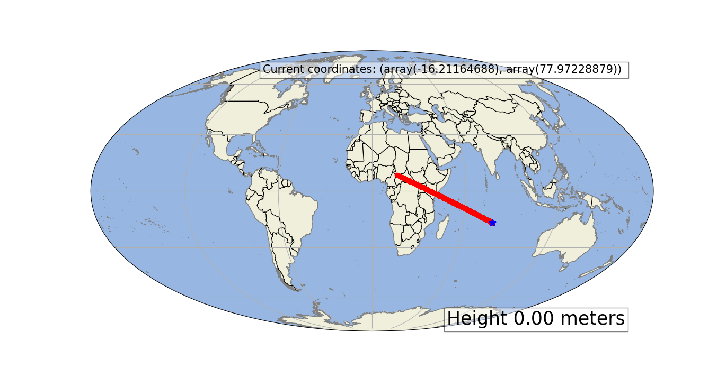
Meteorite Impact Calculator
Iain Williams

Slide 2
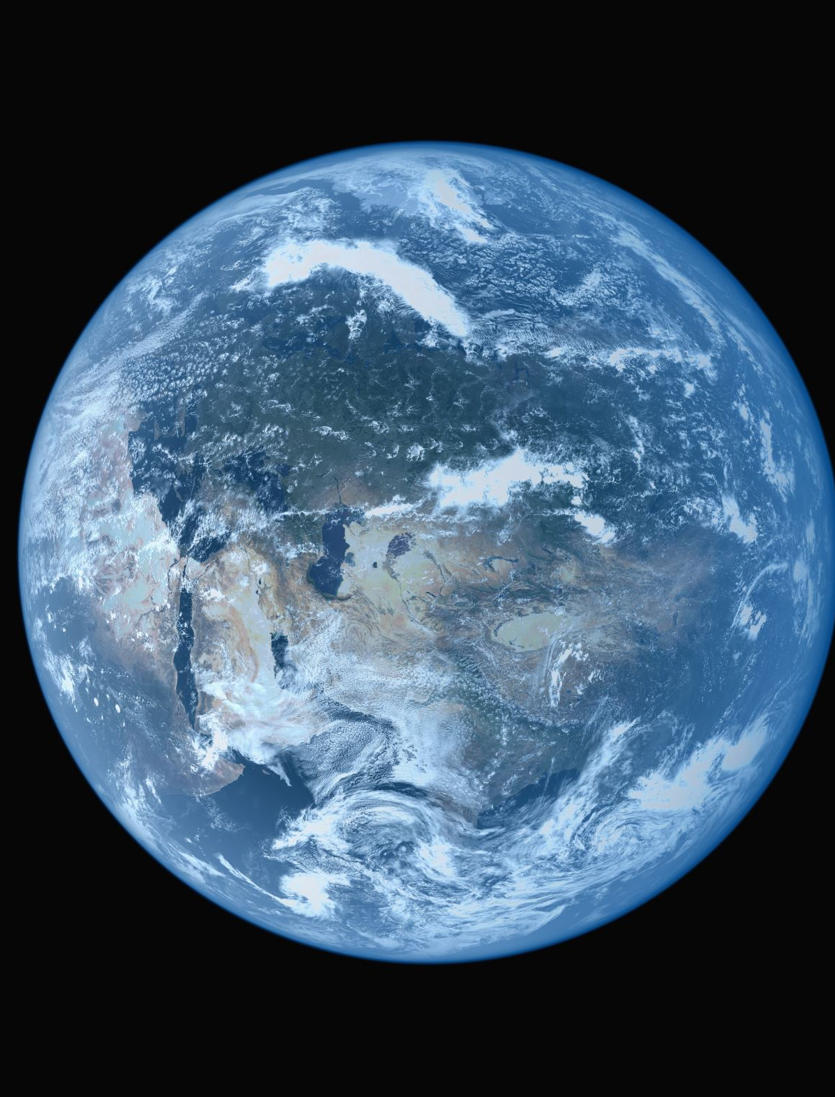
Meteor descending the atmosphere and where it impacts
Projected onto map using CartoPy
Velocity estimates of Chicxulub taken from scientific paper: https://www3.nd.edu/~cneal/CRN_Papers/Schulte10_Sci_Chicxulub.pdf
Atmosphere altitudes from NOAA: https://www.noaa.gov/jetstream/atmosphere/layers-of-atmosphere
Some code borrowed from Professor Militzer
Newtonian mechanics and geometry
Mollweide uses spherical projection, not ellipsoid
Converted meters to latitude and longitude
Set boundary conditions for prime meridian and poles
First video shows set lat and long as well as velocities
Second has some randomness
Hope to add more realism such as drag and include impact information

