Slide 1
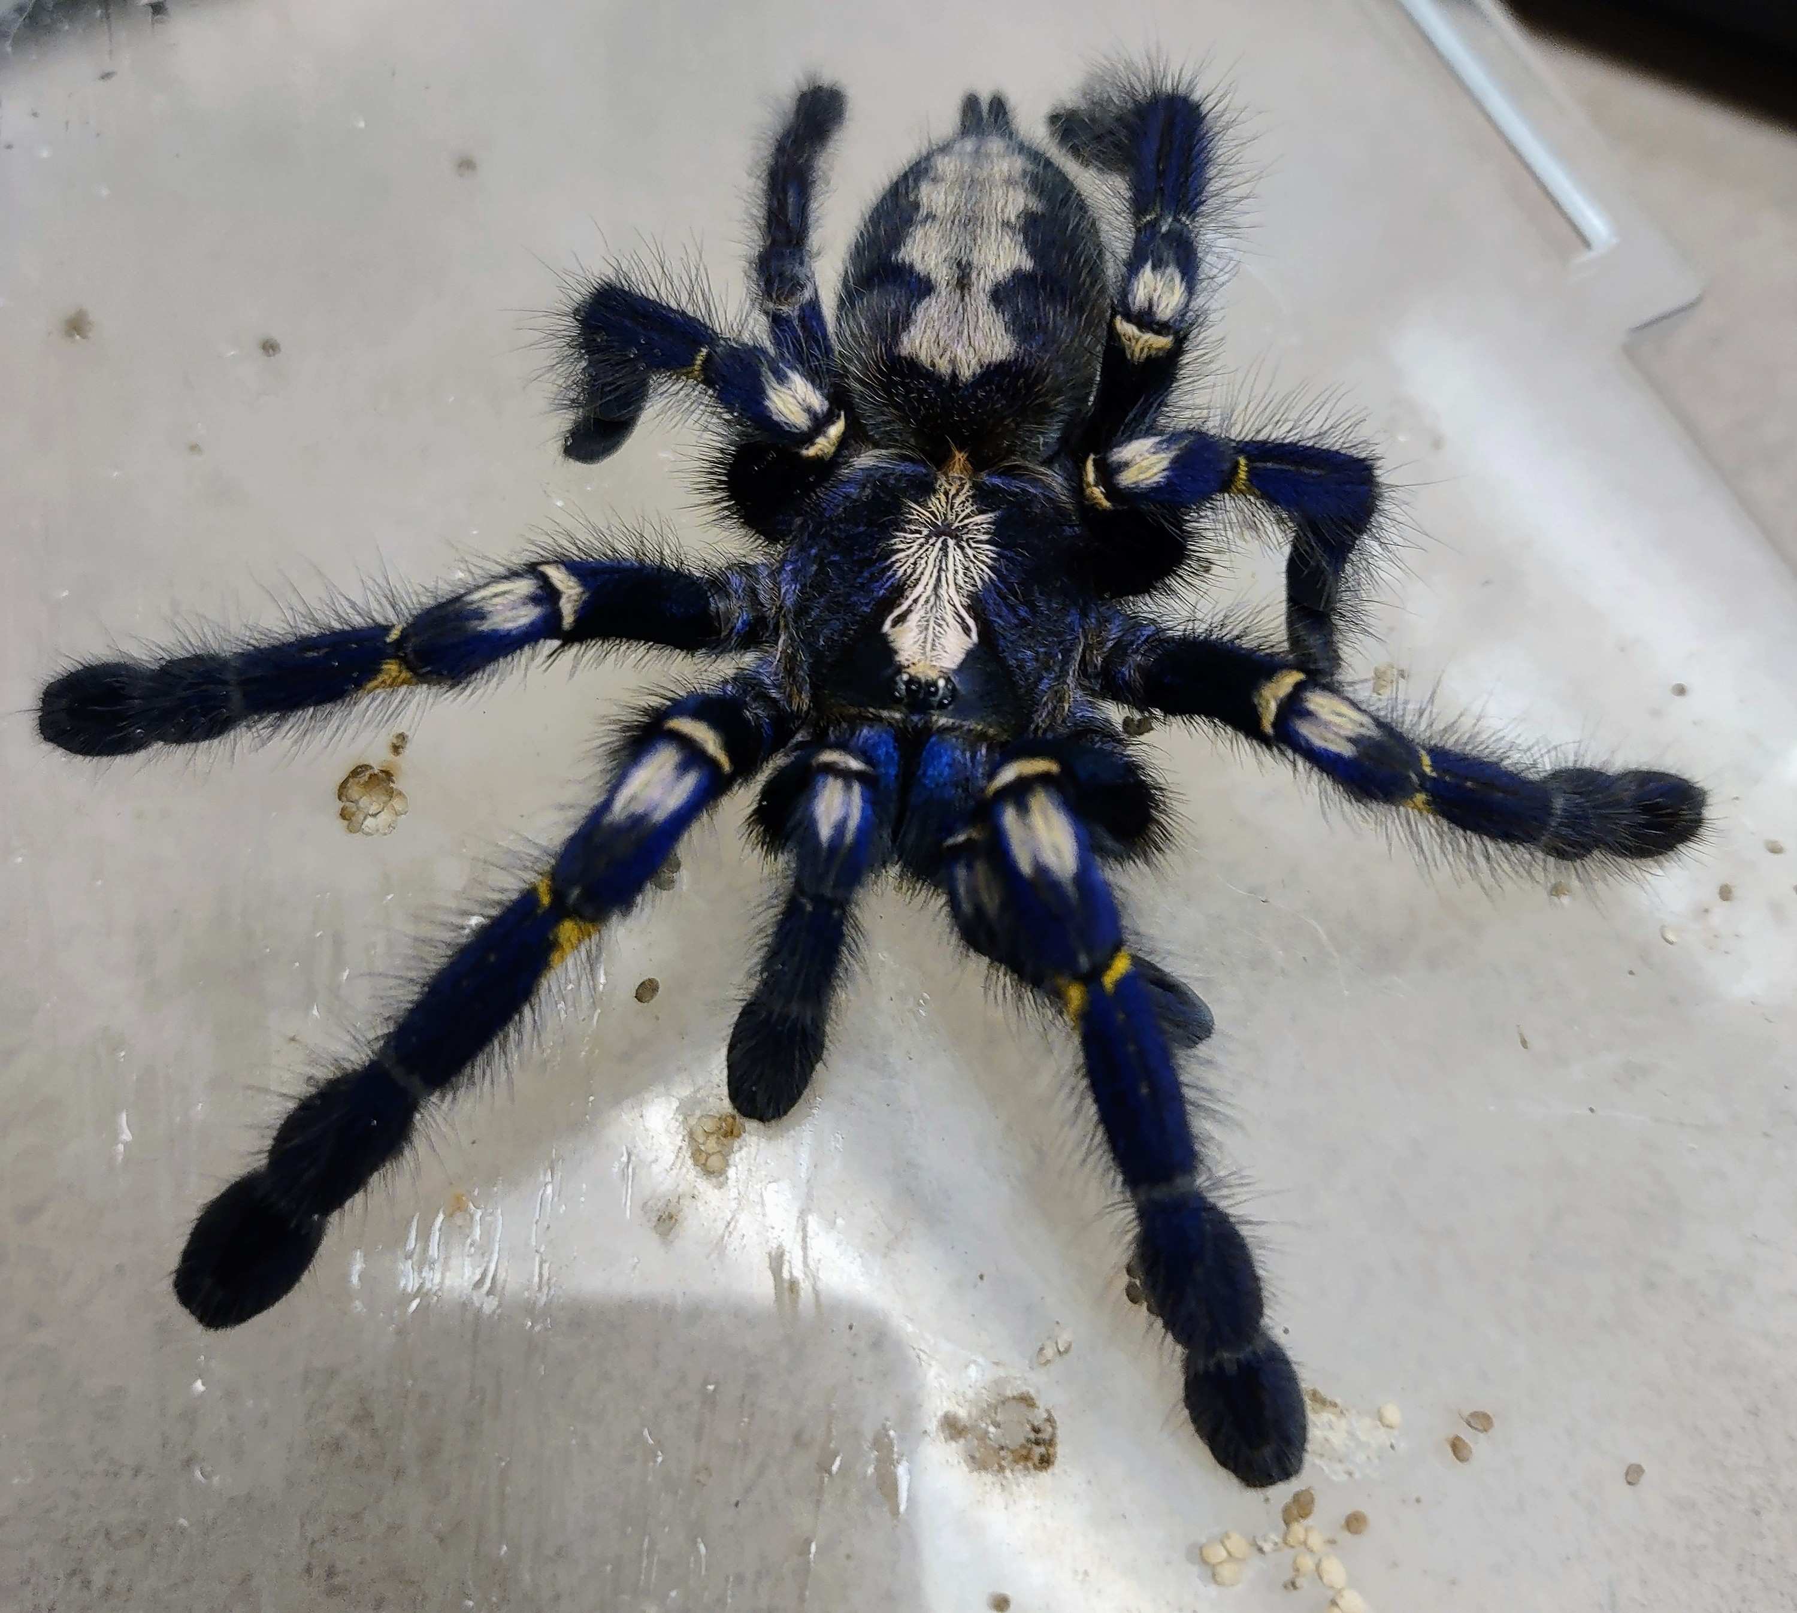
Spider walking along a spiderweb
Monica Yup Chinchilla
EPS 109

Slide 2
Simulating a spider walking along a spiderweb with prey
I tried to model this after a pet tarantula, Miku, that isn’t interested in eating these days
I used random walks and some “crickets” caught in her web
this simulation shows Miku some hesitation while catching the crickets in her web
The simulation also shows her going near the crickets but not catching them, which is something she’s been doing lately
Random walks also just show how randomly Miku can move within her web
Sources: https://www.codingem.com/random-walk-in-python/
Special thanks to: Random walks with Slenderman by Gabrielle Stewart (2022)

