Slide 1
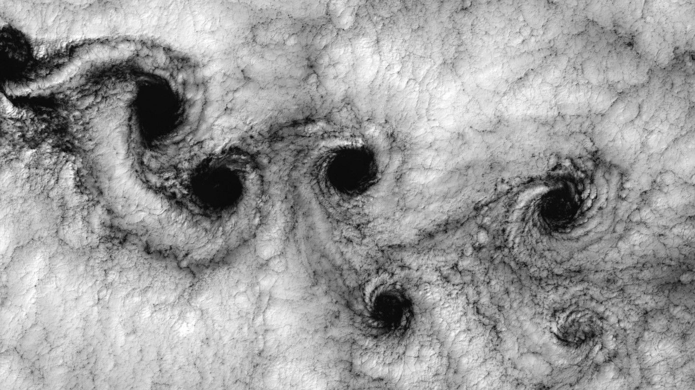
Simulating the Mechanics of Vortices
Richard Saeed
Department of Astronomy
University of California, Berkeley
Image credit: https://github.com/hietwll/LBM_Taichi

Slide 2
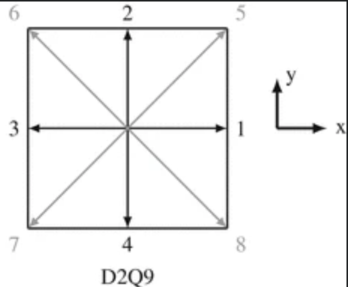
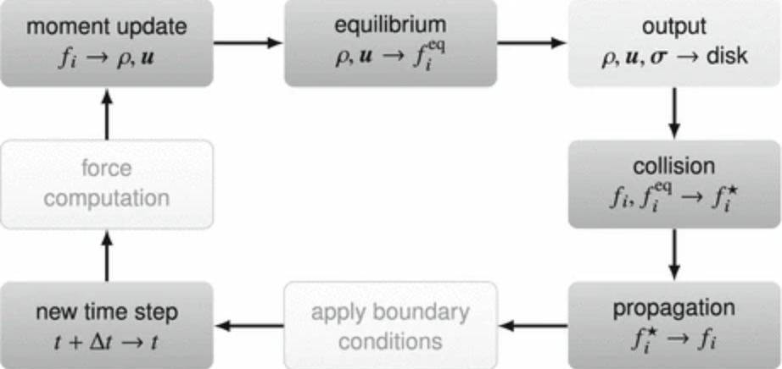
Simulations & Methodology
Represents interactions between fluid and three obstacles via the Lattice Boltzmann Method (LBM).
The method involves modeling the distribution of particle groups/populations over lattice structures of arrangement D29Q (2-dimensions, 9 velocities). Essentially, the LBM is a spatial domain/grid that facilitates the flow of fluid by discretizing space and representing the displacement of particles within said domain.
The LBM makes use of a distribution function that defines the probability of finding particles with specific velocities at each node within the lattice. The probability of particles moving to the corners is ~3%, to either horizontal or vertical nodes is ~10%, at (0,0) the probability is ~45%.
Cited :Works
https://link.springer.com/chapter/10.1007/978-3-319-44649-3_3 - Sec14
https://ncbi.nlm.nih.gov/pmc/articles/PMC7605305/
https://github.com/pmocz
Figures: Lattice & general cycle of LBM simulation
Source: Chapter 3, Springer

Slide 3
Simulations:
Magnitude of Macroscopic Velocities
&
Vorticity Magnitude

