Slide 1
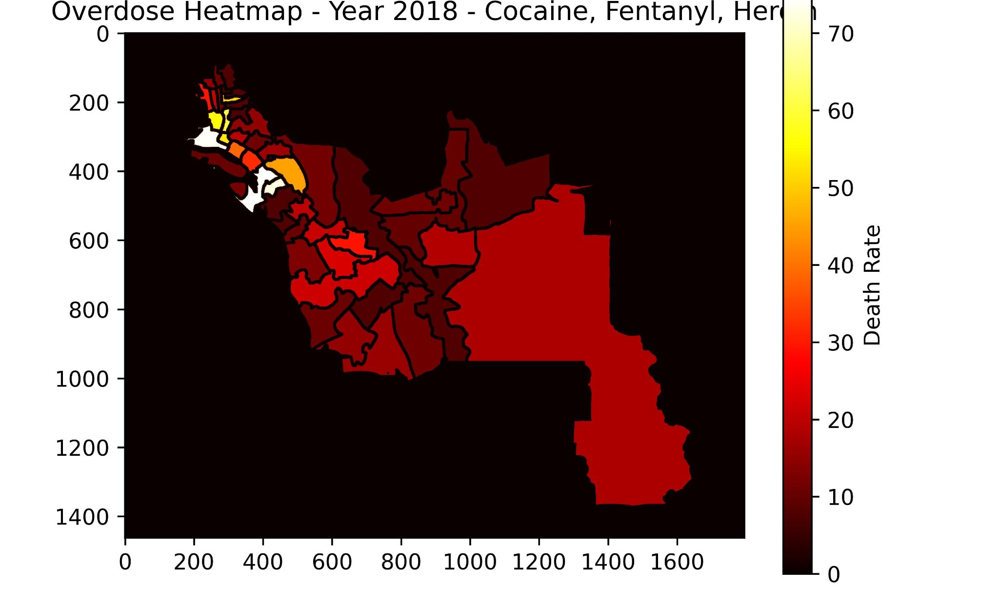
Interactive Opioid Death Rate Visualizer
Alejandro Sanchez

Slide 2
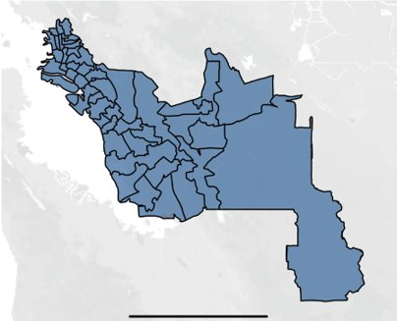
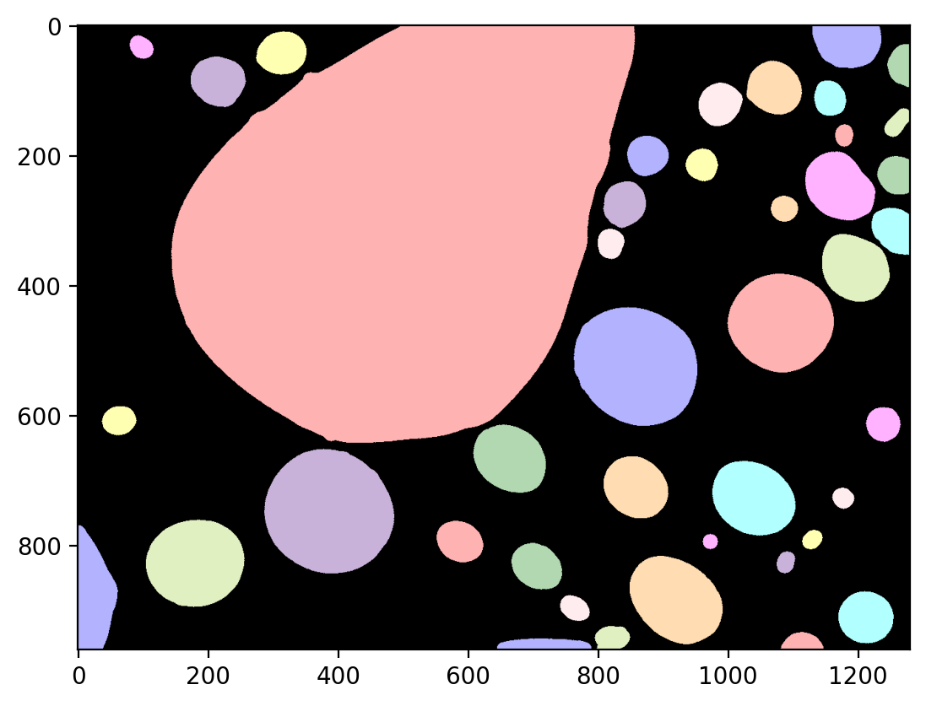
Drug Crisis in Alameda
In the US alone, 83,000 people died from opioid overdoses
Idea: understand where and how these deaths are happening
use publicly available data
start with Alameda county
Methods used: image processing, data analysis

Slide 3
Sample animation!
All code available on
https://github.com/sanchezocegueda/drug-sna

