Slide 1
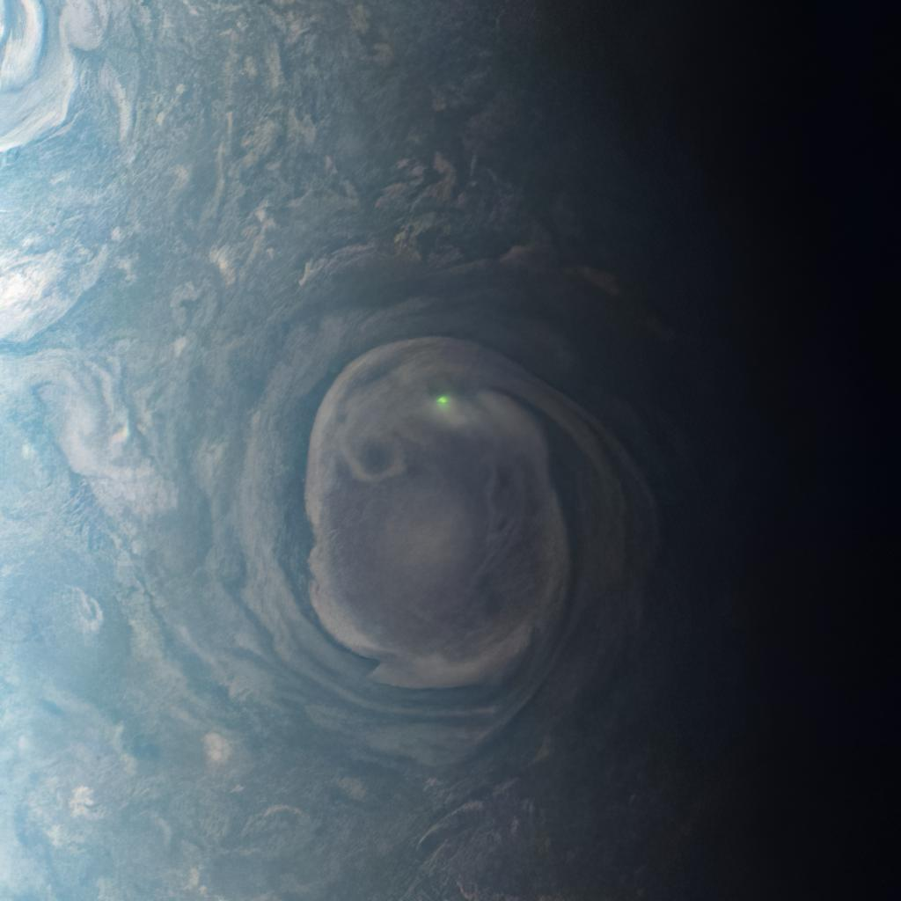
Analyzing Sounds from the Universe
Isabel Aguilar
Image: NASA's Juno Mission Captures Lightning On Jupiter

Slide 2
Topic and Methods Used
Analyzed audio provided by NASA using SimpleAudio and Librosa
Created spectrograms using matplotlib and librosa
Spectrograms provide a visual representation of sound frequencies
Amplitude of wave is represented by brightness
Referenced https://github.com/fabincarmo/vidwav to create the animations

Slide 3
Lightning on Jupiter

Slide 4
Interstellar Plasma Sounds from the Voyager

Slide 5
Black Hole Sound in the Perseus Galaxy Cluster

