Slide 1
Among Us Animation Simulation
Created by Felicity Aktan amogus

Slide 2
Animation Topic
This animation aims to recreate the dynamics of the multiplayer game, Among Us, within a simulated spaceship environment. The setup includes randomly assigned crewmate and imposter positions, with crewmates tasked to complete tasks in various rooms. The imposter strategically moves to eliminate crewmates.

Slide 3
Methods and Features
Crewmate Interactions
Imposter Strategy
Task Distribution
Crewmates move randomly between adjacent rooms, completing assigned tasks
The imposter dynamically navigates the spaceship, choosing the best moments to eliminate crewmates
Crewmates are randomly assigned unique tasks in specific rooms
Dynamic Gameplay
Simulation
Crewmate movements, imposter strategy, and task completion contribute to an evolving narrative within the simulation
Employed a graph-based approach to model the spaceship layout, crewmate movements, and imposter actions

Slide 4
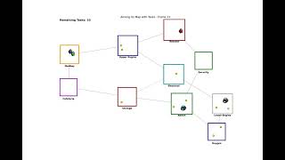

Slide 5
Red was ejected

