Slide 1
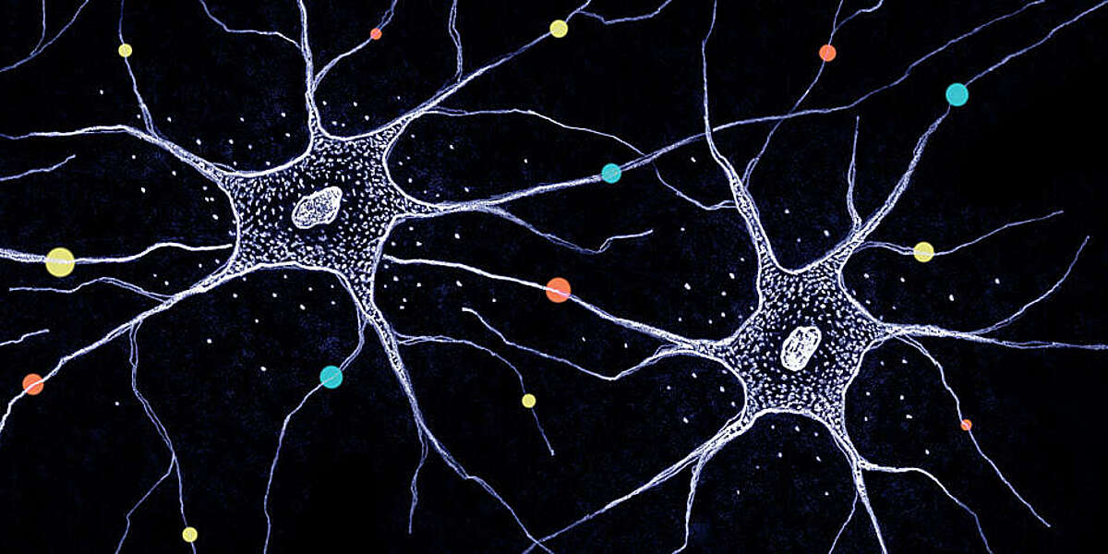
Simulating Neural Connectivity
Sadhika Akula
EPS 109, Fall 2023

Slide 2
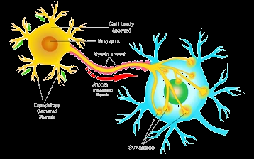
Parts of a Neuron
Cell body (soma)
Nucleus
Myelin Sheath
Axon (transmitted signals)
Dendrites (gathered signals)
Synapse

Slide 3
Goal: simulate neurons hard at work
initialize nucleus locations
grow dendrites with DLA + random walks
include a decay factor to represent weaker neuron strength at ends of dendrites during random walk
in order to create axons between neurons, use shortest path algos (Dijkstra) to find path between both
animate frames to represent movement of the action potential between both neurons
finetune iteration times, decay factor for best simulation
Notes:
Darker colors represent less covered, new thought

Slide 4
