Slide 1
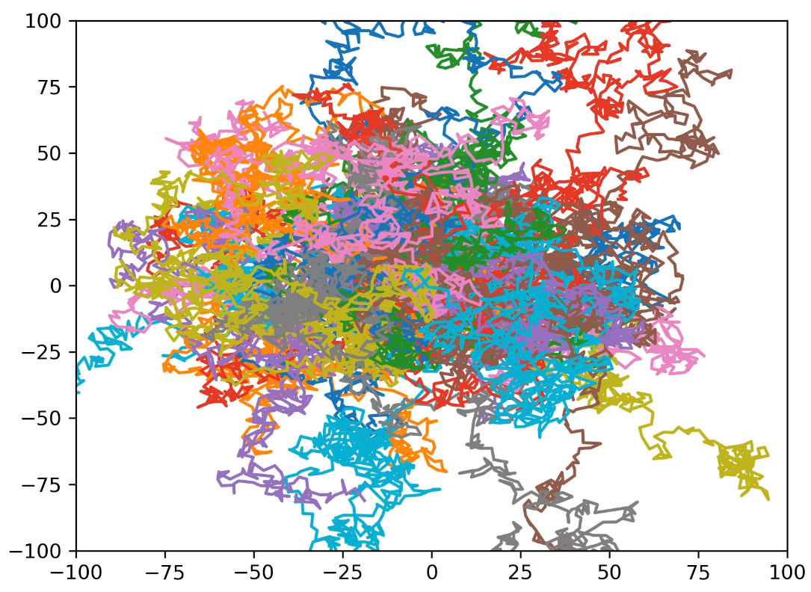
Random Walks in Ecology:
Movement of Large Herbivores
Adam Angle

Slide 2
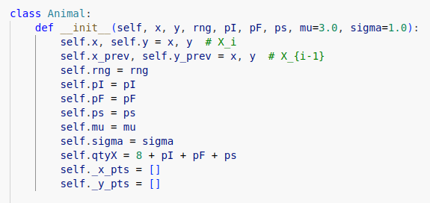
Background
Goal: To create a versatile simulation for animals in a field using random walks, including how an interest point affects this behavior.
Methods:
Created an Animal object to easily manage movement parameters for a single animal on a plot.
Stores the previous and current animal positions for use with a biased random walk system.
Allows for dynamically changing goal point with piecewise random function.
Used multithreading with computations to speed up simulations with multiple subplots.

Slide 3
Random Walk Procedure
Berthelot, G., Saïd, S. & Bansaye, V. A random walk model that accounts for space occupation and movements of a large herbivore. Sci Rep 11, 14061 (2021). https://doi.org/10.1038/s41598-021-93387-2
Parameters:
p_F = Bias that the animal will walk towards the goal point, X_F.
p_I = Increased probability of walking forward (in the direction of the previous step).
p_s = Immobility factor; increased probability of being stopped for one step.
Randomness:
x is a uniformly distributed random variable within [0, 8+p_I+p_s+p_F].
d (distance per step) is a log-normal random variable with parameters μ and σ
Behavior:
If x lands within [0, 8), we advance distance d in a random direction without bias.
If x lands within [8, 8+p_I), we use atan2 to determine the next point forward at distance d.
If x lands within [8+p_I, 8+p_I+p_s), we stay at the same point and do not move.
Otherwise, we move a distance d towards the goal point X_F.

Slide 4
Demo (All parameters at zero)

Slide 5
Demo (Multiple parameters)

Slide 6
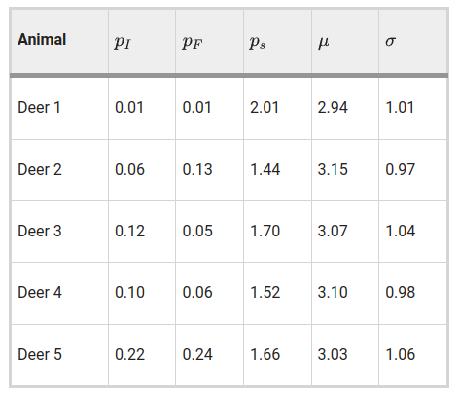
Demo (Estimated parameter values)

