Slide 1
Agent-Based Evolution
Jerry Chen

Slide 2
Key Topics
Evolutionary Dynamics
Traits are influenced by both local interactions with neighboring agents and the overarching environmental factor.
Selection pressure governs the direction and strength of trait evolution.
Abstraction
Each agent adapts its trait based on the traits of nearby agents and the local environment to reflect real-world scenarios of traits being shaped by inheritance and environment
Framework
Adaptable and allows for even further addition to simulation complexity for more realistic representation of evolution and parameters

Slide 3
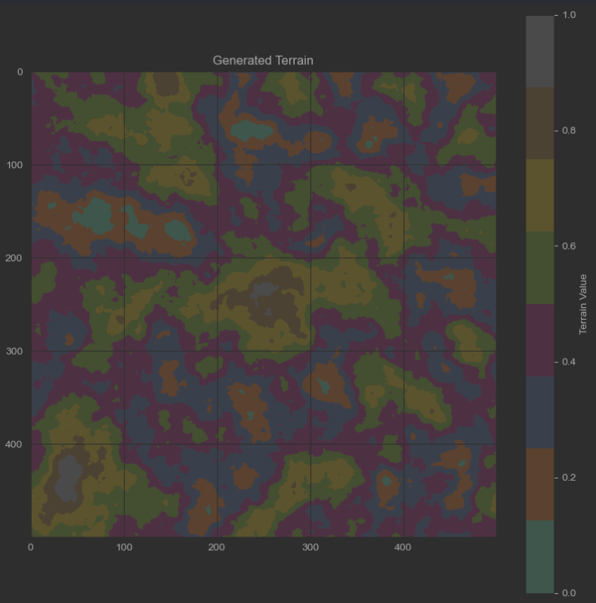
Method
A global environment factor is defined to imitate a range of how the environment interacts with the agents
Arbitrary float range between 0-1 which can represent climate, predation, or resource availability
Agents are instantiated along with the evolution model with various parameters
Agents have a mutation factor and are assigned a position (x, y)
Model parameters include:
N agents(int)
Size of the area(int values of width and height)
Environment factor(float that defines how much the environment changes over time)
Selection pressure(float that defines how much the agents are affected by environment)
Traits(a list of float values for randomly assigned trait values)
Terrain(a 2D array of values between 0-1)
Evolution is simulated by comparing agents with their neighbors and terrain and adjusting through each step until the traits begin to stabilize.

Slide 4
Code
Focus on applying various simulation techniques from both the course and also in own research
Use of matplotlib and NumPy for plotting and animation generation
Using MESA based agent modeling and OOP approach for simulation framework efficiency
MESA allowed for efficient storage of results and getters for them to decrease animation time(use dataCollector to gather all values and get them later for plotting)
Various other features not yet implemented but modular framework allows iteratively improving on the simulation from a complexity and user friendliness standpoint

