Slide 1
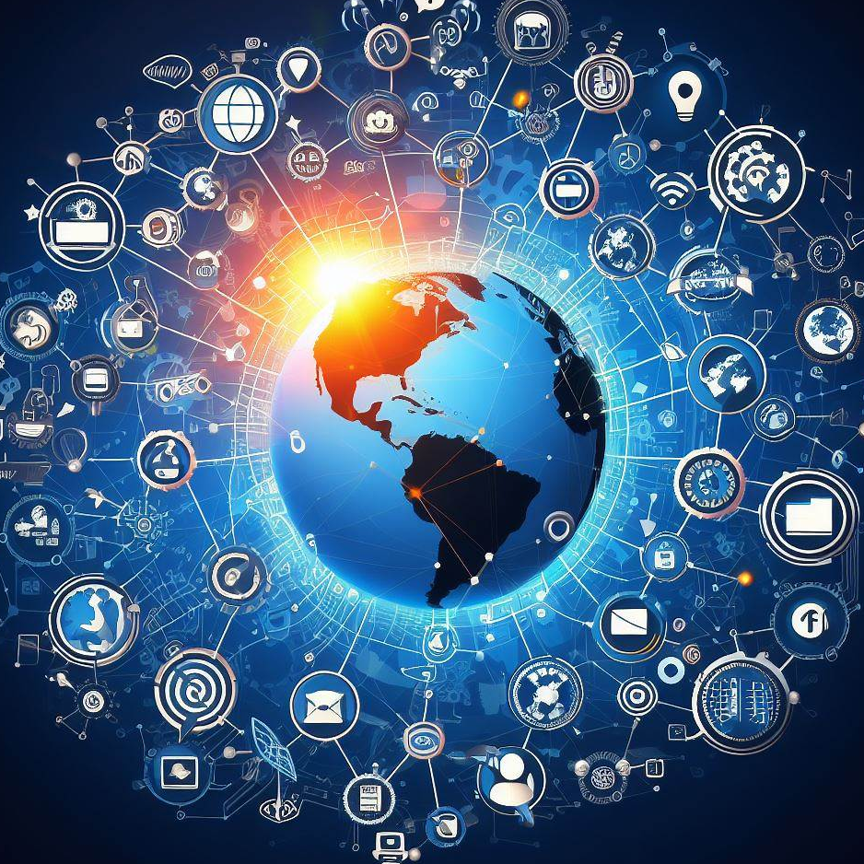
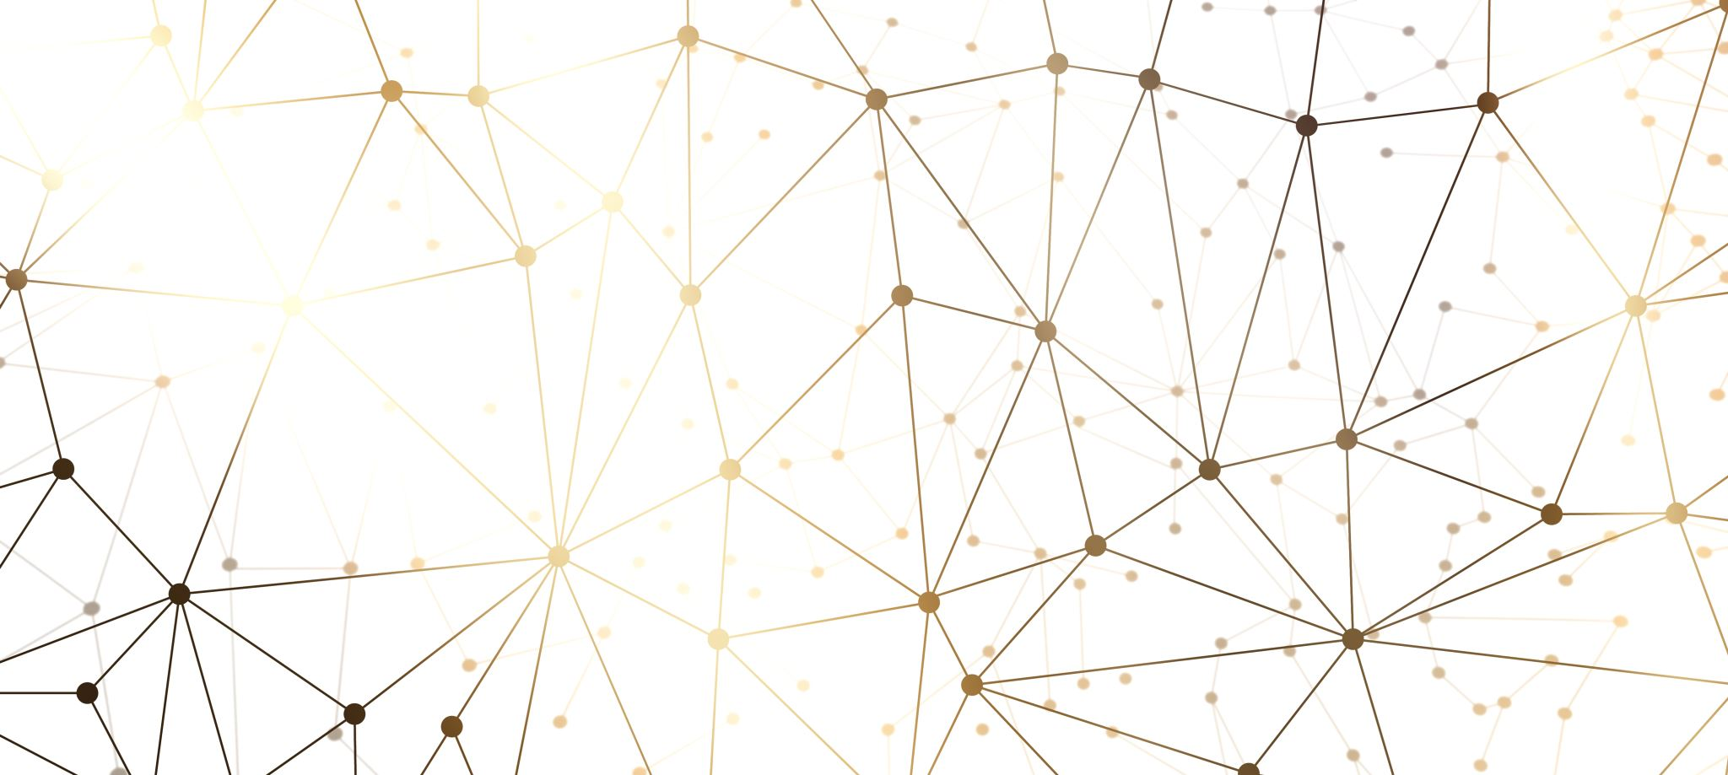
Modeling The Infection of an Idea
By Haik Decie
“An idea is like a virus. Resilient. Highly contagious. And even the smallest seed of an idea can grow. It can grow to define or destroy you.” - Cobb, Inception

Slide 2
Step 1: Social Media Network Mapping
Twitter
Many frequent connections between random people
Scale Free Network
Facebook
Similar to Twitter, but on avg has more clustered communities (e.g. family)
Small World Network
LinkedIn
Assuming people on avg have roughly same amount of coworkers
Regular Lattice Network
Mass, Randomized, connections between all users of platform
Random, Highly Connected Network
Omegle
Reddit
Hierarchical tree-like connection structure (due to sub-reddits)
Random Tree Network

Slide 3
Step 2: Sooo much code
Network Generation
Animation1
Simulation Generation
Master Notebook (controls & runs everything)
Animation2
Animation Generation
etc
JSON Data Handling

Slide 4
General Process
The SIR Model
SIR model Random Walks
Purpose = Used to model the spread of a disease throughout a system
Consists of some network of people, an infection rate, and a recovery rate
Each Person exists in 1 of 3 states:
Susceptible
Infected
Recovered
Using the infection rate and recovery rate to serve as boundary conditions for random numbers.
At each timestep, randomly determine whether neighboring nodes get infected / recovered.

Slide 5
Media Infection Visualizations
Twitter
Facebook
LinkedIn
Omegle
Reddit

