Slide 1
Shallow Water: 1D Animation Final Project

Slide 2
01
02
03
THE MATH
THE CODE
THE ANIMATION

Slide 3
01
THE MATH

Slide 4
WHAT ARE THE SHALLOW WATER EQUATIONS?
A set of differential equations that describe the motion of shallow water and is commonly used to simulate the water’s motion after a disturbance.

Slide 5
SIMPLIFIED EQUATIONS USED

Slide 6
EXTRA CONSIDERATIONS

Slide 7
02
THE CODE

Slide 8
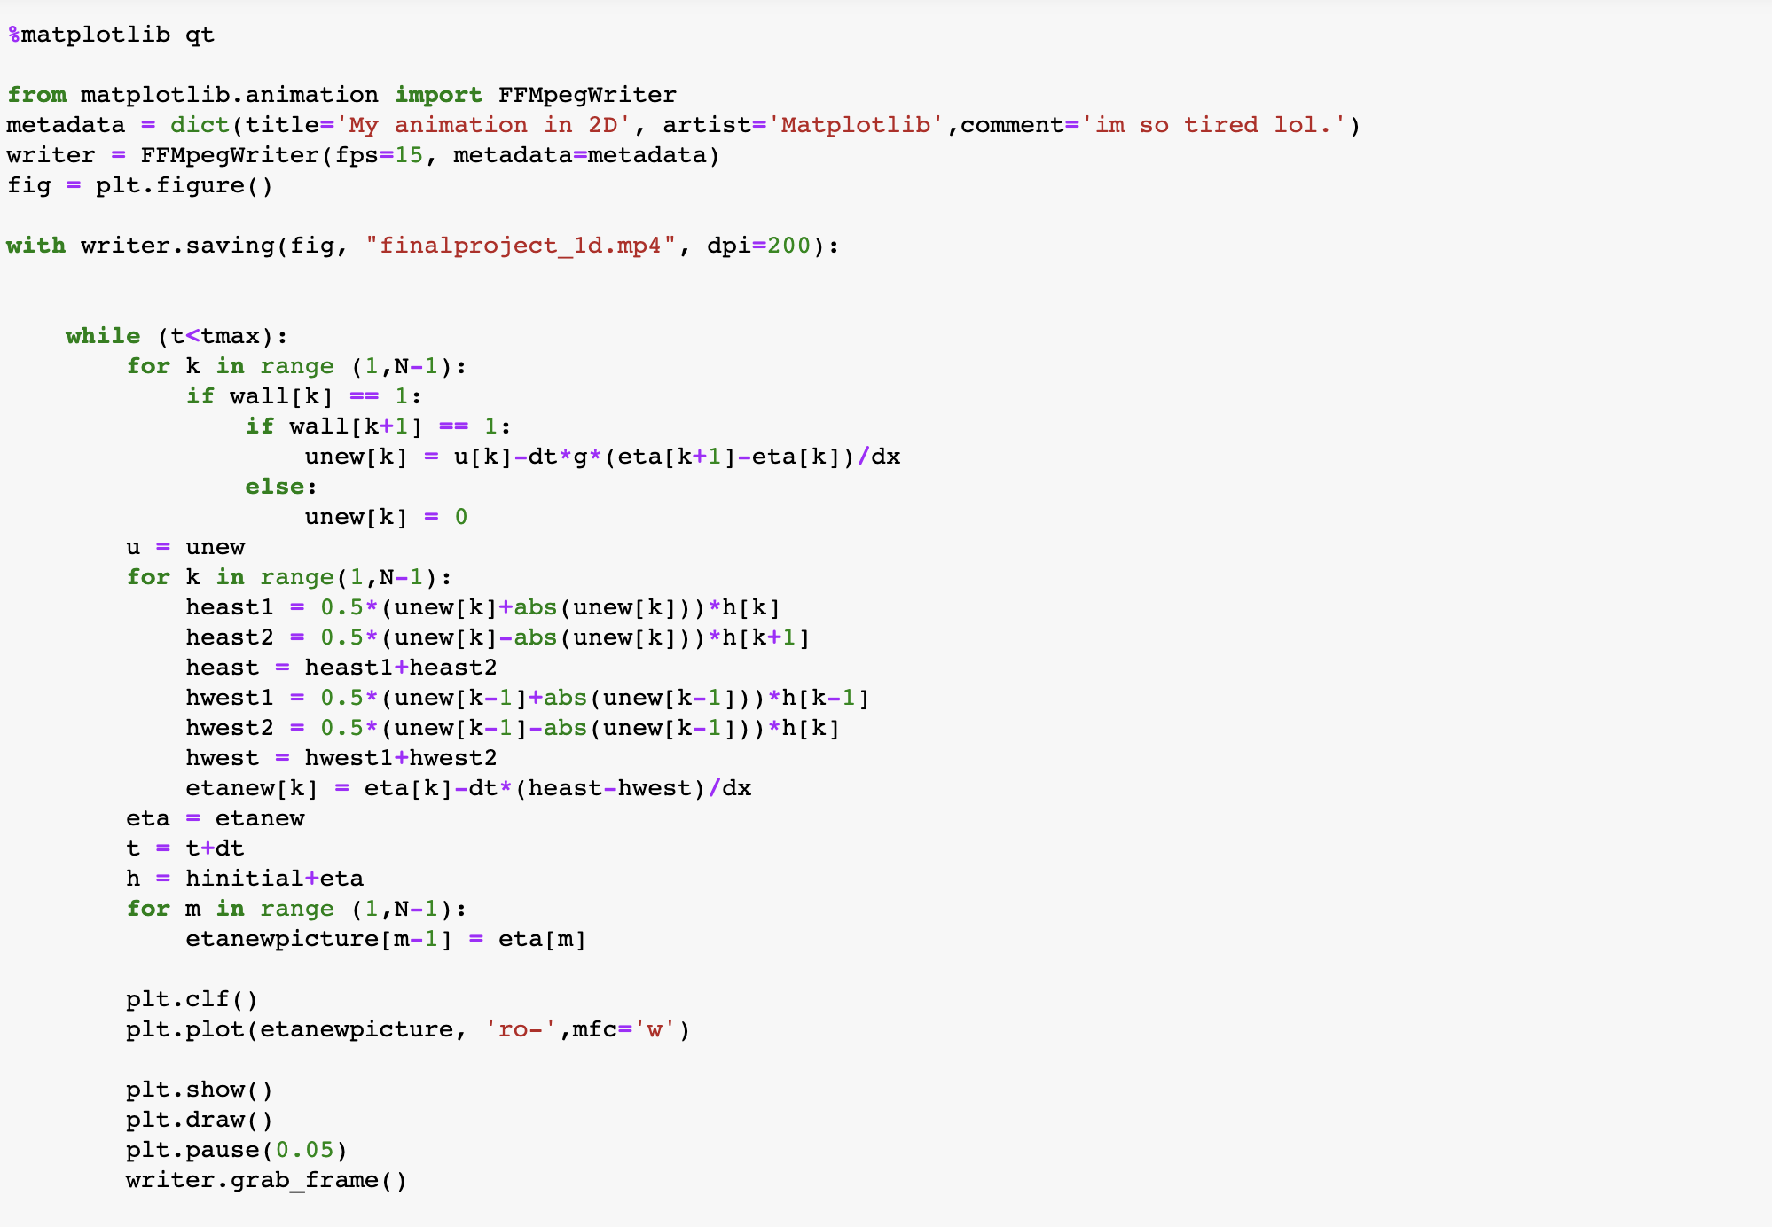

Slide 9
03
THE ANIMATION

Slide 10
