Slide 1
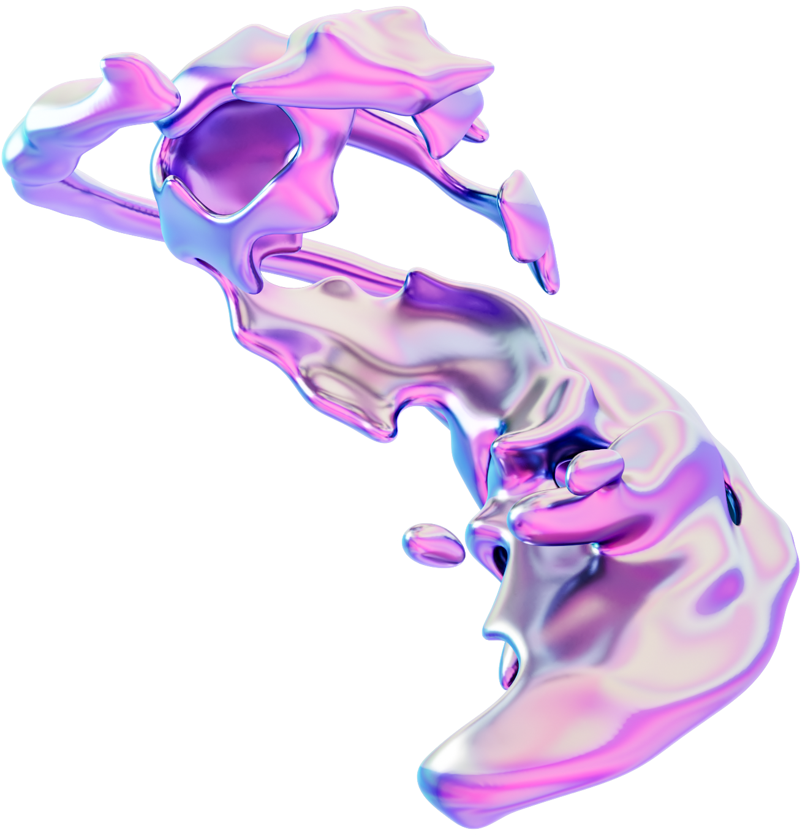
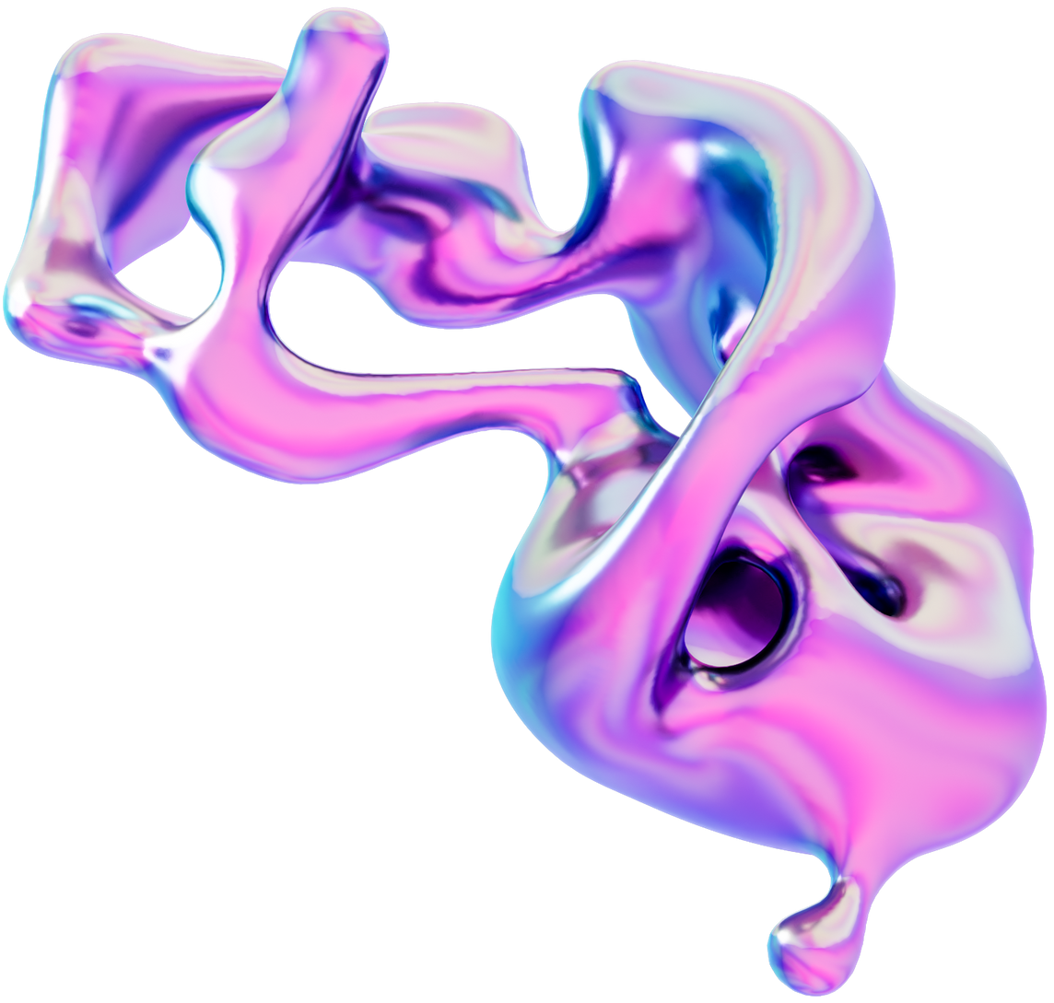
Visualy Pleasant Random Walks
Fernanda Mejia
EPS 109

Slide 2
Overview
Serie of animations based on figures moving by the random walks method and interacting with the environment, itself or similar others depending on the simulation. They also include sound and color processing as we seen on lectures / labs.

Slide 3
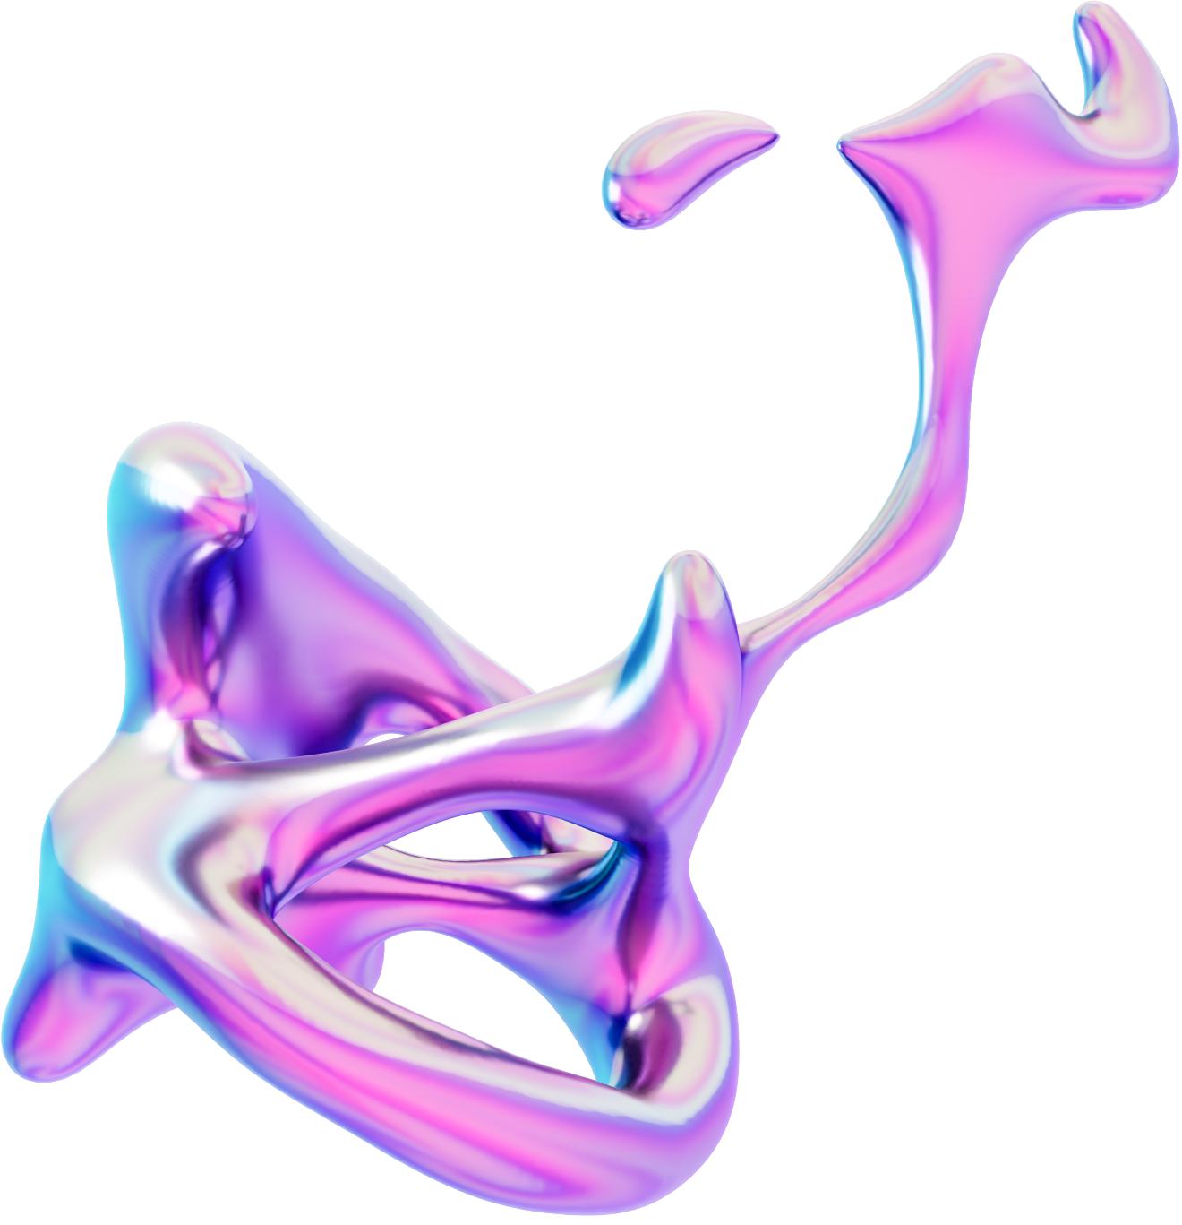

Christmas tree Star

Slide 4
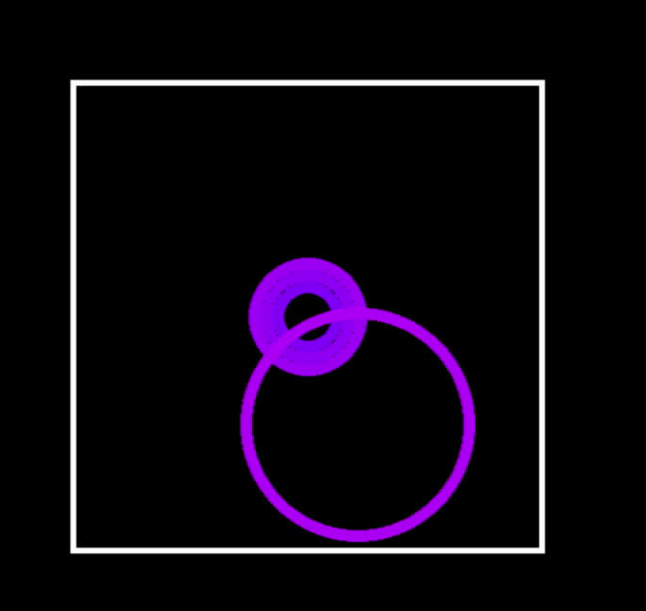
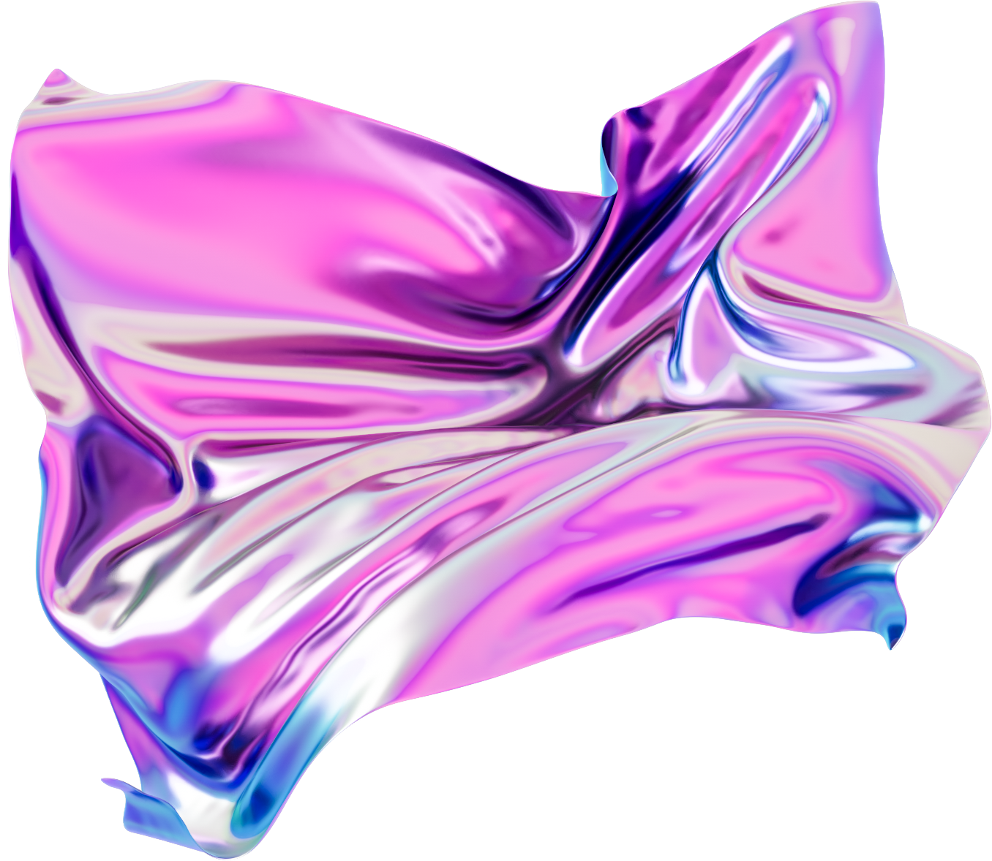
Relaxing Rings

Slide 5
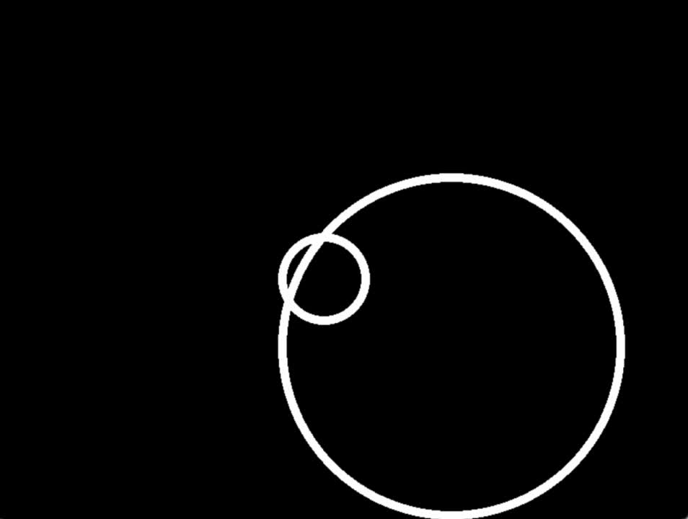
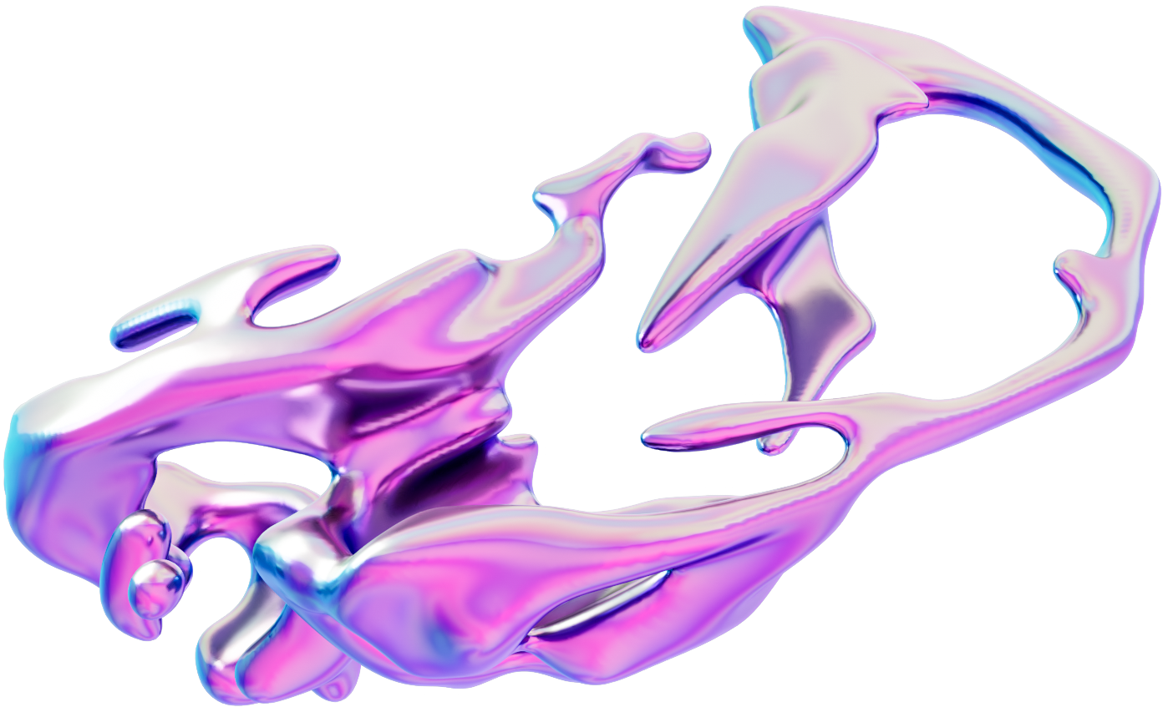
Anxiety

Slide 6
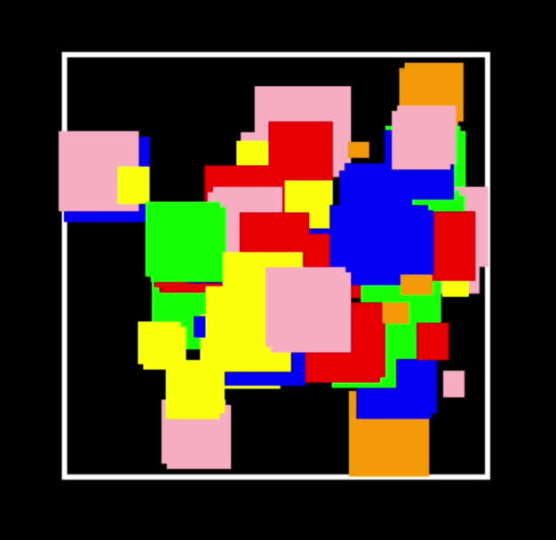
“I ask my boyfriend and he told me it is Minecraft animals, a small fence and a lot of wheat”

Slide 7
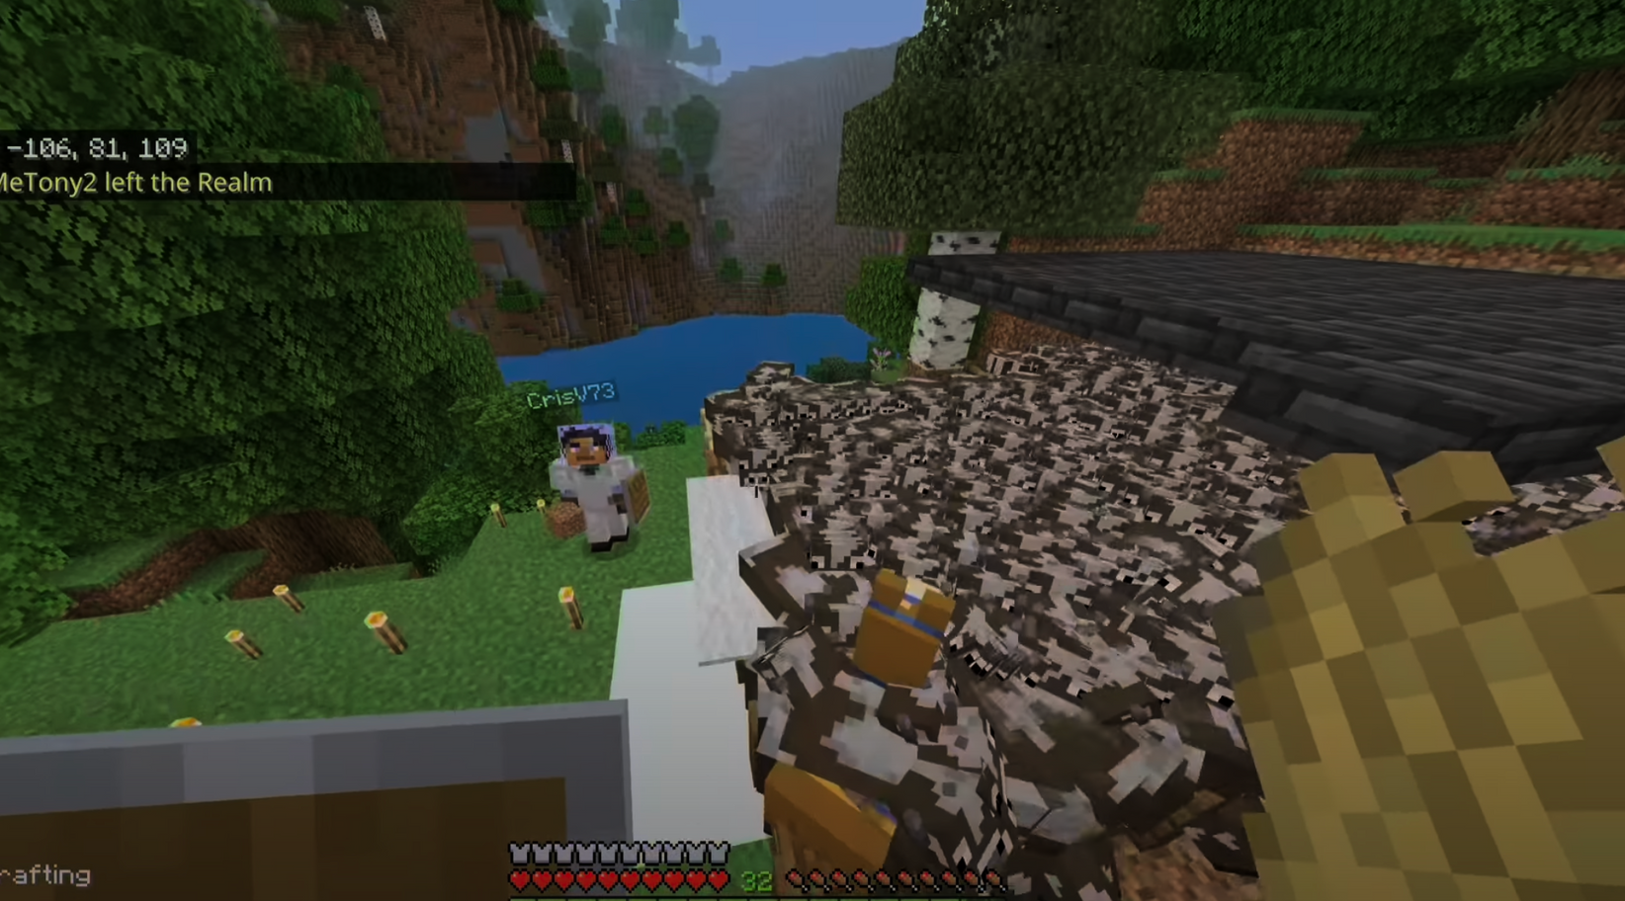

Slide 8
¡Gracias!

