Slide 1
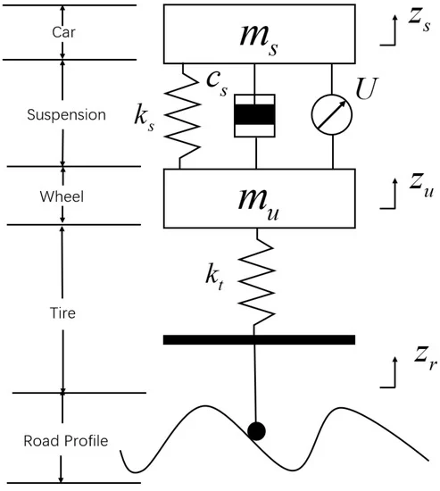
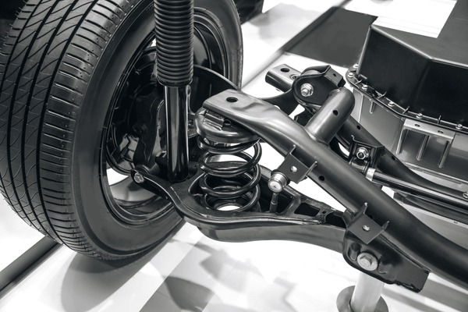
Evaluating Quarter Car Suspension Comfort
By Aditya Goel

Slide 2
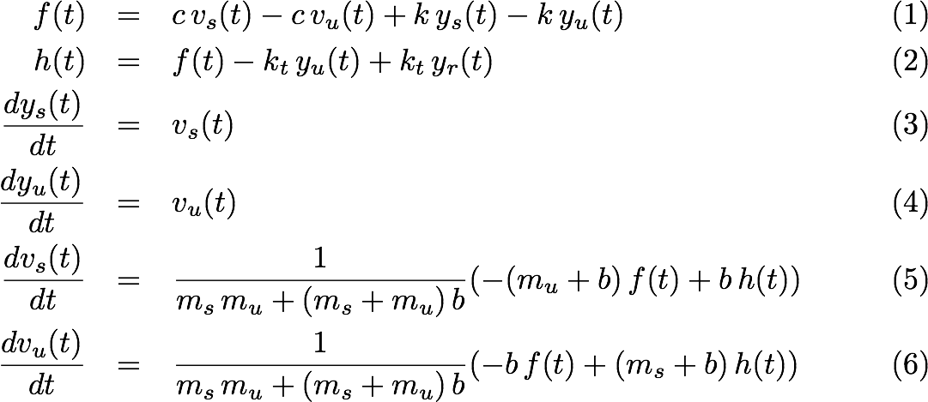
Project Details
Objective:
Analyzing the suspension response and comfort level in a quarter car model with a passive suspension system
Components of the Simulation:
Quarter Car Model: Consists of a wheel (unsprung mass, m_{u}) and a quarter of the car body (sprung mass, m_{s})
Passive Suspension System: Composed of a spring (k), a damper (c), and an inerter (b).
Road Profiles: Various road conditions such good & bad roads, potholes, speed bumps, uneven surfaces
Simulation
2nd order ordinary differential equations that describe the motion of the car's suspension system.
These equations account for the forces acting on the sprung mass (car body) and the unsprung mass (wheel).
Spring: Absorbs and releases energy from road impacts, supporting the vehicle's weight.
Damper: Stabilizes oscillations and controls energy dissipation from the spring.
Inerter: Manages kinetic energy to improve handling of high-frequency vibrations.

Slide 3
Good Road:
Best Comfort - Inerter: 100.0, Damping Coefficient: 4842.11
Worst Comfort - Inerter: 311.11, Damping Coefficient: 894.74
Bad Road:
Best Comfort - Inerter: 100.0, Damping Coefficient: 1289.47
Worst Comfort - Inerter: 100.0, Damping Coefficient: 500.0
Pothole Road:
Best Comfort - Inerter: 100.0, Damping Coefficient: 5236.84
Worst Comfort - Inerter: 100.0, Damping Coefficient: 500.0
Speed Bump Road:
Best Comfort - Inerter: 100.0, Damping Coefficient: 1684.21
Worst Comfort - Inerter: 100.0, Damping Coefficient: 500.0
Uneven Road:
Best Comfort - Inerter: 100.0, Damping Coefficient: 2473.68
Worst Comfort - Inerter: 2000.0, Damping Coefficient: 500.0

