Slide 1
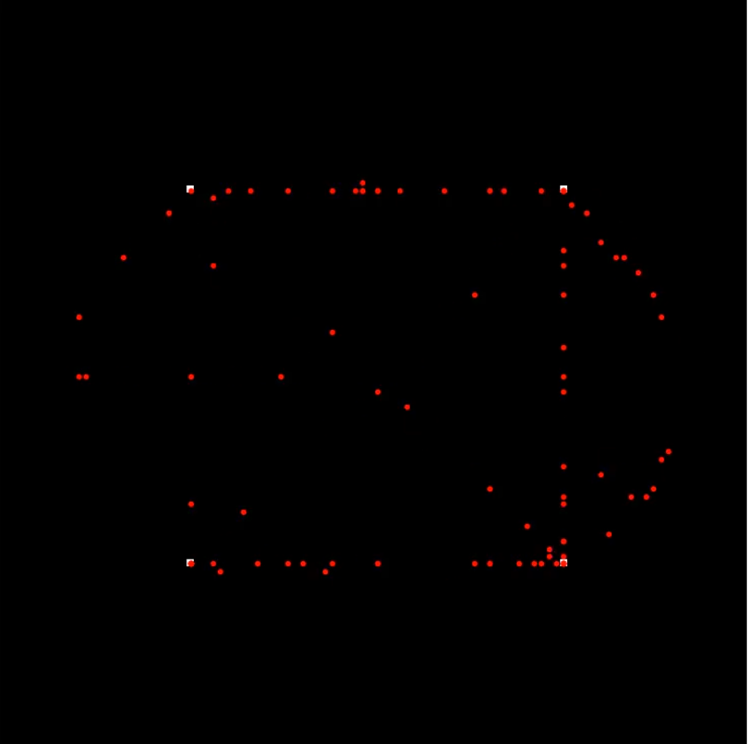
Navigating Crowds: Random Walks in Exhibit Congestion
Bill Hu
EPS 109 Final Project Presentation, Fall 2023
Notes:
a) a slide with the title, your name, and a large, descriptive still image.

Slide 2
Topic & Methods
In this simulation, we simulate 4 exhibits where people enter in a stream and visit the exhibits on their agenda, each for a random time, beforemoving towards the exit. Throughout the simulation, we’ll track number of people at each exhibit as well as the target of each visitor to analyze congestion. Visitors will try to do their best to avoid exhibits with large crowds, and will opt to visit another exhibit and come back. They will also not go directly to their target exhibit but will use random walk behavior.
Exhibit #3
Exhibit #1
end
start
Exhibit #4
Exhibit #2
Notes:
b) a second slide that explains the topic of your simulation and the methods used.

Slide 3
Animation
Notes:
c) The last slide should show your animation. The movie must be in MP4 or GIF formats, embedded directly in the PPTX file, and preferably start automatically when you switch to slide 3. On a Mac, you can achieve this in following way:

