Slide 1
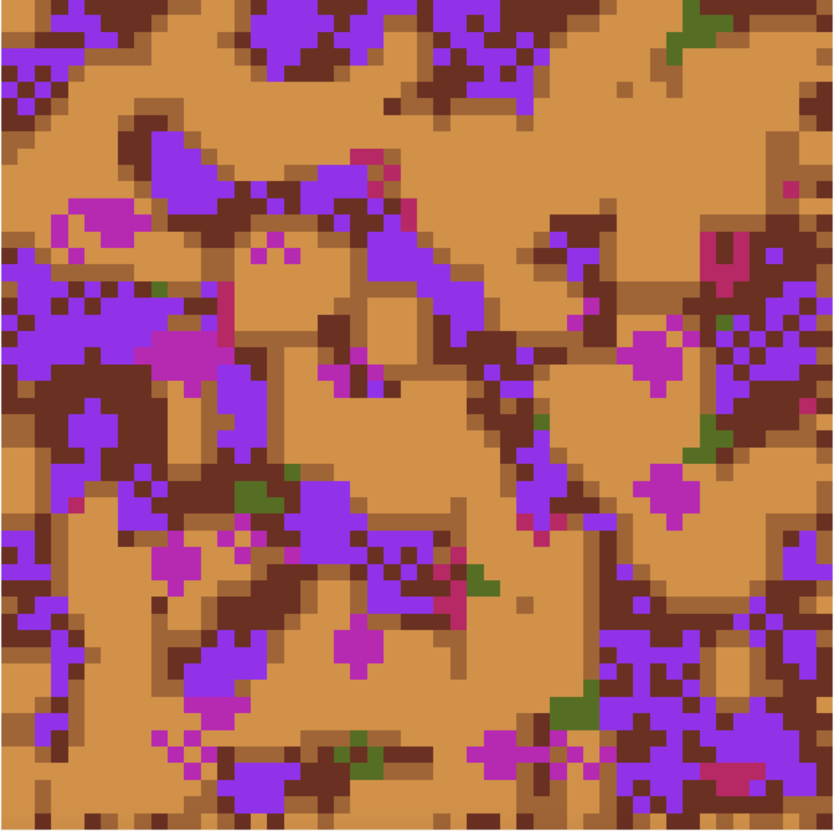
Effect of Soil Moisture on Plant Survival
Hima Kolavennu

Slide 2
Methods
Goal: Simulate the change over time in a terrain which begins as soil patches of different moisture levels, on which I plant flowers; want to see what factors allow for survival
Generated a random terrain by creating a grid of cells which are randomly chosen to be 1 of 3 moisture levels
Adjusted grid to more realistically resemble a terrain by clustering cells of the same soil level together
Created 4 plant types and randomized their locations
Simulated plants aging and reproducing offspring. Each plant’s survival depends on the moisture of the soil it’s on or whether it’s being planted on a cell occupied by a more competitive plant.
Created methods to simulate each of these steps: reproduction_cycle(), and aging_cycle()

