Slide 1
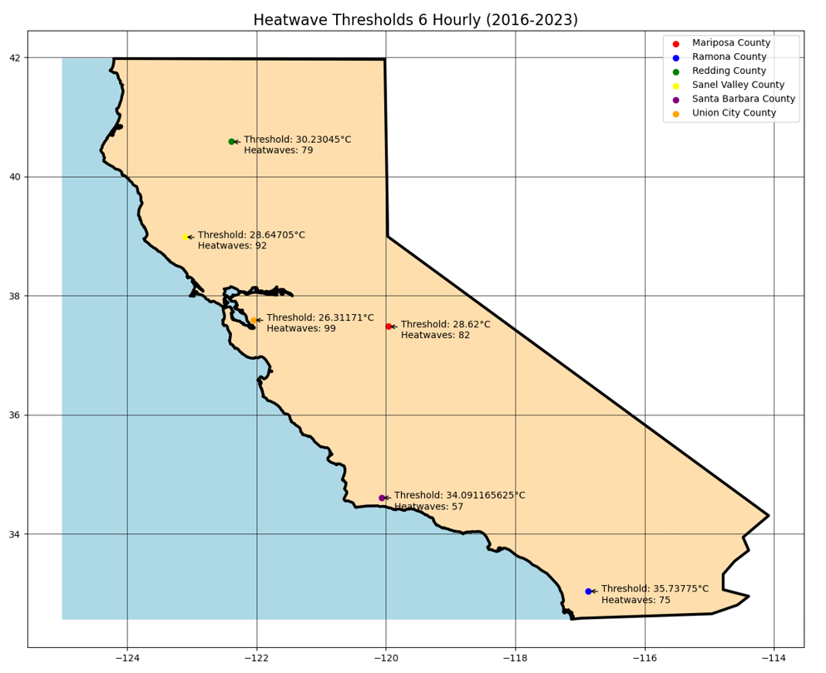
Understanding and Analyzing Heatwaves in Six Regions of California: A Comprehensive Data-Driven Approach
Anvita Korrapati
EPS 109

Slide 2
Data + Methods
The topic includes using weather datasets to analyze heat waves that have occurred in six different fire zones in the state of California (Sanel Valley, West of Redding, Union City, Santa Barbara, Mariposa, and Ramona). The goals of this project are to first gather and clean the satellite data from NASA and NOAA, which I can then use to identify heatwaves and model that data on a map of California.
Procedure: After cleaning the data sets, the temperatures (which were either in Fahrenheit for the hourly data or Kelvin for 6-hourly) were converted to Celsius to create the final, cleaned datasets
Finding Thresholds
1) According to the California Department of Public Health, a heatwave is defined as two or more consecutive heat events. A heat event is defined as when the temperature is at or above the 95th percentile of daily temperatures for that region.
2) Using this definition and the cleaned dataset, a temperature threshold was determined for each county.
3) Heatwaves were then identified for each region by filtering out extreme heat events that have lasted 2 or more days
Animation
A threshold temperature is set to determine when a heatwave occurs (e.g., temperatures exceeding 95%).
A matplotlib plot is initialized with two lines: one representing the temperature over time (in blue) and another as a threshold line (in green, dashed).
The animation is created using the matplotlib.animation.FFMpegWriter
The resulting animation visually represents temperature fluctuations over time in the month of July for the year 2023 in Mariposa county.
This specific time period and region was visualized only because data analysis showed that Mariposa county had a large number of heat events during the month of July, and these circumstances proved to be a great basis for visualization.
Red dashed lines appear whenever the temperature surpasses the defined threshold, indicating periods of heatwaves.

Slide 3
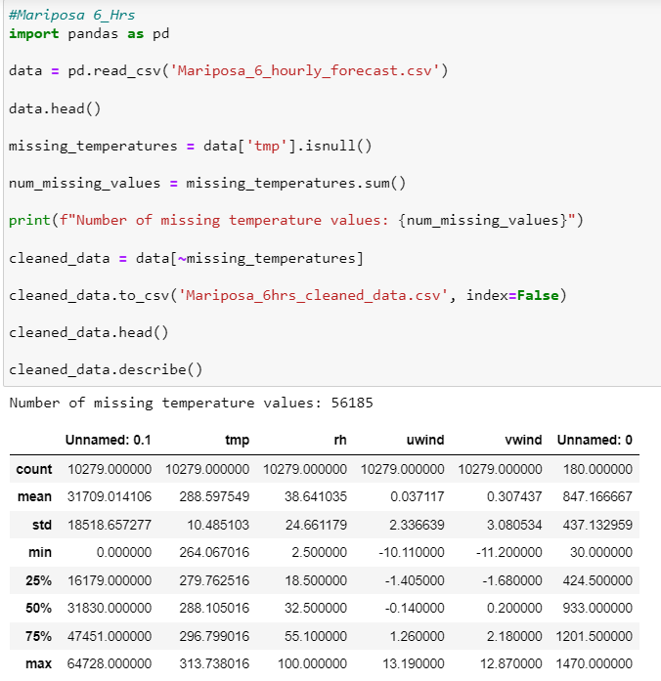
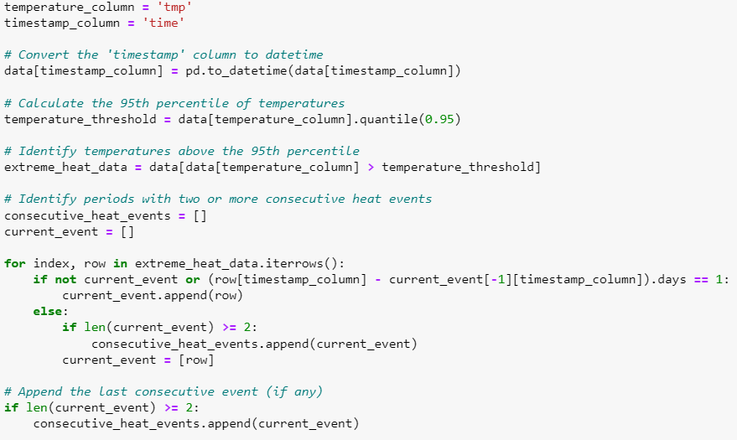
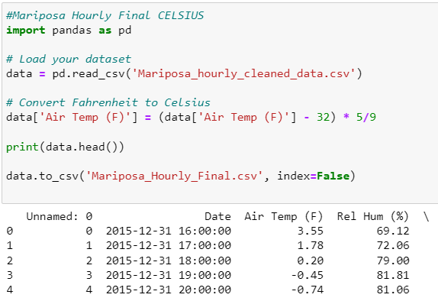
Notebooks
Start the “Clean Data Notebook” first
Then load the provided data sets
Use the “Heat Notebook” to view analysis and animation

Slide 4
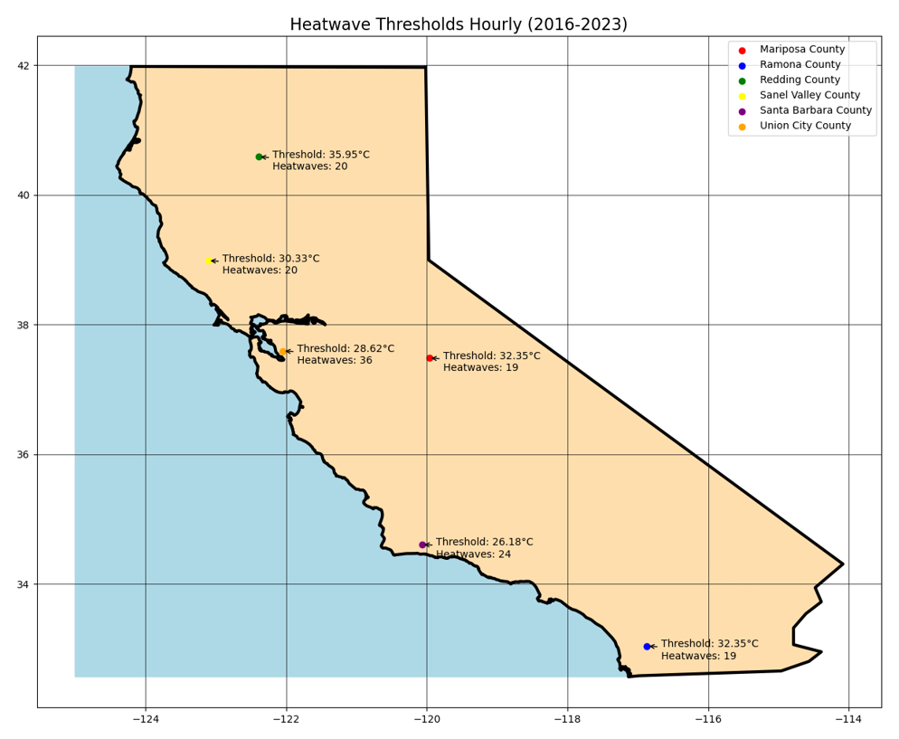

Slide 5
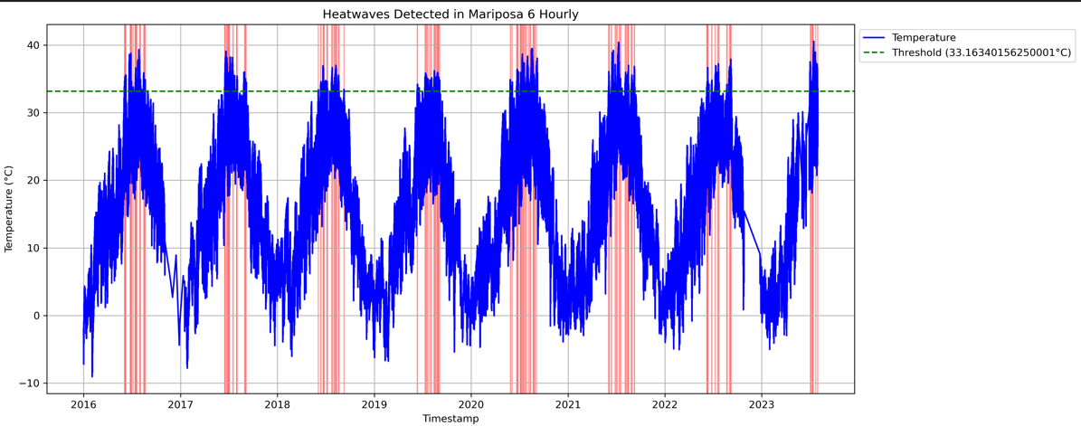

Slide 6
