Slide 1
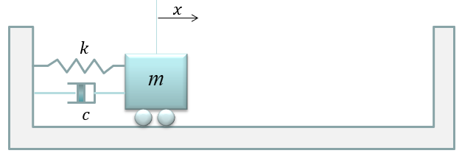
Spring Simulation
EPS 109
Sangeeta Kumar

Slide 2
Background
Simple harmonic oscillators are systems that have a restoring force which brings back the system to an equilibrium point
However, these systems are not *that* realistic considering that you would be continuously putting in energy into that system to make it oscillate forever
This is where we introduce damped oscillation which includes a drag force (similar to friction)
Since we are including this force, different scenarios arise from the ratio between the damping coefficient and the spring constant

Slide 3
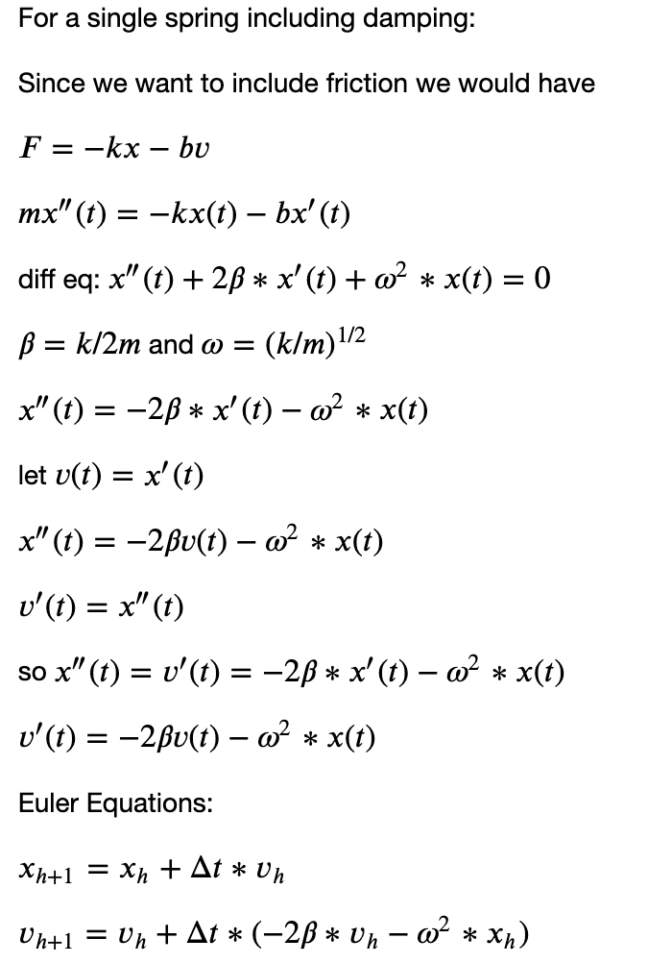
Methods

Slide 4
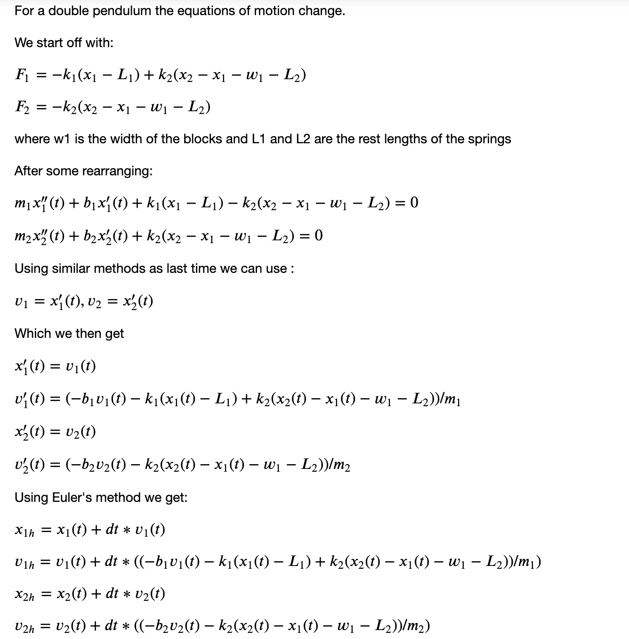
Methods

Slide 5
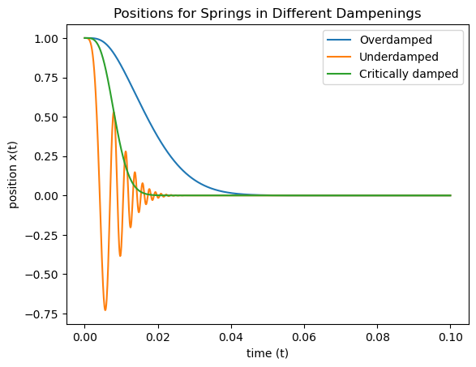
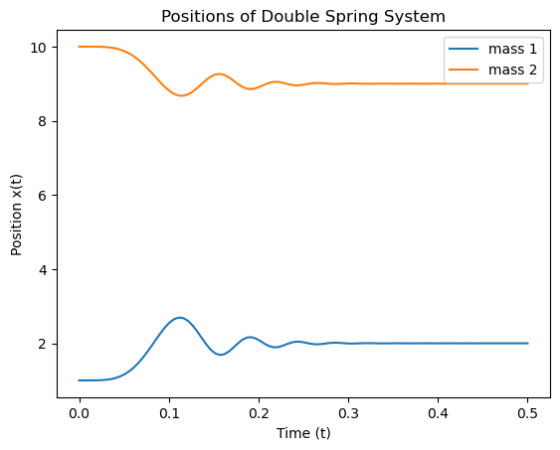
Methods - Position Graphs

Slide 6
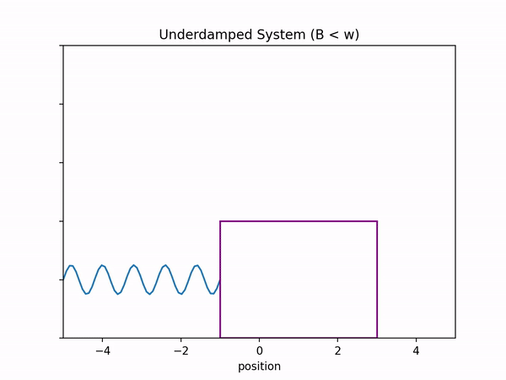
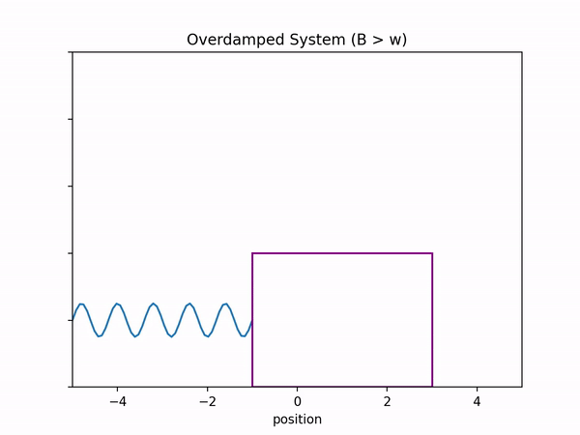
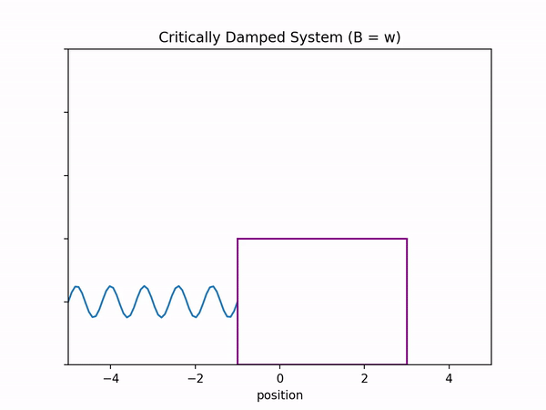
Animations - Single Spring

Slide 7
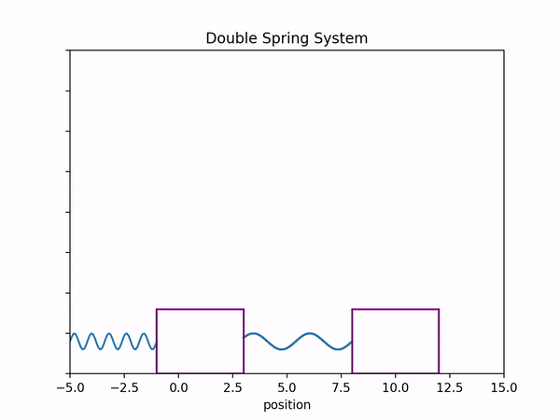
Animations - Double Spring
In case gifs don’t work:
https://youtu.be/SLnjXfyOtCA

