Slide 1
Central Limit Theorem: An NBA Demonstration
Francisco Martinez Iniguez
Image Source: nba.com

Slide 2
The Central Limit Theorem
The distribution of taking the sum of a large enough number of samples from a probability distribution will tend towards a normal distribution
Will be of the form:
$$Ρ\left[X≤x\right]=\int_{−∞}^{x}{\frac{1}{\sqrt{2πnσ^{2}}}e^{−\frac{{(χ−μn)}^{2}}{2nσ^{2}}}dχ}$$
Where $n$ is the number of samples, $σ^{2}$ and $μ$ are the variance and mean of the underlying distribution, respectively
Requirements:
Sampling needs to be random
Sampling needs to be done with replacement
Sampling needs to be done from identical distributions
Sample size needs to be sufficiently large
Variance and mean of the underlying distribution need to be finite

Slide 3
Demonstration of the Central Limit Theorem working using a Monte Carlo approach to selecting values from 2 different probability distributions based on NBA players’ statistics

Slide 4
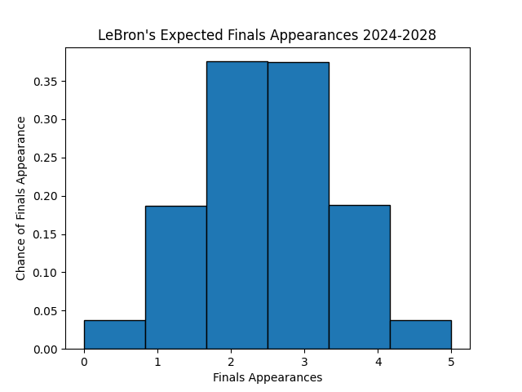
Source: statmuse.com

Slide 6
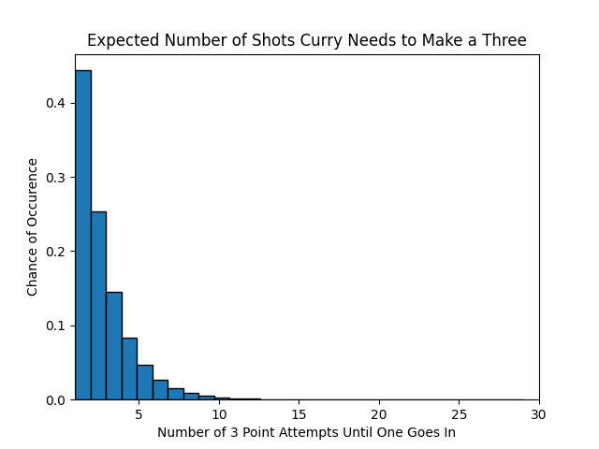
Source: statmuse.com

Slide 8
Usefulness of Central Limit Theorem
Allows complex distributions to be more easily analyzed in a manner that people more easily understand
Makes calculations behind that analysis much easier
NumPy and SciPy have heavy support for normal distributions

Slide 9
Case Study: Klay Thompson’s 2023-2024 season
Statistics | 2011-2023 | 2023-2024
Points Per 40 Minutes | 24.27 | 19.2
Rebounds Per 40 Minutes | 4.38 | 4.5
Assists Per 40 Minutes | 2.92 | 2.8
Turnovers Per 40 Minutes | 2.08 | 2.63
Blocks Per 40 Minutes | 0.64 | 0.68
Field Goal Percentage | 45.5% | 40.3%
Source: statmuse.com

Slide 10
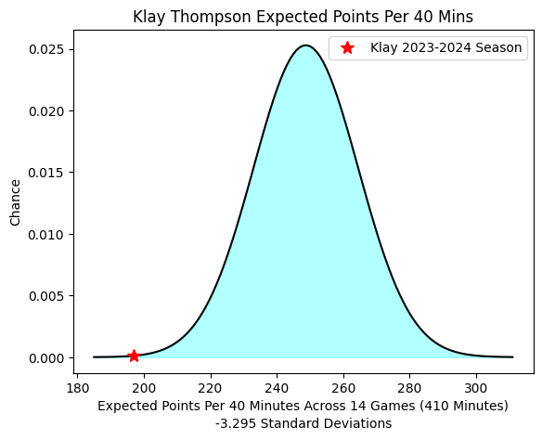
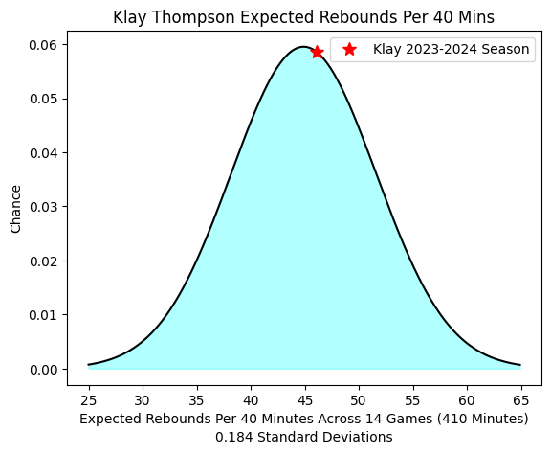
0.05% Chance of Being at this Level or Worse
57.3 % Chance of Being at this Level or Worse

Slide 11
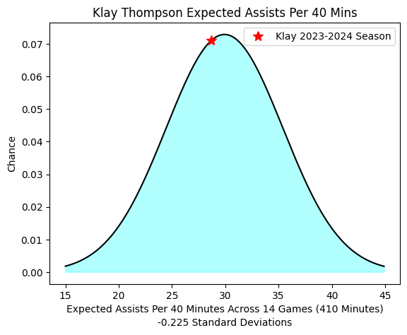
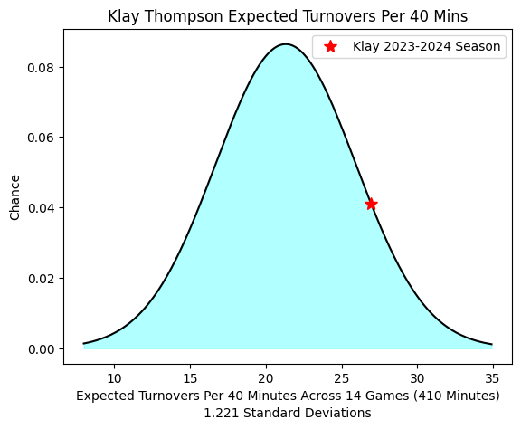
41.1% Chance of Being at this Level or Worse
11.1% Chance of Being at this Level or Worse

Slide 12
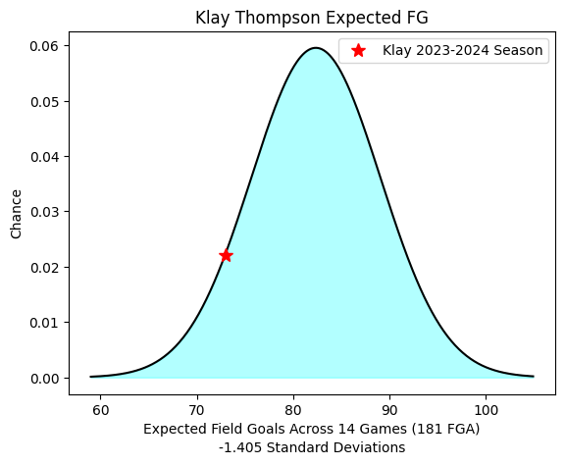
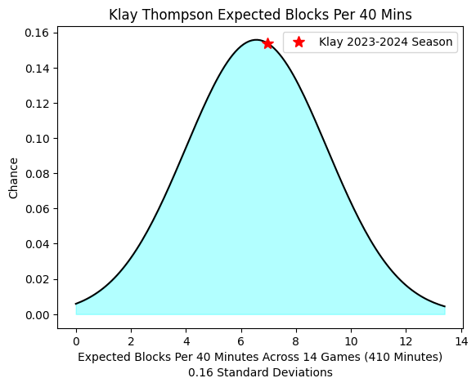
8.0% Chance of Being at this Level or Worse
56.4% Chance of Being at this Level or Worse

