Slide 1
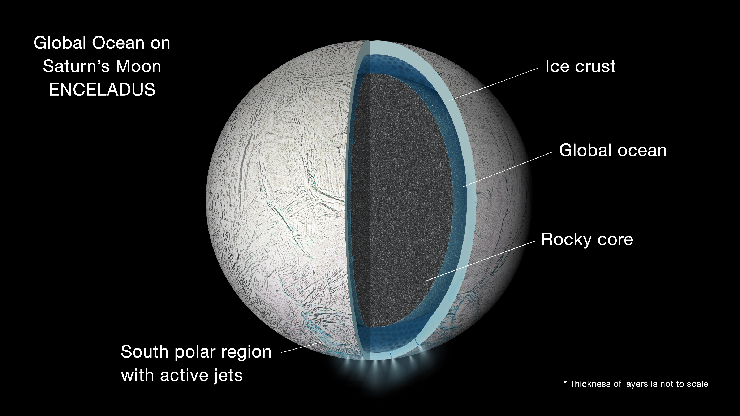
Eruption on Enceladus
​​
By Nathaniel Mekis

Slide 2
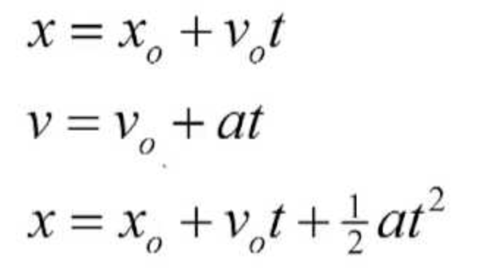
Topic and methods used
Molecular dynamics/ODE
Kinematic equations
Randomizing initial velocities and directions and scaling them

Slide 3
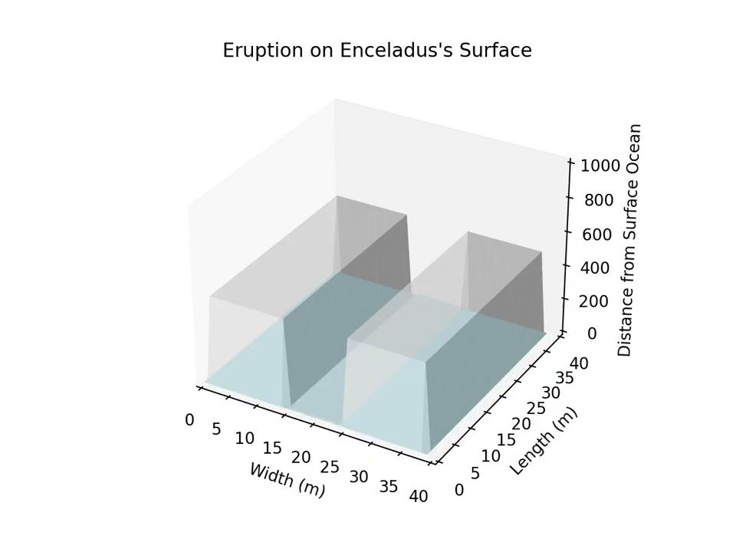
High gravity
Low initial velocity
Low gravity
High initial velocity
Basic

