Slide 1
Clash of Clans
Random Walks
Harjot Multani

Slide 2
Topic
In a playing field there are 4 players: Goblin, Barbarian, Archer, Giant
Each Fighter has a unique attack and health
Elixir adds 10 health to a player
Gold adds 10 attack to a player
Dark Elixir adds 10 health and 10 attack to a player

Slide 3
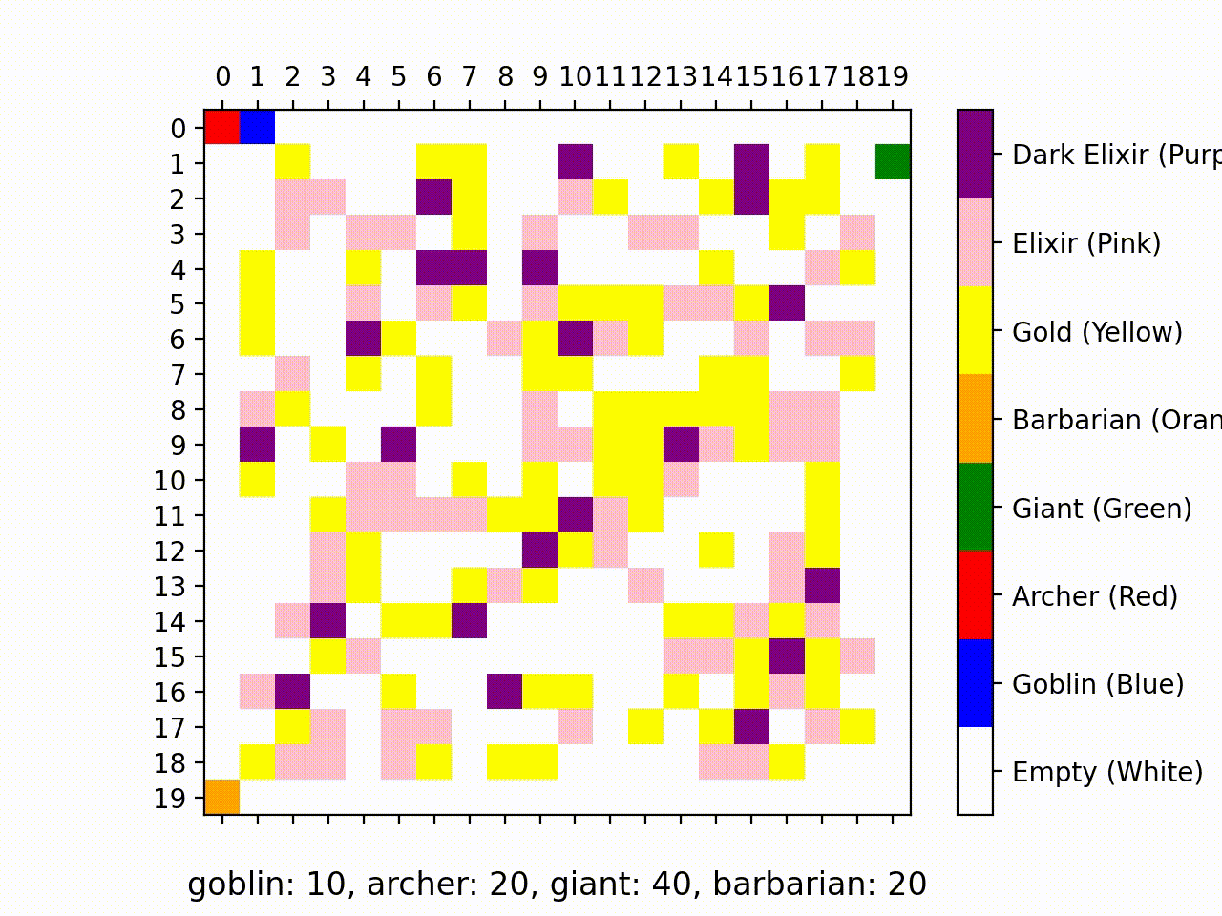
First Animation (Fight Occurs)

Slide 4
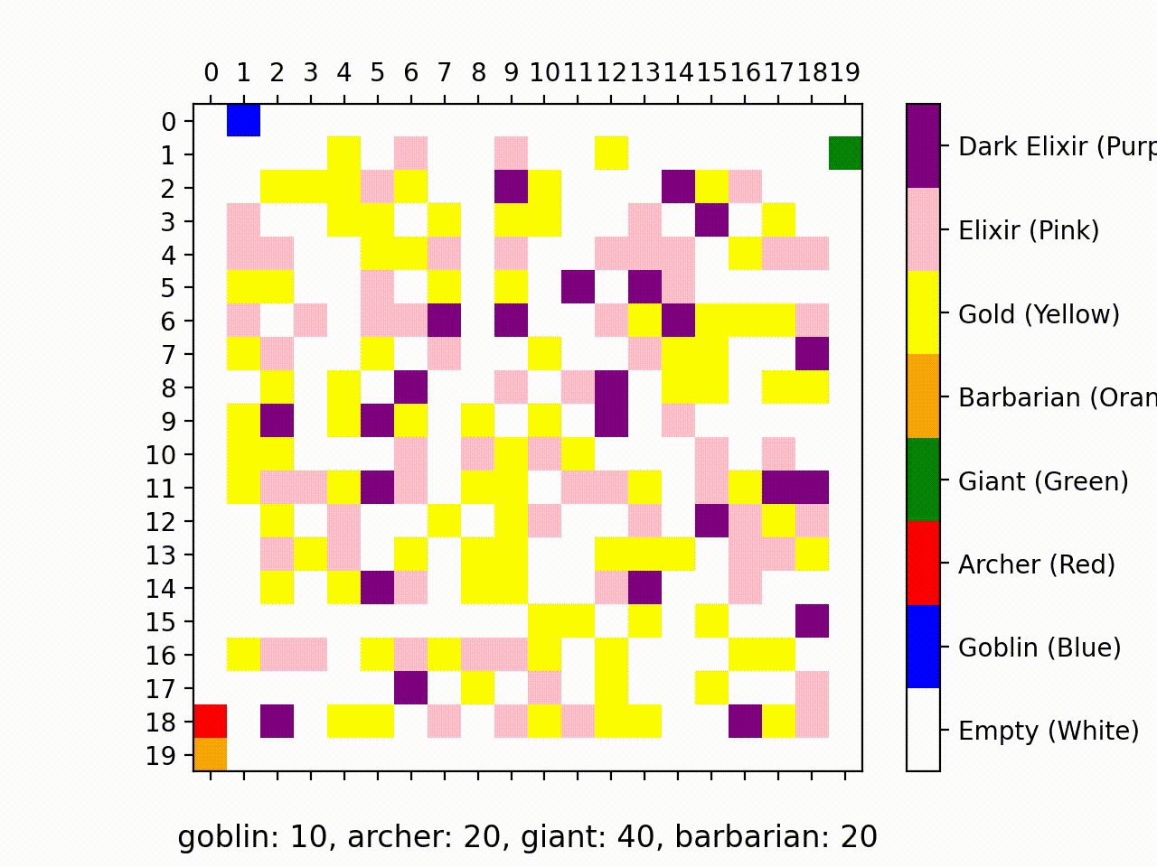
Second Animation (Longer Ran)

Slide 5
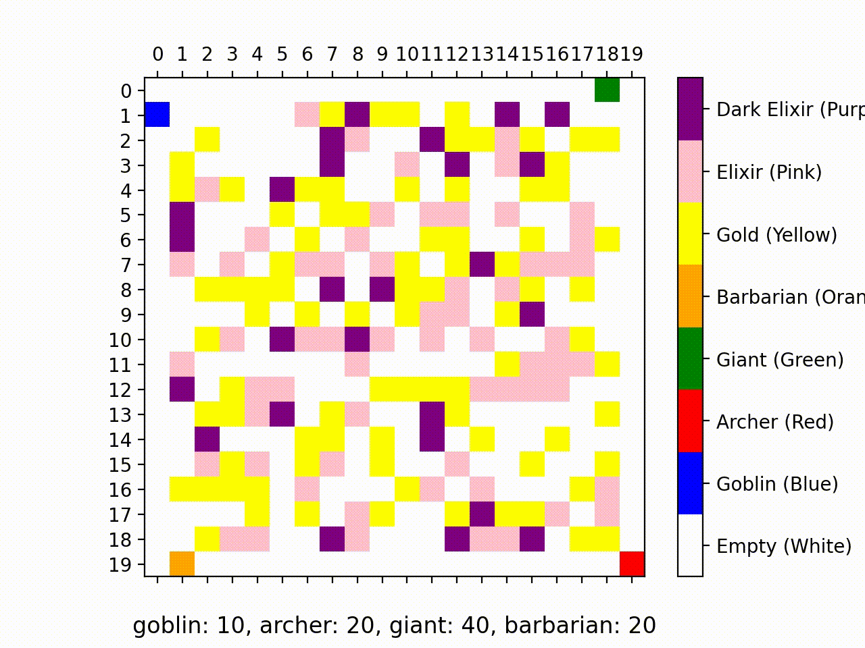
Third Animation (Everyone in Corner

Slide 6
The Algorithms
Random Walks: Each fighter takes a random step towards the left, right, up, down with even probability.
Eat: When a fighter lands on resources, they consume the item and at it to their HP/AP
Fight and Eat: When two or more fights land on a single tile they fight to the death. Only one can survive and that survivor gets to eat the resources at the tile. They also get bonus health and attack

Slide 7
Improvements
Initially wanted goblin to move faster than everyone else but implementing eating two at a time
Add certain troops stronger to other troops.
Add more troops to the board to make the game look crazier

