Slide 1
Visualizing Martingale
Betting & Stocks
Ryan Nurwono

Slide 2
Martingale System
Betting strategy primarily used in games of near 50/50 probability with 1:1 payout
Double bets upon losing, will eventually recuperate all lost money + initial bet
Although small likelihood of busting, all casino games are negative EV

Slide 4
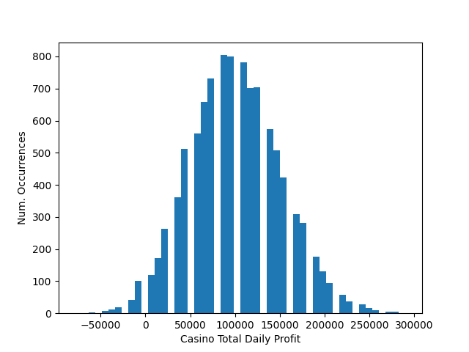

Slide 5
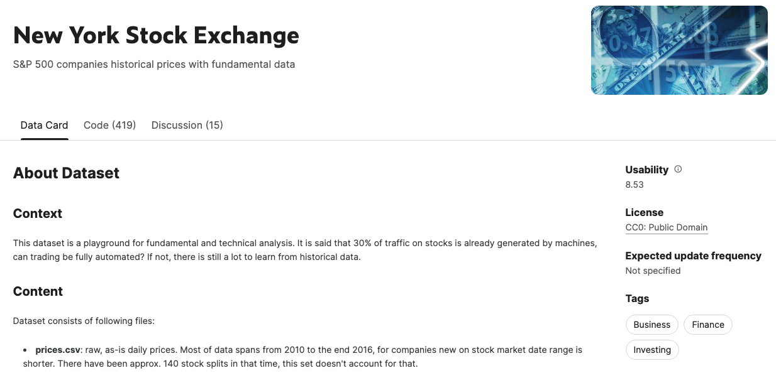
Applying Martingale to Stocks - Using NYSE data
Less Straightforward - not 1:1 payout
Relies on mean reversion
Does not factor in limits on trade size or fees

Slide 6
