Slide 1
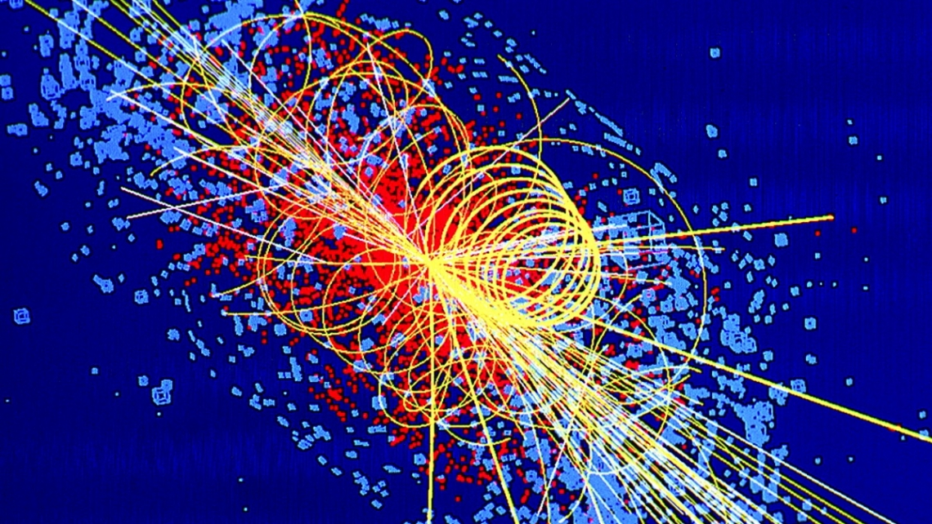
proton-proton collision
Ava Phillips

Slide 2
Simulating the proton-proton collisions that occur within the Large Hadron Collider (LHC).
Methods from class:
Random walks generate new positions for the quarks.
Monte Carlo used to decide each quarks movement.
The code simulates a particle collision, where the protons transform into partons and a Higgs boson can be randomly formed with a probability set to 10%.
The LHC generates around 1 billion proton collisions every second, so it is estimated that a Higgs boson is produced every 1-2 seconds.
Quarks oscillates back and forth really fast and in random directions!
My code is extremely simplified but shows the complex nature of particle physics!

Slide 4
Simulating the jets of proton proton collisions
A production of the particles (jets) in proton-proton collision. Shows the evolution of particle positions in 3D space as a result of proton-proton collisions.
Involves parton distribution function, hard scattering, and jet fragmentation.
Parton distribution function: probability density of finding a parton with a given momentum fraction.
Hard scattering: where partons collide and produce quarks.
Jet fragmentation: where quarks form jets of particles.
The number of particles produced in a collision are unique for each event so I randomized the number of particles in each jet.
Methods from class:
Parton distribution functions are essential in Monte Carlo simulations

Slide 5
SIMULATION of the jets!

Slide 6
Sources
https://gsalam.web.cern.ch/gsalam/repository/talks/2009-Bautzen-lecture2.pdf
https://cds.cern.ch/record/1183646/files/p37.pdf
https://arxiv.org/pdf/hep-lat/9609018.pdf
https://cms.cern/physics/higgs-boson

