Slide 1
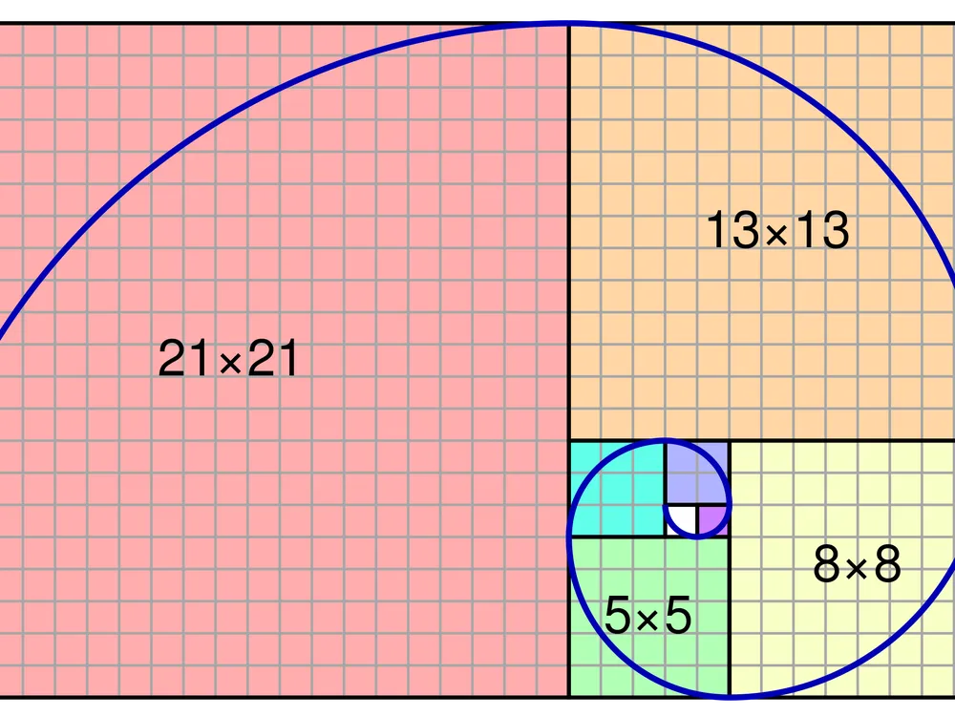
FIBONACCI’S SPIRAL AND THE GOLDEN RATIO
ANTONIA QUIROGA CORTES

Slide 2
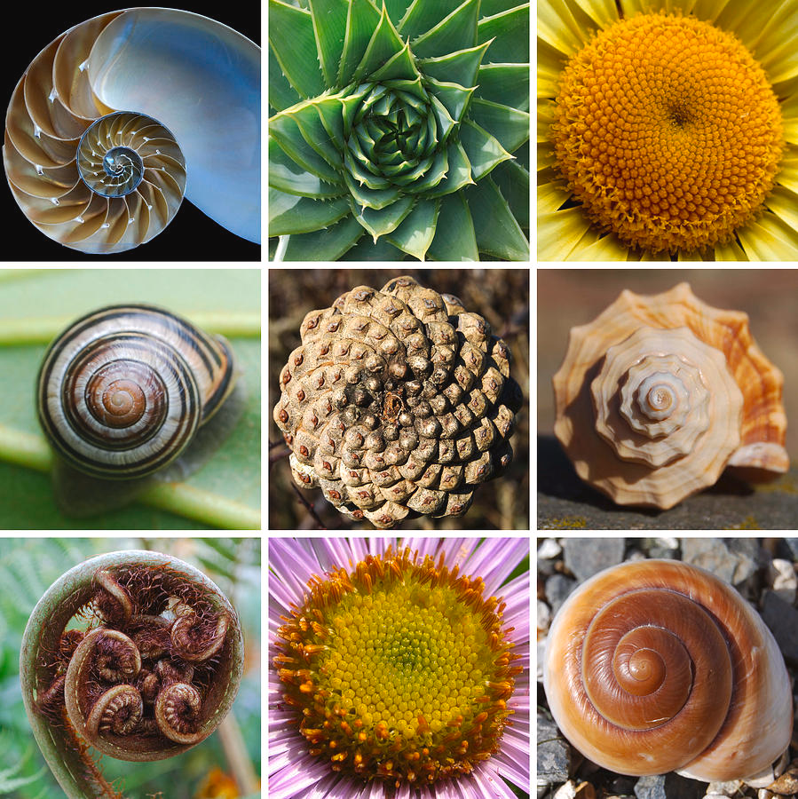
Objectives:
- Simulate Fibonacci’s spiral, and
ilustarte how it is build using
Fibonacci’s sequence.
- Show how the ratio between two
consecutive Fibonacci numbers
tends to the golden number.
= 1.618033988749894...
Methods used:
-Graphical simulation using
Turtle library and for loops to
create the animation and the
sequence.
-Helper functions to draw the
squares and the arcs.
- Use frame captures to turn
the simulation into a.gif file.

Slide 3
SIMULATION

Slide 4
THE END

