Slide 1
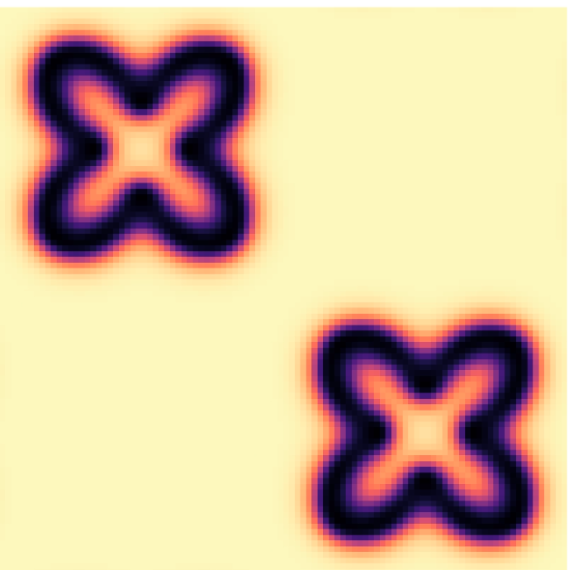
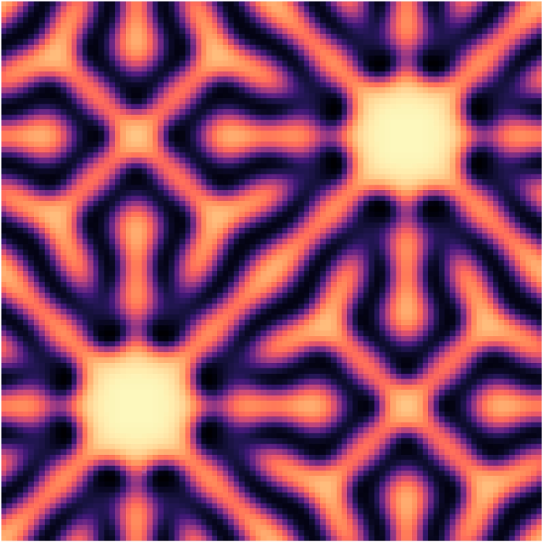
Reaction-diffusion simulation
Kevyn Ramirez

Slide 2
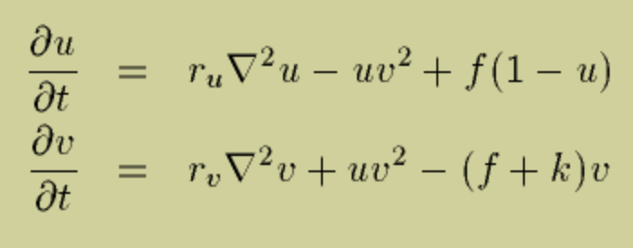
References: https://www.karlsims.com/rd.html, https://www.karlsims.com/rdtool.html, https://github.com/benmaier/reaction-diffusion/blob/master/gray_scott.ipynb
Reaction-Diffusion
Gray-Scott
2D Lagrangian
What this means is to simulate two different “chemicals” A and B interacting throughout a grid.
As time passes on, the concentration of each chemical throughout the grid creates patterns.
∇² stands for the Lagrangian.
Convolution of each cell with the matrix
This is to sum the neighbors and negate the current cell
0 | 1 | 0
1 | -4 | 1
0 | 1 | 0
PDE that calculates the change of concentration of a chemical u or v.
f is the feed term, k is the kill term

