Slide 1
Modelling Thermal Hotspots on Printed Circuit Boards
Aneesh Murthy Srinivas
EPS 109 - Final Project Presentation

Slide 2
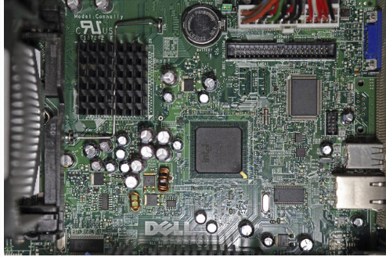
Background
Printed Circuit Boards (or “PCBs”) is a non-conductive surface that help mount (multiple) semiconductor chips that are connected in a complex way by thin copper strips.
PCBs are usually made of a conductive material (“copper”) and insulating material (“Resin and Glass”).
Each PCB can have 100! (yes, 100s) of components and can have multiple layers.
Each component is different and have different thermal & electrical characteristics.
So, it can get very complex and messy to make all of the components co-exist.
So, what is the problem?
When semiconductors are turned on, they generate heat.
This heat is transmitted to its surroundings and if not designed properly can cause PCBs to burn and crack.
Therefore, it is very important to simulate heatmap to understand the behavior of the electrical circuit on the PCB.
My model has the following:
4 semiconductors on the PCB
4 copper interconnections of varying lengths
PCB substrate is assumed to be glass-resin mixture[we used the specific heat of glass for all our calculations]
The initial board temperature of the PCB (including all its components) is assumed to be 25℃.
Given that a circuit can operate at different voltages and current ratings, I have assumed the current through the conductors to be different.
It is the max-current that can be sent on that wire (note: This is fixed during design)
The current are in mA (milli-amperes)
I will be using the Finite Difference Method to model the heat transfer into the PCB substrate.
The PCB is divided into a (100 × 100) grid
Semiconductors have similar thermal properties and hence I have modelled the temperature rising using a scaled version of the arctan function
( constant) × ( 0.5 +arctan(0.25t )/pi) // where t is the time & (constant = 50)
Note: Thermal models for semiconductors are complex and hence i chose a realistic representation based on research from the internet.
My code is modular and a new semiconductor thermal model can be introduced. It will produce different results
All Conductors have resistance. (measures in ohms (Ω); It is a function of the length (& thickness) of the conductor.Copper has a resistance of 0.000331 Ω/cm ; Note: The lesser (↓) the thickness , the greater (↑) the resistance
Resistance in conductors cause voltage (or energy) loss when current flows through the conductor. This energy is heat that is generated when circuits are powered up.
Equations:
Determining the resistance of of the conductor:
We know the length of the wires; Using distance formula, we compute the length of the wires in our model. We know the density of copper. So, we can calculate the mass.
Energy (or Power) in a conductor is:
P = (Voltage) × (current) ⇒ (current)² × (resistance) (because = V = IR based on ohms law)
Converting Energy into temperature is:
(change in temperature)ΔT = (Energy) ÷ ((specific heat capacity of copper) × (mass))
(change in temperature)ΔT = (((current)² × (resistance)) × (time))÷ ((specific heat capacity of copper) × (mass))

Slide 3
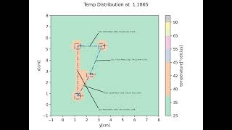
Animation

