Slide 1
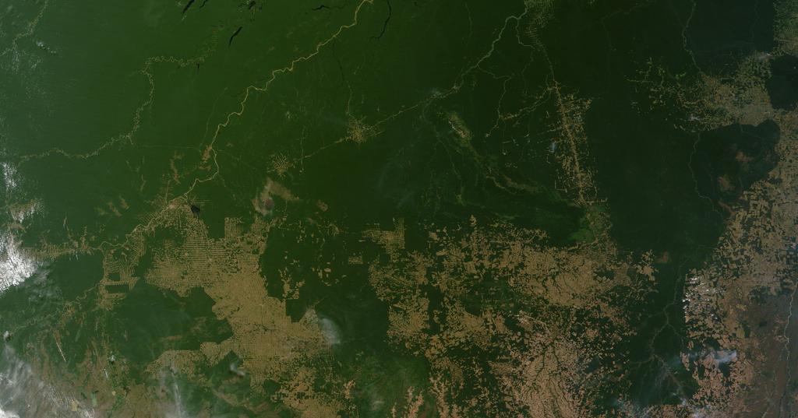
FA23 EPS 109 Final Project - Max Taniguchi-King
Building Baselines
Evaluating NBCS Projects

Slide 2
Investigating NBCS
Nature based climate solutions (NBCS) involve reducing atmospheric CO2 and issuing carbon credits!
Carbon credits are based off a baseline carbon offset and an observed carbon reduction
BUT NBCS projects have seen growing criticism for their inaccurate offset reports
aka many projects could be overestimating their carbon credits!!
Let’s investigate this for ourselves…

Slide 3
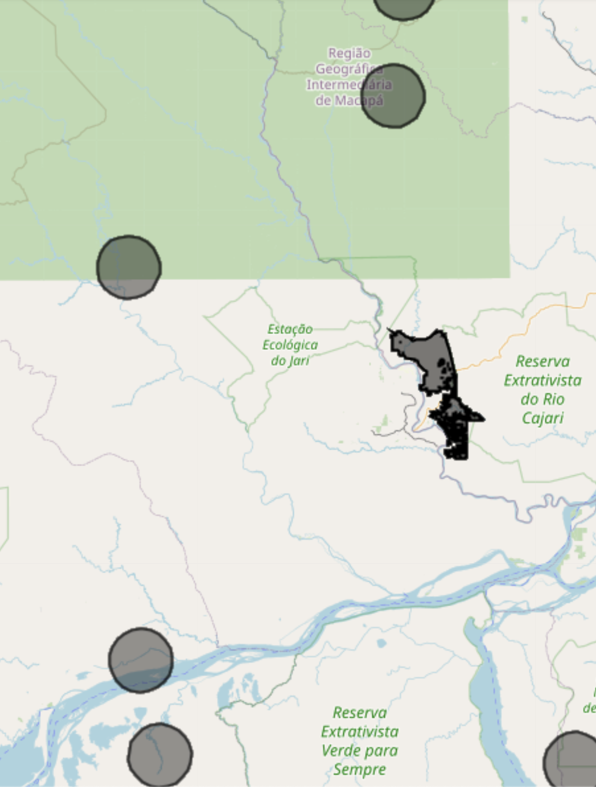
Creating a Synthetic Control
an area that doesn't actually exist
is synthetically created to represent the project area
a counterfactual group
represents what would have happened without the NBCS project

Slide 4
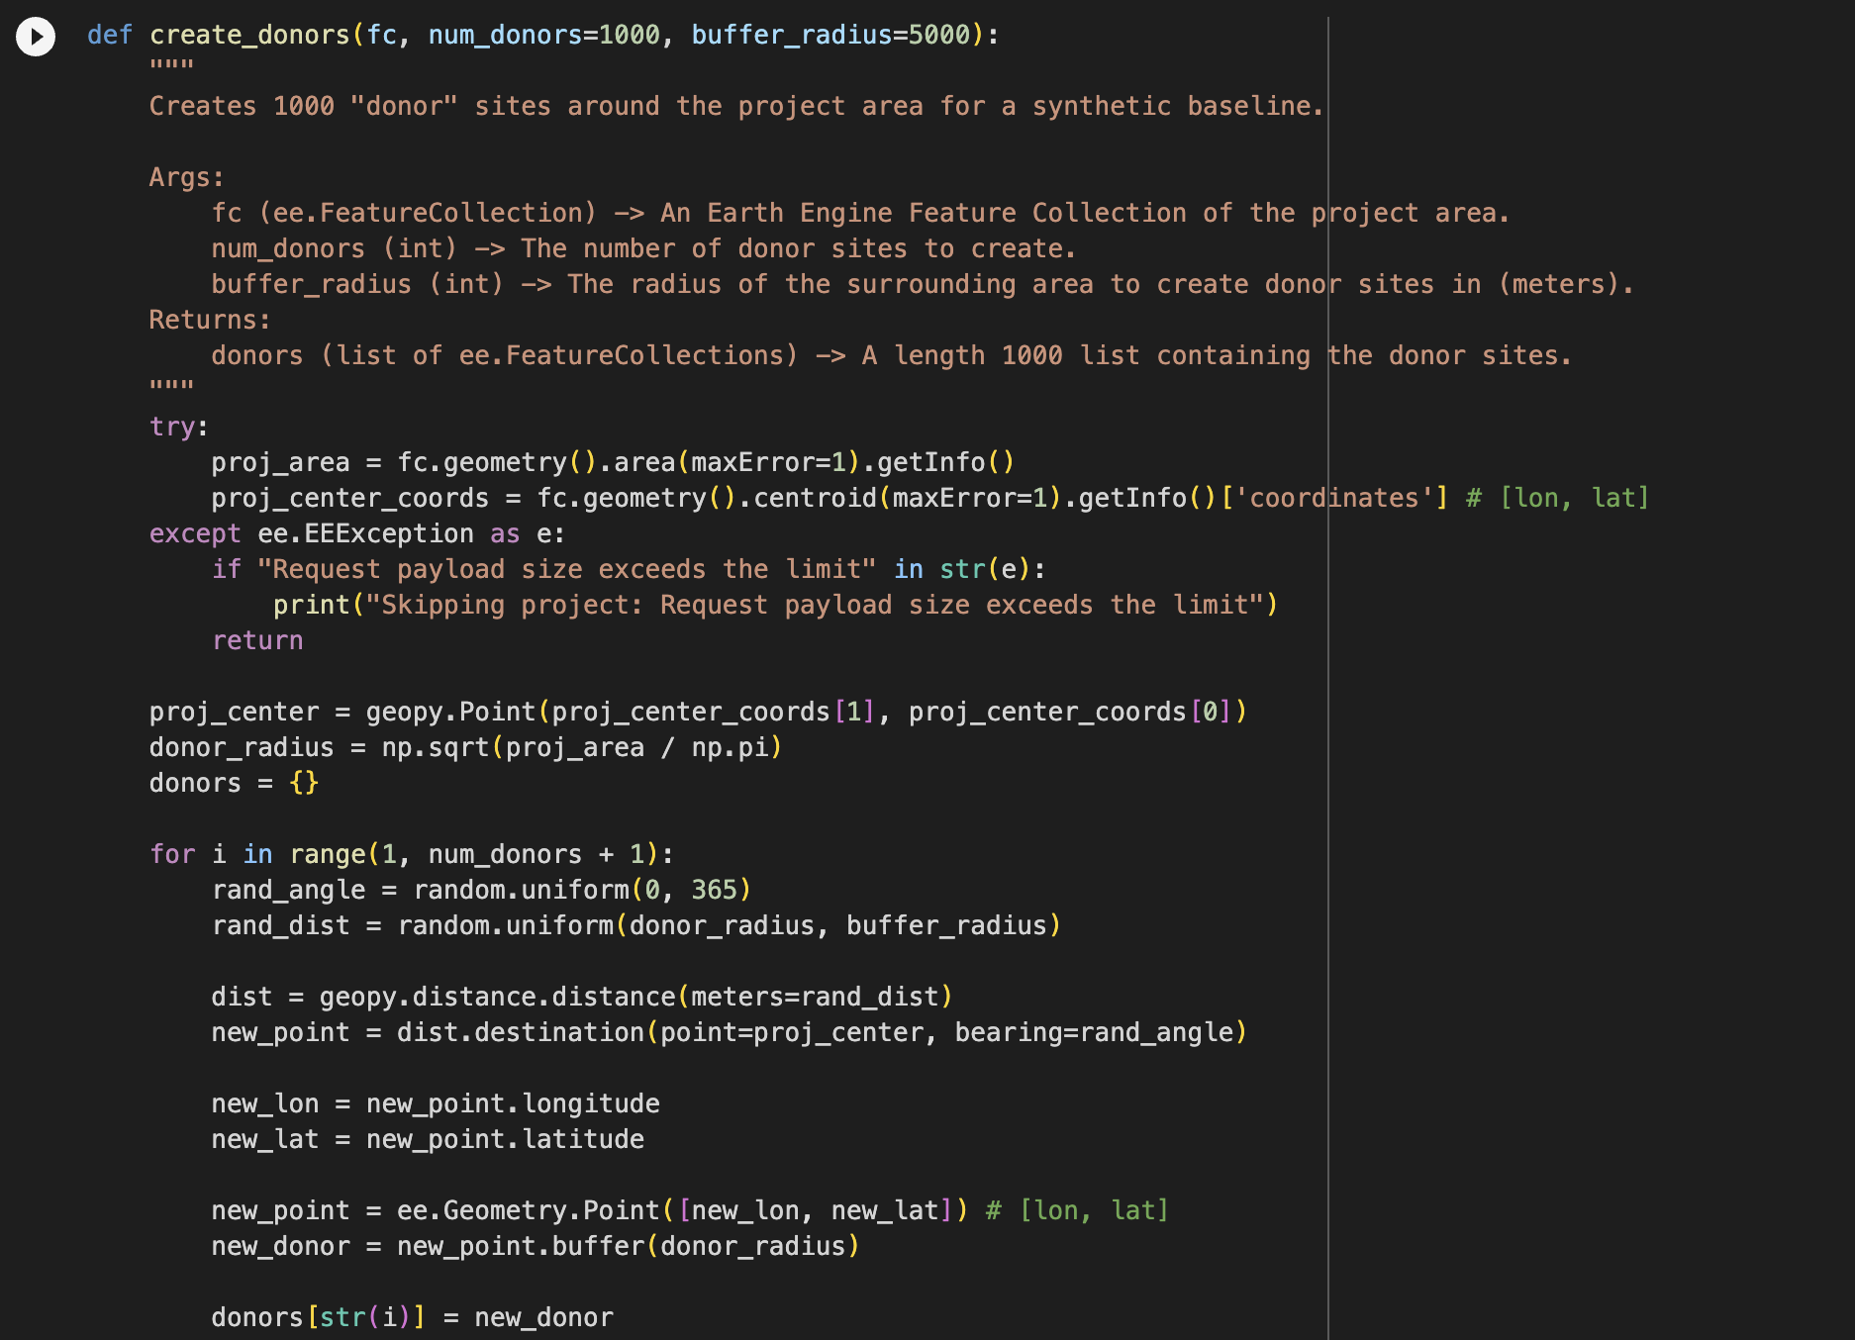
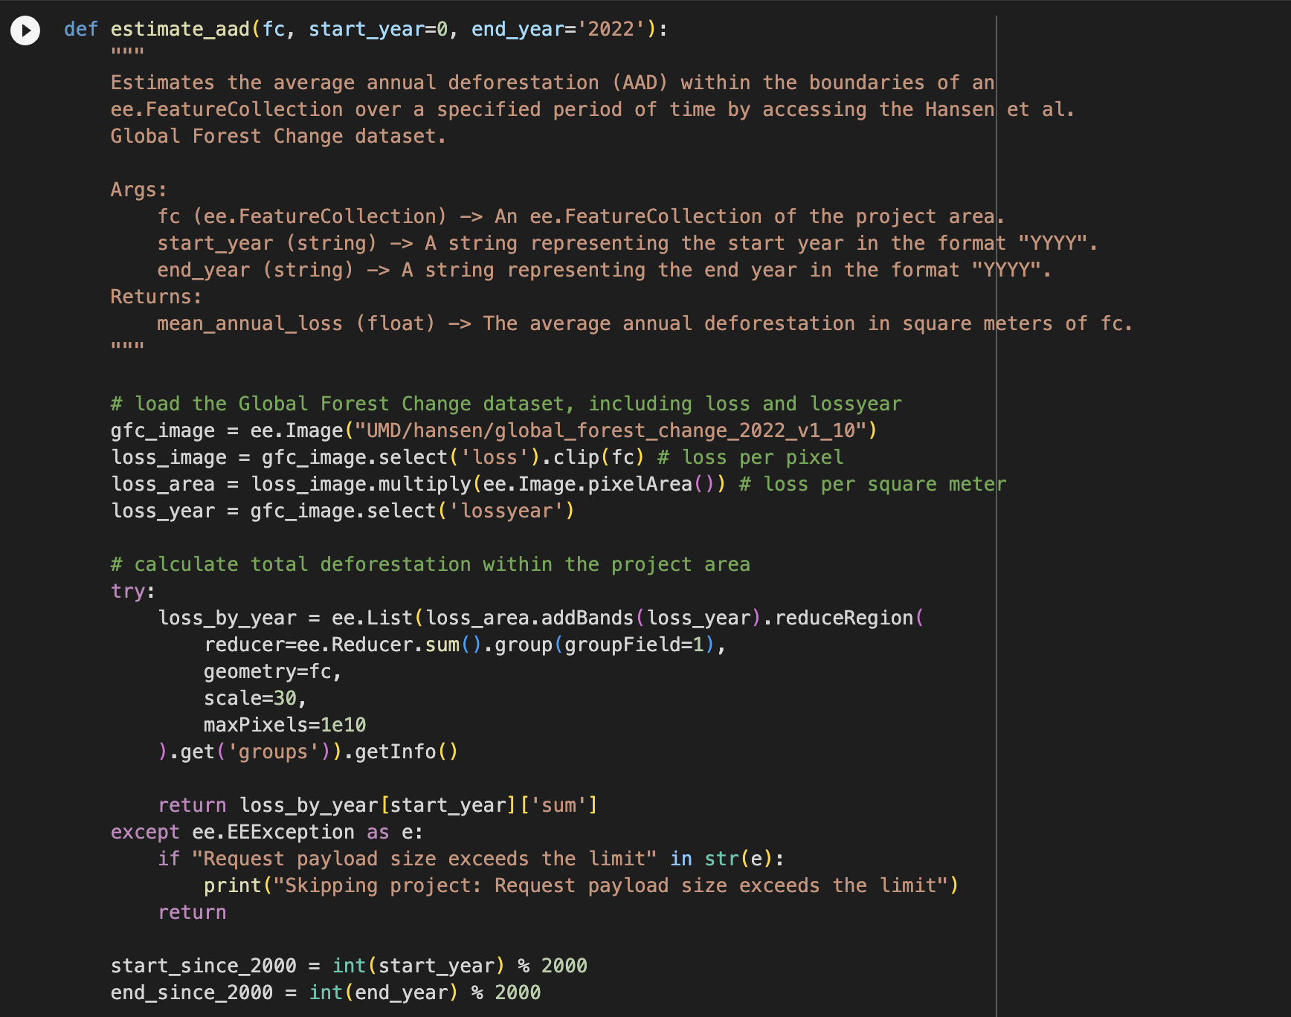
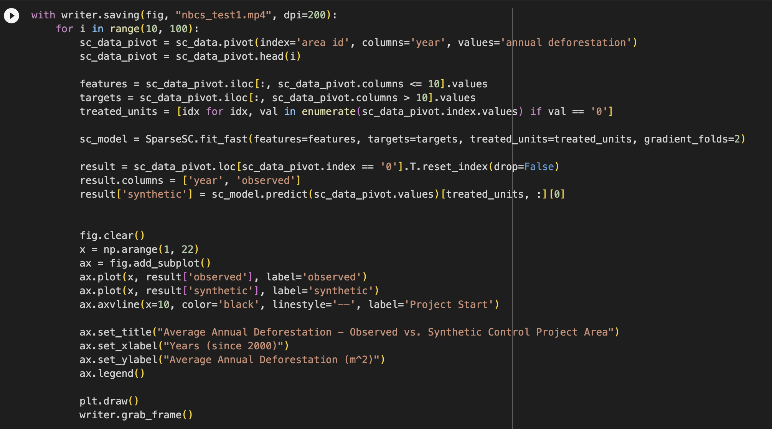

Slide 5
