Slide 1
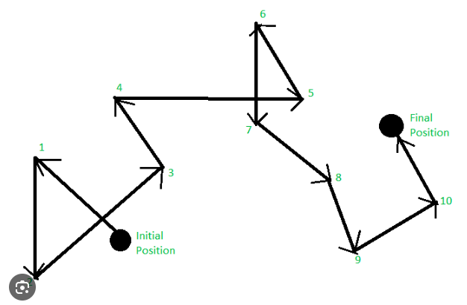
In-depth investigation of Random Walks
Amal Thiru
EPS 109

Slide 2
Regular random walk
Random walks are naturally programmed to be non self-avoiding i.e. a single random walk or two different random walks walks onto points that are already covered

Slide 3
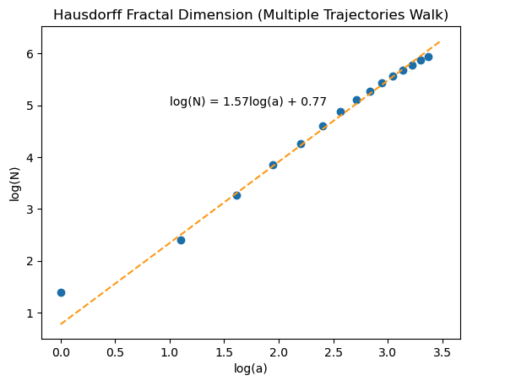
Self-Avoiding Random walk
Self Avoiding Random walks are more useful and come with a range of applications, such as modeling polymer chains, simulating DNA and RNA.
Faced challenges in ensuring they did not overlap
Hausdorff value was approximately 1.57 due to the increased density of higher chains.

Slide 4
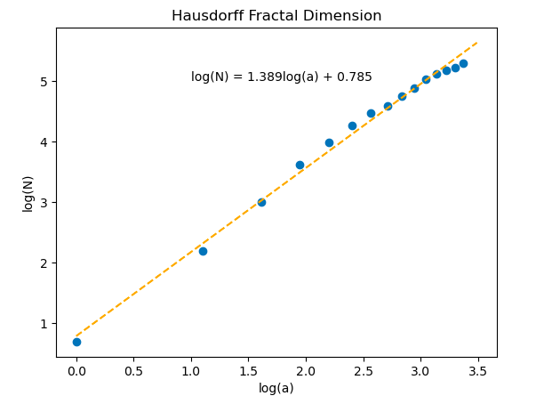
Hausdorff dimensionality
Used to measure the fractal dimensions of a set.
Calculated it by creating a box in the animation, and calculating the number of points in the box.
Calculating the linear regression coefficient to evaluate the hausdroff dimension.
Received a regression coefficient of 1.38, which was coherent with a research paper https://arxiv.org/abs/hep-th/9303055

