Slide 1
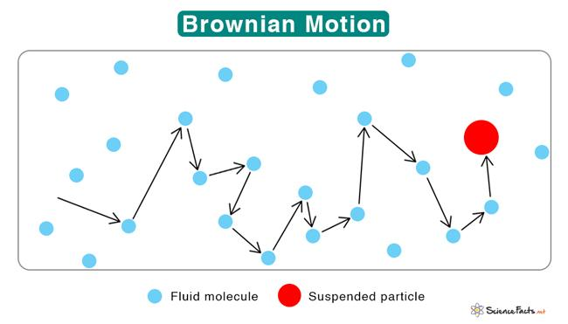
Brownian Motion Simulation
Angel Tu

Slide 2
Topic and Methods
Brownian motion is the random motion of particles suspended in a fluid (a liquid or a gas) resulting from their collision with the fast-moving atoms or molecules in the gas or liquid. This transport phenomenon is named after the botanist Robert Brown.
My simulation will show a dust particle (represented as a red circle) suspended in the air (air molecules will be represented as smaller blue circles)
I used FFmpeg to handle the video (homework 7)
I randomly initialized the starting position of particles (Homework 6)
I used molecular dynamics in my simulation

Slide 3
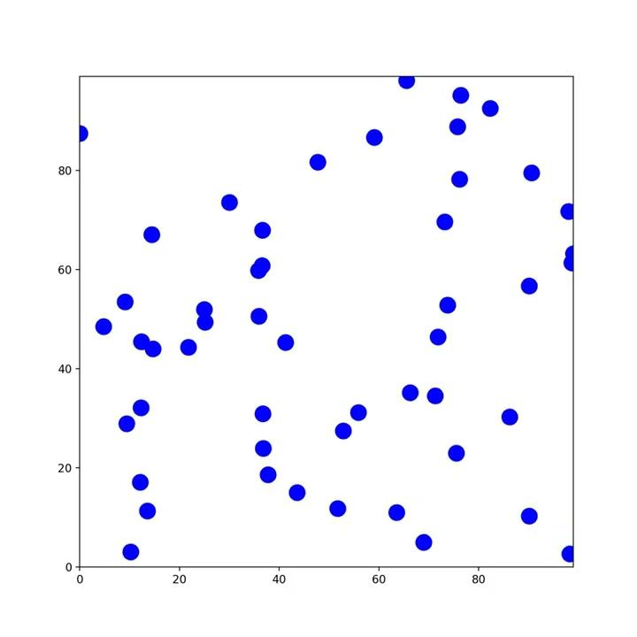
Motion of Air Molecules Before Inserting Dust

Slide 4
Brownian Motion

Slide 5
Reference
https://physics.bu.edu/~duffy/HTML5/brownian_motion.html

