Slide 1
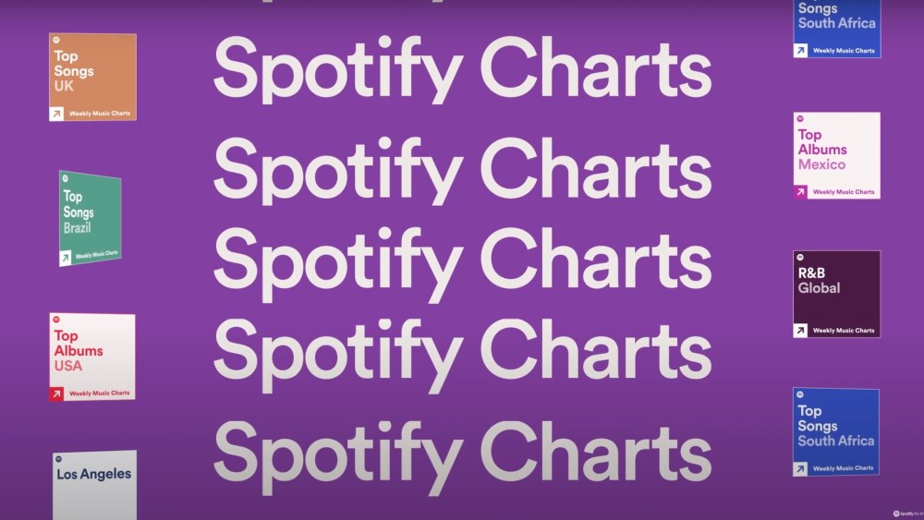
Generating 3-Word Song Titles with Random Walks and Analyzing Popular Songs from 2000-2023
Priya Venugopal

Slide 2
Overview of the Simulation + Methods Used
Source: most popular songs on Spotify from 2000-2023 Kaggle dataset
Simulation uses the concepts of random walks and Markov Chains to generate 3-word song titles based on randomness and a transition matrix mapping the probability of the current word to a proceeding word
Started by using pandas to scrape necessary information from Kaggle csv
Plotted interesting trends like most popular words in song titles, tracking said popular words by frequency per year, number of pop songs per year, most common BPM per year, frequency of genres per year
Used random walk simulation method to generate first word from list of unique words used in song titles
Determined next word in song title by creating a transition matrix that tracks the probability of seeing that unique word immediately after the chosen word
After grabbing all probabilities associated with the current word, use random walk to generate second word
Repeat this process for choosing third word
Visualized this entire process with histogram choice breakdowns for various 3-word generated song titles
Also created animations for some of the interesting trends mentioned above
Technologies used: NumPy, Matplotlib, pandas, re

Slide 3
Animation: Random Walks

Slide 4
Animation: Plotting Various Trends [Genre]

Slide 5
Animation: Plotting Various Trends [BPM, Popular Words]

