Slide 1
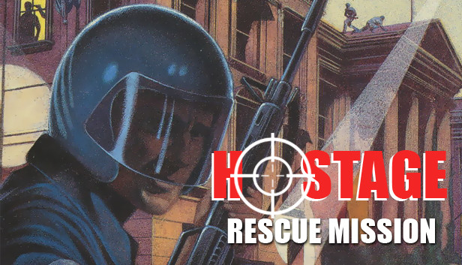
Search and Rescue Random Walks
By Alaysha Zarate
*Content warning* Imagery of guns in the presentation.

Slide 2
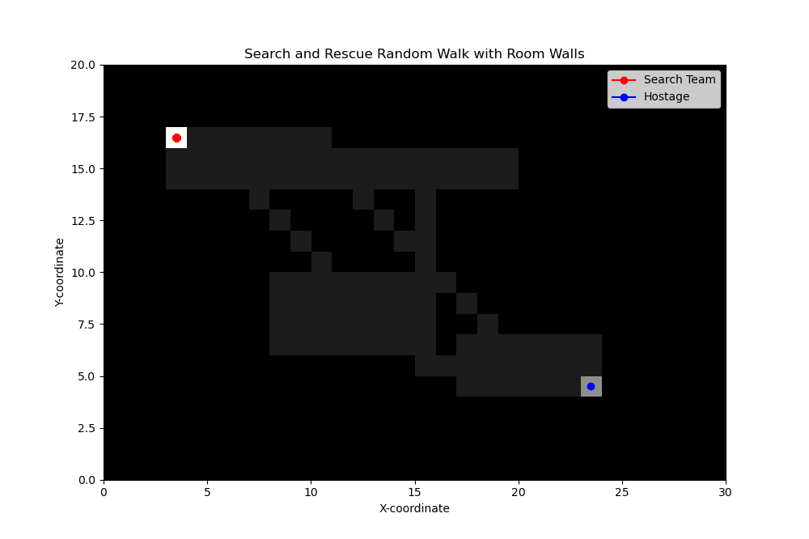
Methods
Objective
Implement many random walk strategies (change of likelihood of direction) to model the movement of a search team. The idea is to analyze the effectiveness and efficiency of different search patterns. The process only terminates once the hostage is found.
Discrete Random Walk:
A random walk in a discrete space involves making a series of discrete steps.
At each step, the walker randomly chooses a direction and takes a step in that direction.
2D Random Walk on a Grid with conditions:
The steps are up or down AND left or right.
There are 2 main conditions, only travel to the gray grids as black grids represent out of bounds.
Once the search team makes it to the coordinates of the hostage, the walk is over and there is a message that prompts that the search team rescued the hostage.
Randomized 2D Grid to create the floor plan:
Chose the number of rooms and coded up how to connect the rooms
Chose the farthest corners to be the different points where search team is in the top left corner and the hostage is in the bottom left corner
For the presentation, I chose to demonstrate the seed 106
Technology Stack:
Python
NumPy
Math
Matplotlib
FFMpegWriter
Animation

Slide 3
Animation

