Slide 1
A Simulation of the Earth’s Surface Temperature During the Snowball Earth
EPS 109 – Final Project
Youkang Zeng 11/29/2023

Slide 2
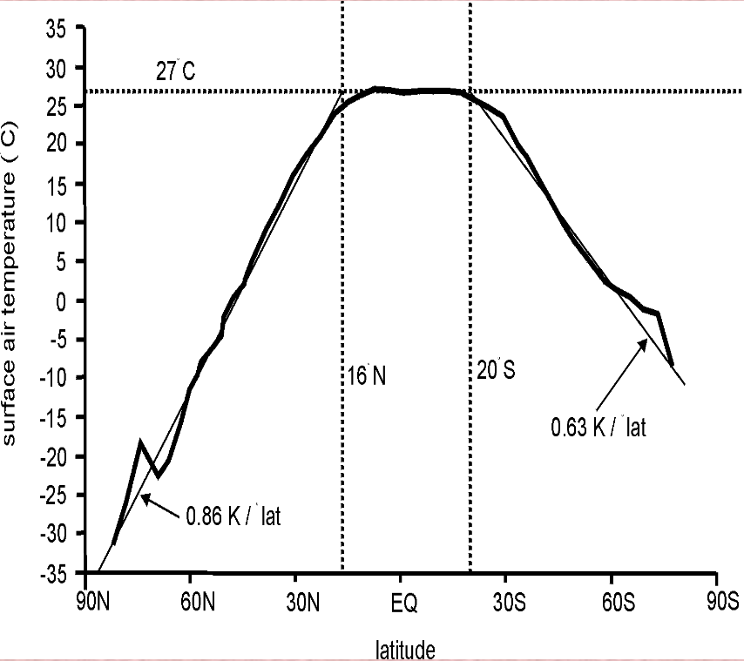
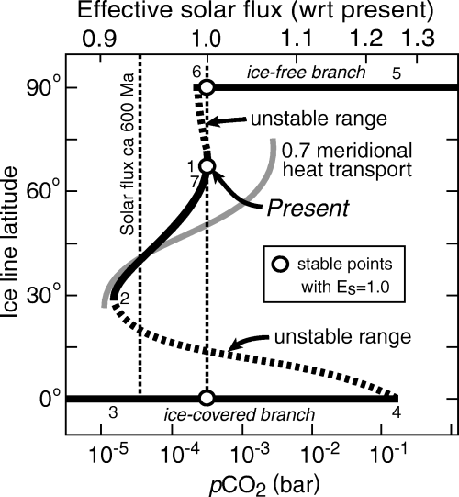
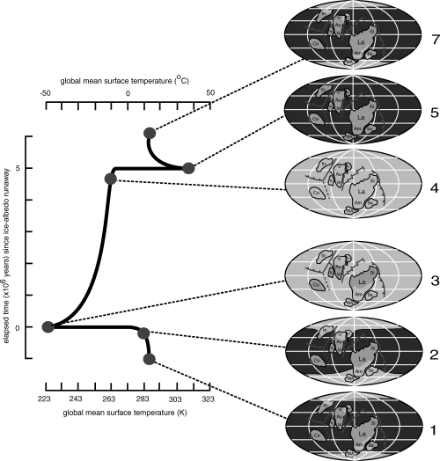
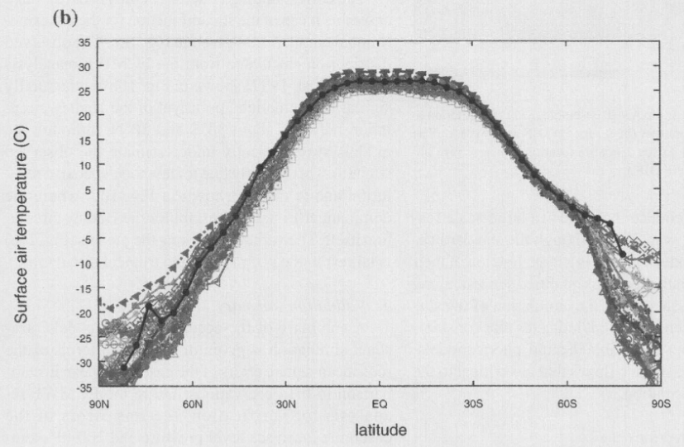
Stefan-Boltzmann Law: j* = σT⁴ ⇒ S(1 − α) = 4FσT⁴
S: solar constant α: planetary albedo F: transmission factor
σ: Stefan-Boltzmann constant T: temperature
(E. Linacre)
(P. Hoffman and D. Schrag, 2002)
(L. Gates, et al, 1999)

Slide 3
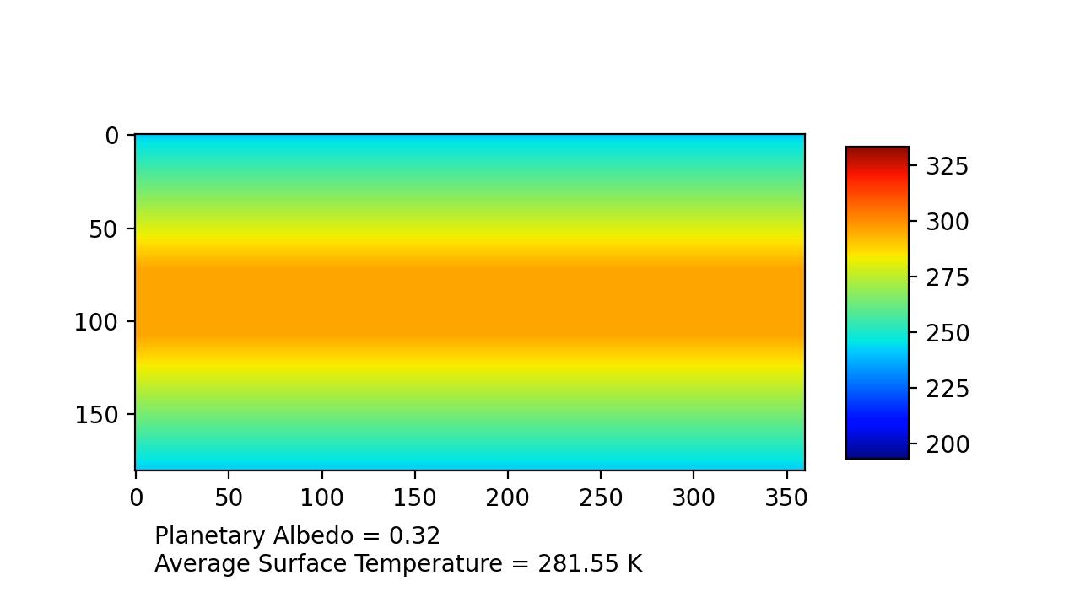
Surface Temperature

Slide 4
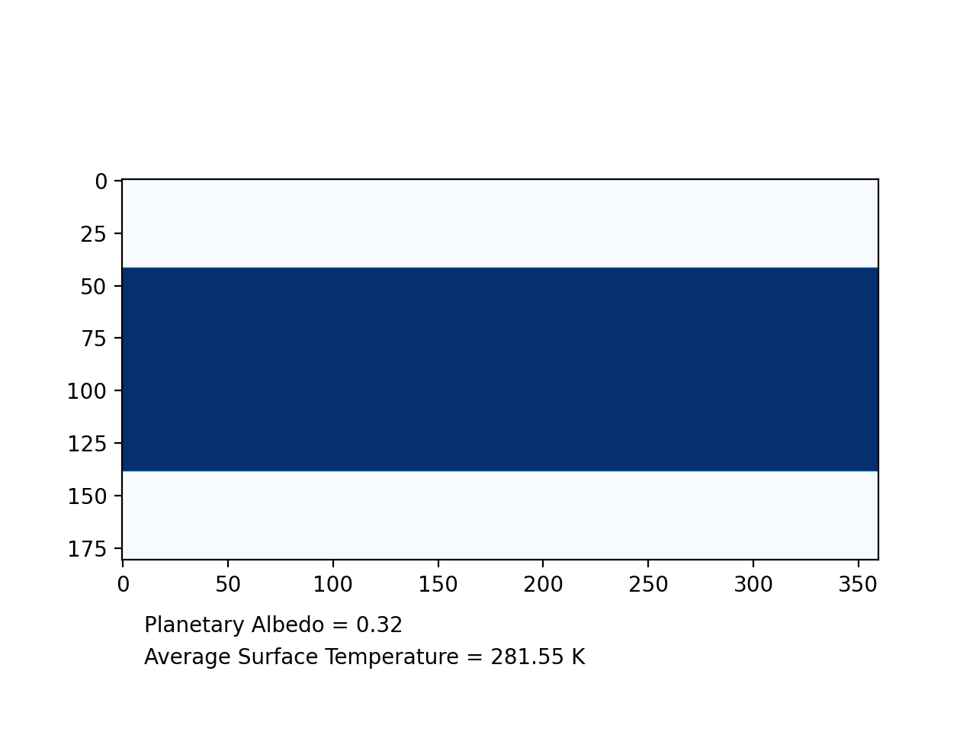
Ice Coverage

Slide 5
Reference
Gates, Lawrence, et al. “An overview of the results of the Atmospheric Model
Intercomparison Project (AMIP I).” Bulletin of the American
Meteorological Society, vol. 80(1), 1999, pp. 29-55.
Hoffman, Paul, and Daniel Schrag. “The Snowball Earth Hypothesis: Testing the
Limits of Global Change”. Terra Nova, vol. 14(3), 2002, pp. 129-55.
Linacre, Edward. “Geography and Climate.” University of Wyoming. http://
www-das.uwyo.edu/~geerts/cwx/notes/chap16/geo_clim.html.
UCAR Center for Science Education. “Calculating Planetary Energy Balance &
Temperature.” 2015. https://scied.ucar.edu/earth-system/planetary-
energy-balance-temperature-calculate.

