Slide 1
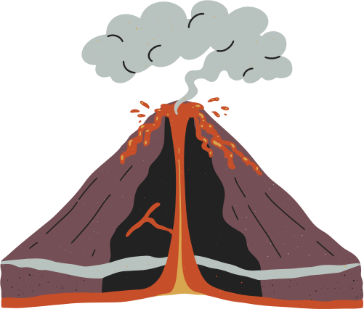


HARMONY OF NATURE:
HOW EARTHQUAKE - VOLCANO CORRELATE
BY YEONE KIM

Slide 2
METHOD
  Import and modified volcanic eruption data from Smithsonian Institution National Museum of Natural History Global Volcanism Program
    https://volcano.si.edu/search_eruption.cfm
  2D plotting on a world map
  Dividing a whole world to 4 places - N.America/Asia/Europe&Africa/S.America
  Earthquakes
    Catalog of all earthquake from 2013 to 2023.
  Volcanoes
    used eruption data to plot all volcanoes in that period
    volcanoes caused by earthquakes
      using nested for loops to find volcanoes that might have been erupted caused by an earthquake
              research paper: Which earthquake can trigger a volcanic eruption?
        within in 5 months and 80 km

Slide 3

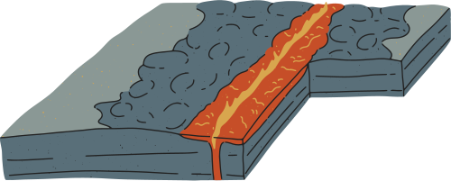



DOES EARTHQUAKES AND VOLCANOES CORRELATE?
DESCRIPTION:
I always thought there’s a correlation between earthquakes and volcanoes but I didn’t know how much they correlate
With data I have... No correlation!
  might think that is because of length of the time period
I referenced a research paper: Which earthquake can trigger a volcanic eruption?
The percent I got is: ~ 1.4%

Slide 4
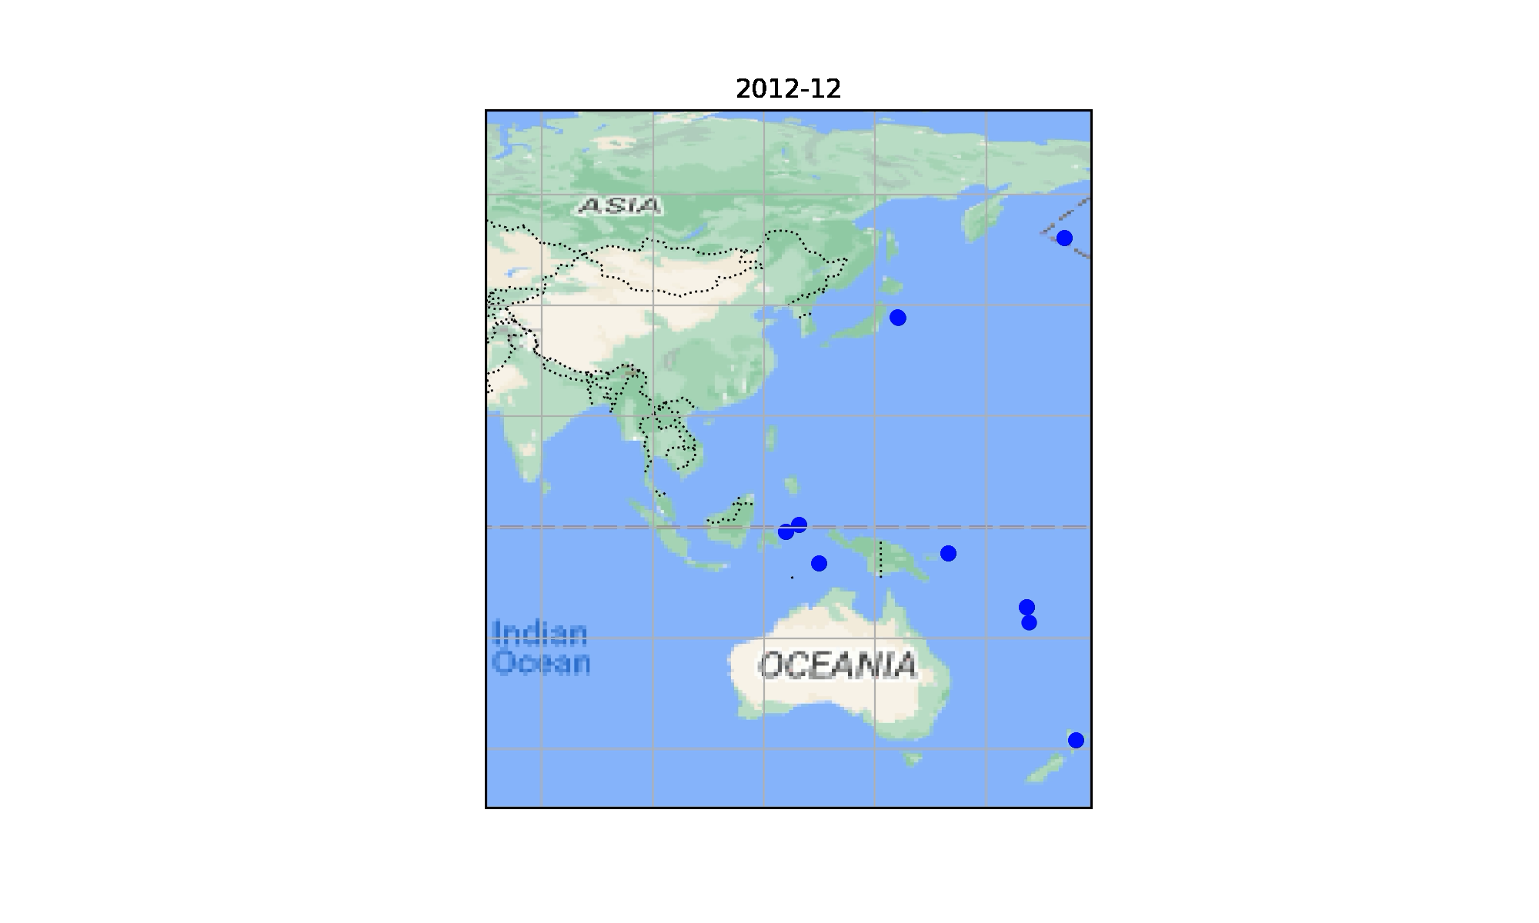
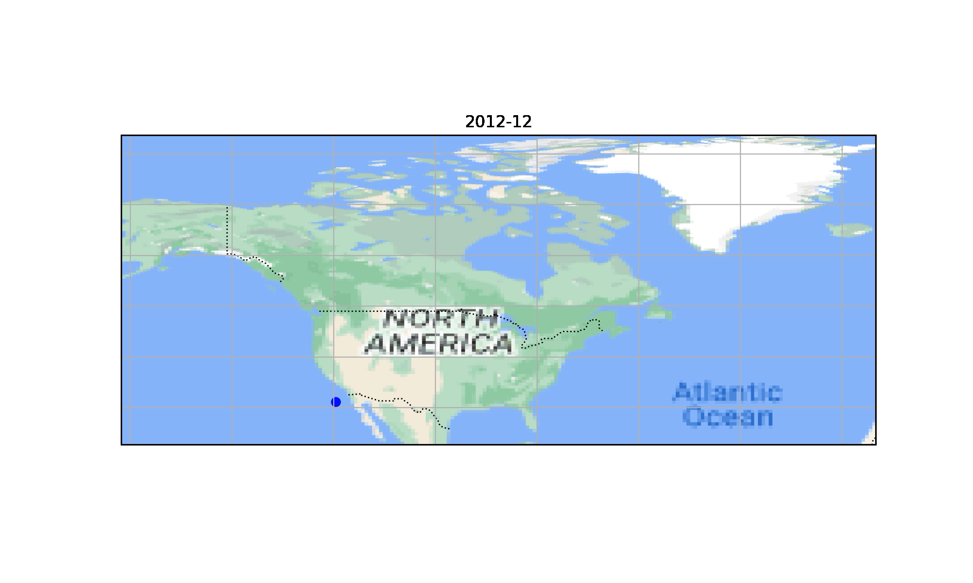
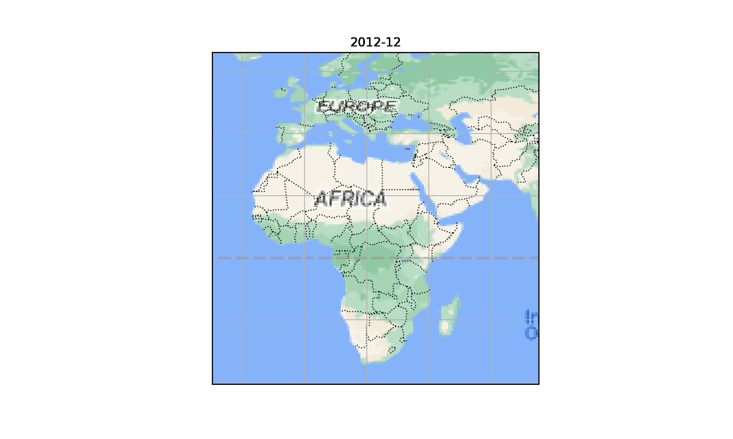
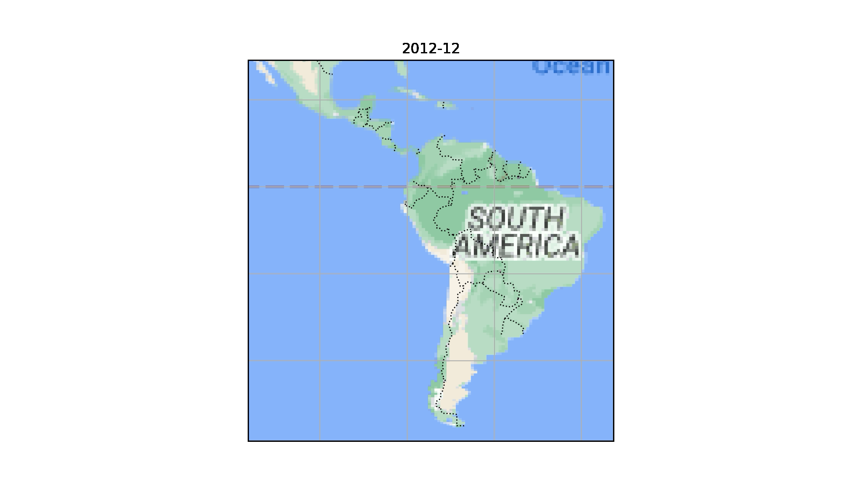
Asia
N.America & Greenland
Europe & Africa
S.America

Slide 5
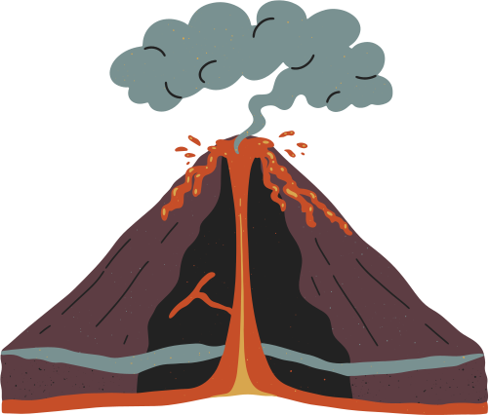


THANK YOU!
Any questions? :)
Slides template: Canva, made by Dream Bird Designs, “Exploring Volcanoes Earth Science Education Presentation Organic Semi-lined Style”, modified

