Slide 1
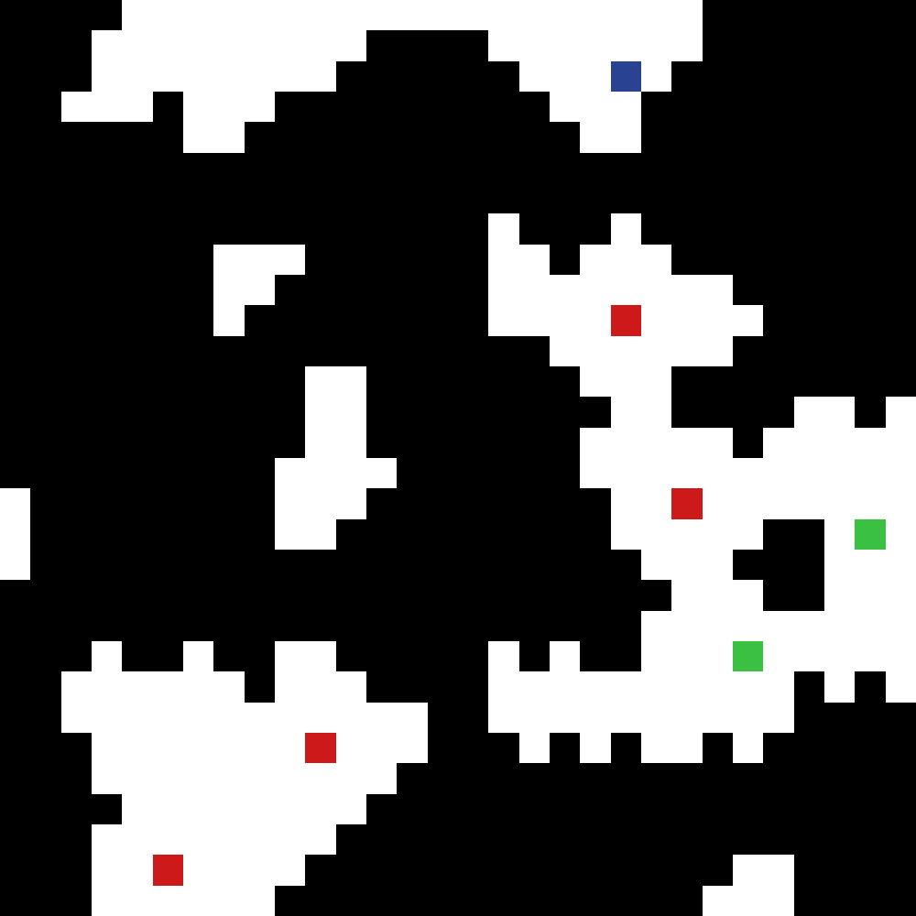
Procedural Generation Using The Wave Function Collapse Algorithm
Sage Aguina-Kang

Slide 2
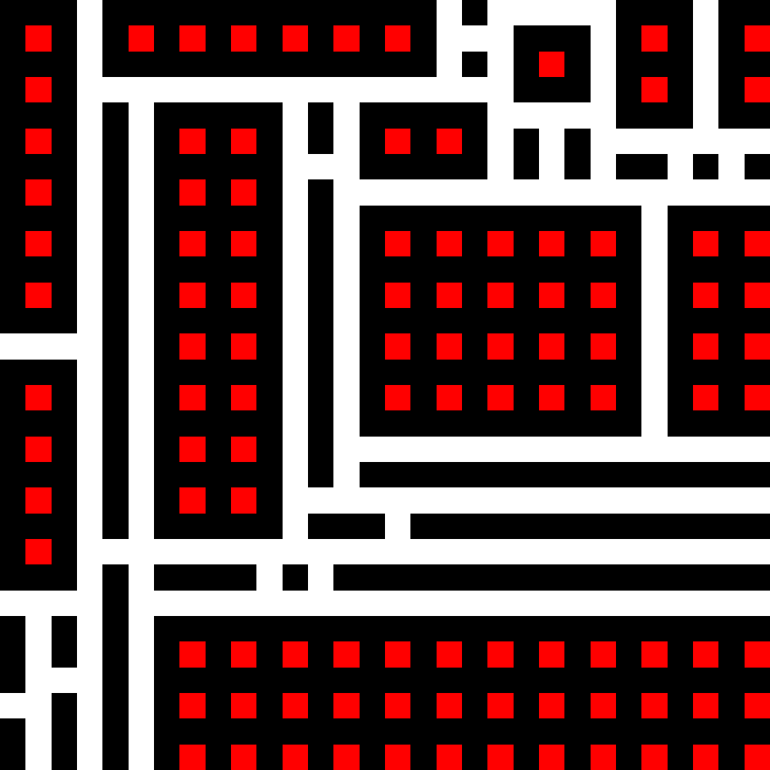
A bit of background on WFC
This program goal is to generates bitmaps that are local similar to the input bitmaps
mostly used numpy, pillows, and matplotlib
*disclaimer* the algorithm I am using does not simulate a genuine wave function collapse in quantum physics.
The term 'wave function collapse' was coined by the algorithm's creator, Maxim Gumin,
as a loose reference to the original phenomenon.

Slide 3
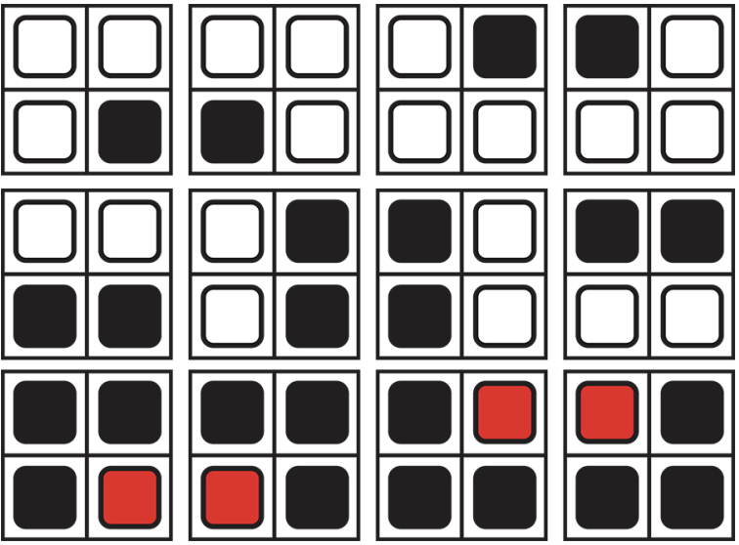
Getting the Patterns
For this 4x4 image sample, If N = 2 and we accounted for all rotations and reflections, we would have 12 unique patterns as seen on the right
Figure made by Isaac Karth and Adam M. Smith

Slide 4
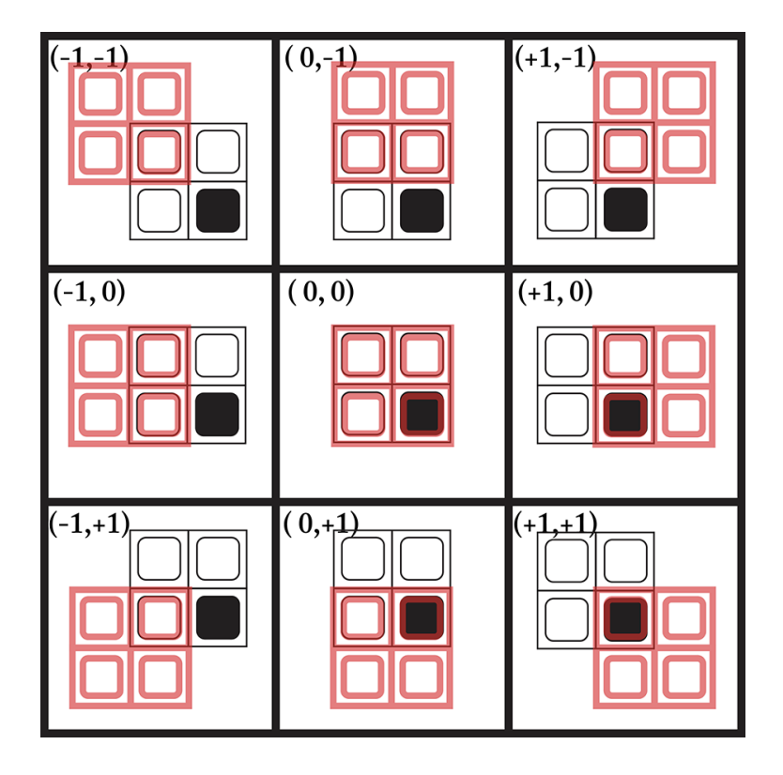
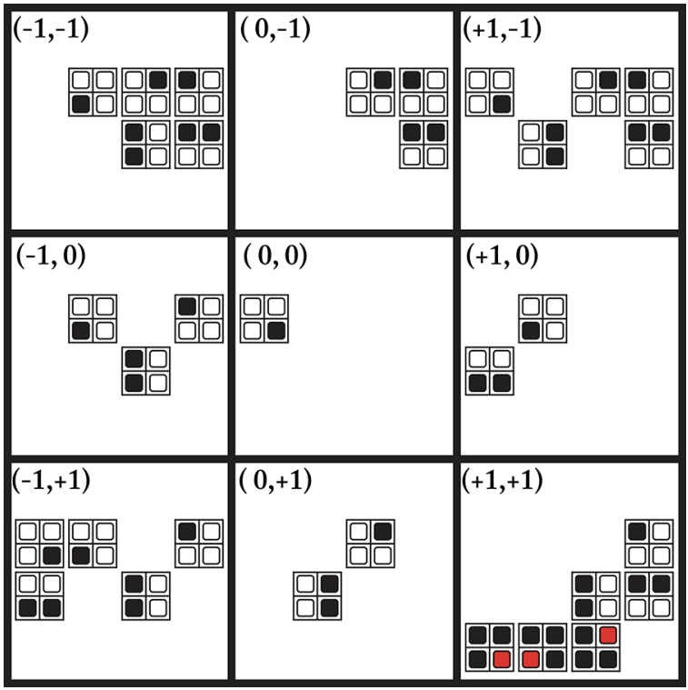
Overlapping
The overlapping method is then used to establish the constraints for each individual pattern!
Figures made by Isaac Karth and Adam M. Smith

Slide 5
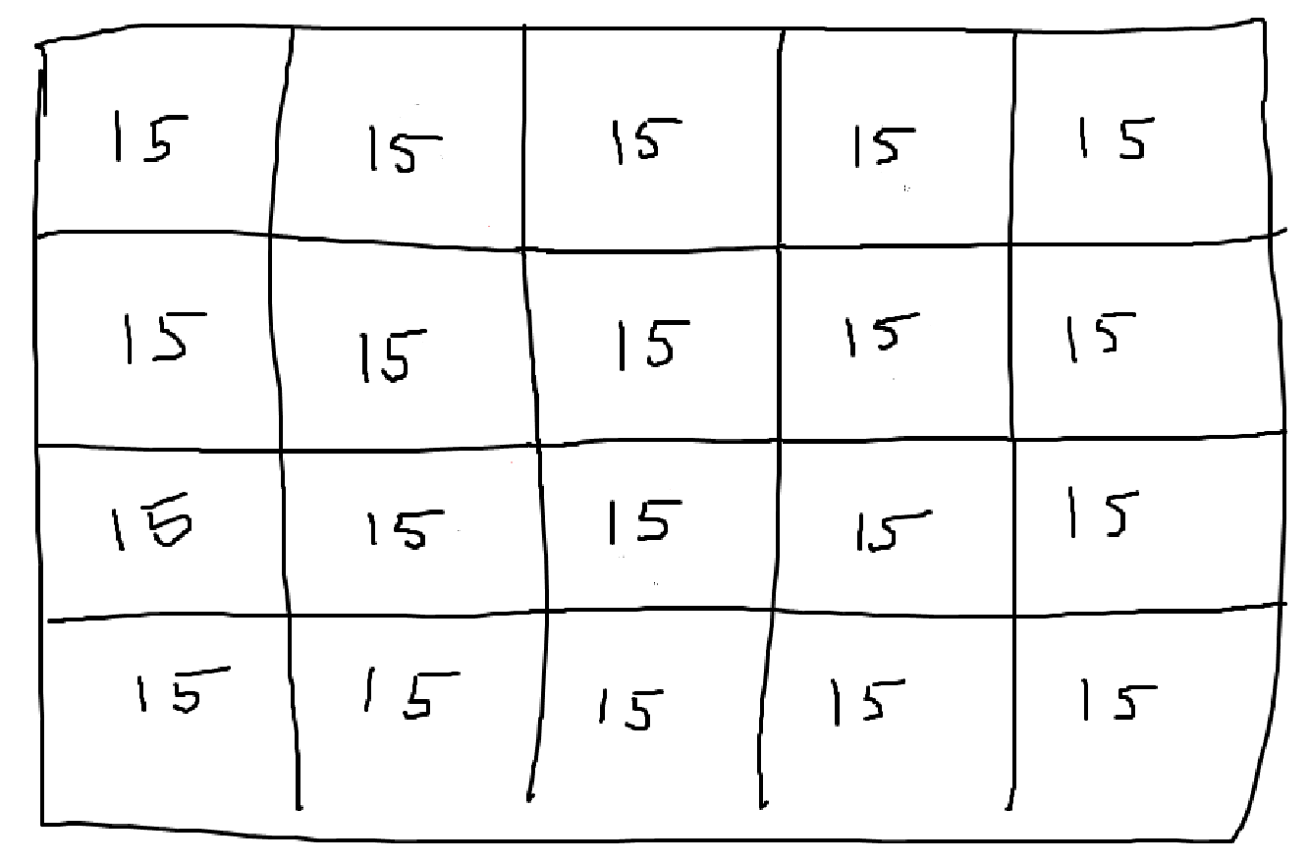
Setup!
We set up a grid which will represent our output bitmap!
Our grid is in a completely unobserved state, so each cell has the max amount of entropy!

Slide 6
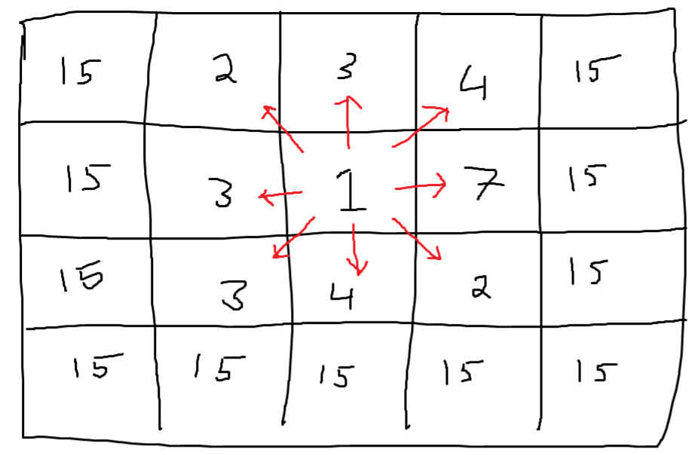
Observe and Propagate
We then observe a cell with the lowest entropy and collapse it to a definite state.
- (initially since every cell has the same entropy it will select a random one)
Once a cell has collapsed, we propagate this information to the neighboring cells.
This process of observe and propagate will repeat until all cells have collapsed!
*disclaimer* the image above might not be accurate! It’s just a quick example to help you wrap your head around the idea

Slide 8
Sample
N = 3

Slide 9
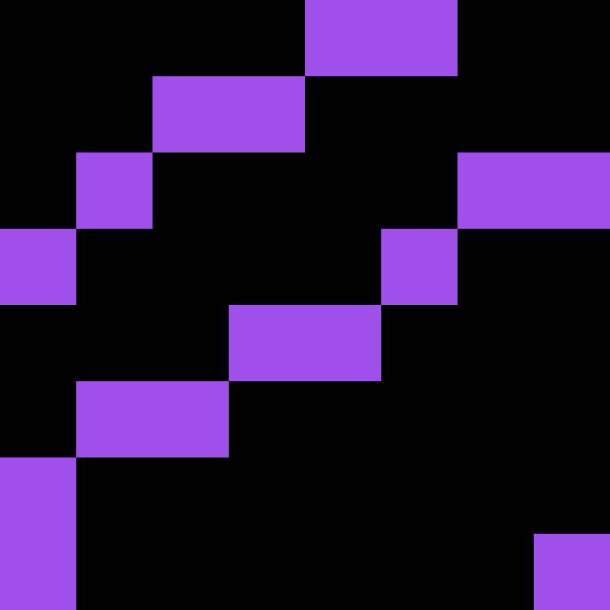
Sample
N = 3, Rotated, and Reflected

Slide 10
Works Cited and Resources
https://github.com/mxgmn/WaveFunctionCollapse
(Original Git Repo by Max Gumin)
https://github.com/avihuxp/WaveFunctionCollapse
(Avihu Almong repo! He has a very clear explanation of the WFC! I also used his method of exporting the WFC to a video).
Isaac Karth, Adam M. Smith, "WaveFunctionCollapse is Constraint Solving in the Wild," In Proceedings of the Eighth Workshop on Procedural Content Generation (PCG2017), 2017.
(Used their diagrams for some of my slides. I would recommend to read if you want to make your own implementation of the WFC).
https://robertheaton.com/2018/12/17/wavefunction-collapse-algorithm/
Also, a good read if you want to get started with the very basics of WFC

