Slide 1
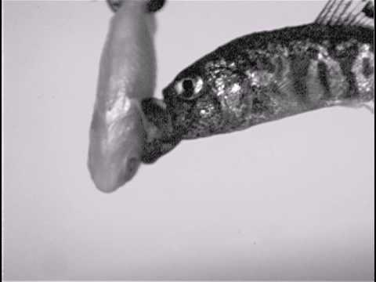
Fitness Landscape:
Pupfishes’
Adaptive Walk
Cyprinodon desquamator
How Bimodal Distribution of Jaw Morphology Can be Selected for Under Disruptive Selection
Ellington Chen

Slide 2
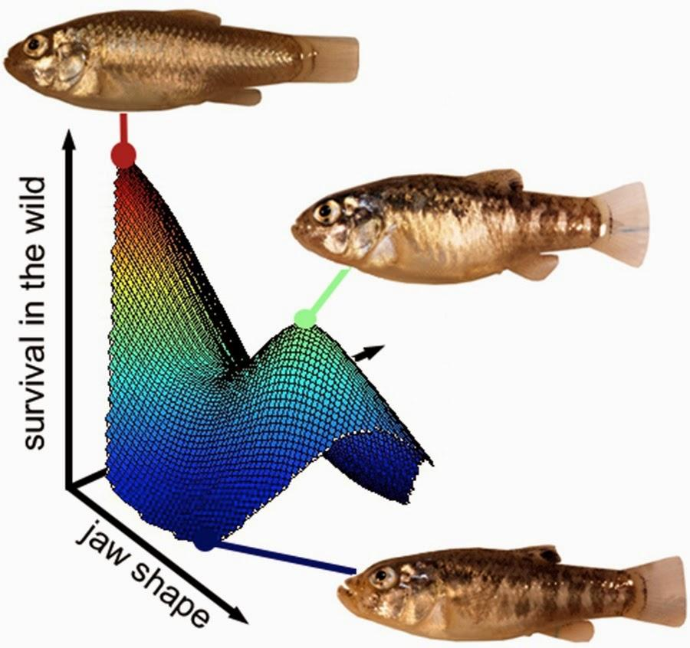
What is a Fitness Landscape?
Maps different combinations of individual’s traits that confer varying degrees of fitness
Traits tend to exist on a spectrum
Proximity is proportional to separation by mutations

Slide 3
Methodology
01
02
03
04
Erosion Model
Mathematical Randomizer
Mountain-fitness landscape corollary
Random Walk Probability Based on Normalized Gradient
Reiteration
Plotting
Many Independent Lineages Mapped over hundreds of generations

Slide 4
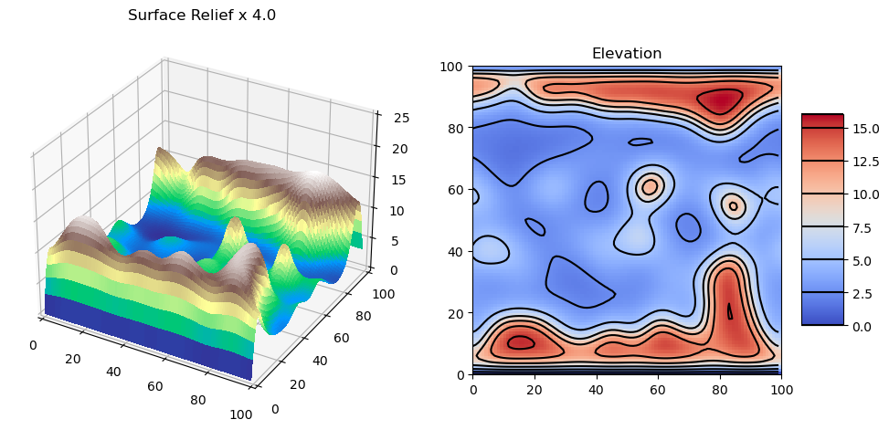
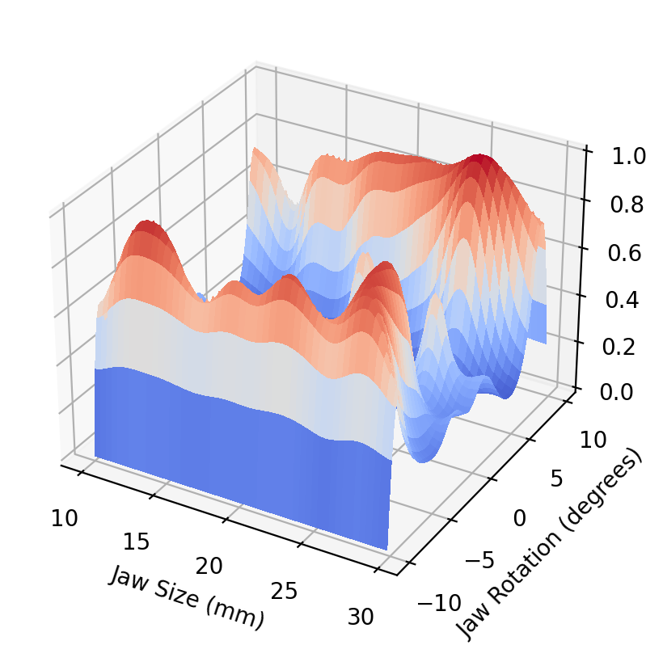
Erosion Model
Large K, Small m, large n => produce steeper terrain with fewer mountains
Normalize height to a max value of 1

Slide 5
Probability Determinant
def Normalize(F,B,L,R):
total = abs(F) + abs(B) + abs(L) + abs(R)
F = F/total
B = B/total
L = L/total
R = R/total
total = abs(F) + abs(B) + abs(L) + abs(R)
F += 1
B += 1
L += 1
R += 1
total = abs(F) + abs(B) + abs(L) + abs(R)
F /= total
B /= total
L /= total
R /= total
return F,B,L,R
Normalize surrounding fitness gradients so that they add up to an absolute value of 1
Bias probability in favor of steeper (+) gradients and disfavor steeper (-) gradients
Normalize to 1 again.

Slide 6
Iterating
Variables:
# of lineages
# of generations
Starting point

Slide 7
01
1 Lineage, 10000 Generations,
Starting Point: Middle

Slide 8
02
5 Lineage, 10000 Generations,
Starting Point: Middle

Slide 9
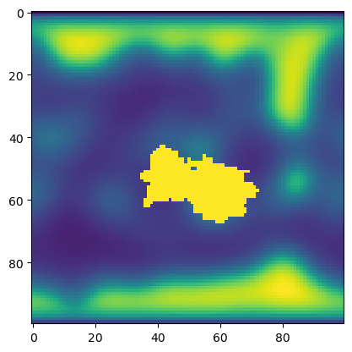

Slide 10
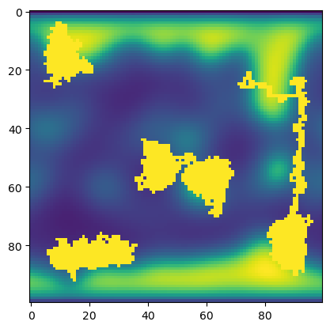
03
5 Lineage, 10000 Generations,
Starting Point: Varying

Slide 11
Key Takeaways
Evolution tends towards the highest level of fitness
[All Simulations]
Lineages can get ‘locked’ on phenotypes that are relative peaks, even if they aren’t absolute peaks of fitness
This leads to diversity [Simulation #2,3]
It is rare, but possible for lineages to move from one peak to another [Simulation #1]

