Slide 1
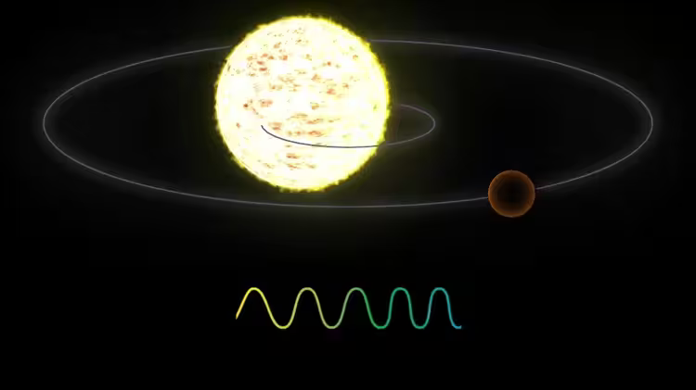
The Effect of Undetected Planets on RV Measurements
Anmol Desai

Slide 2
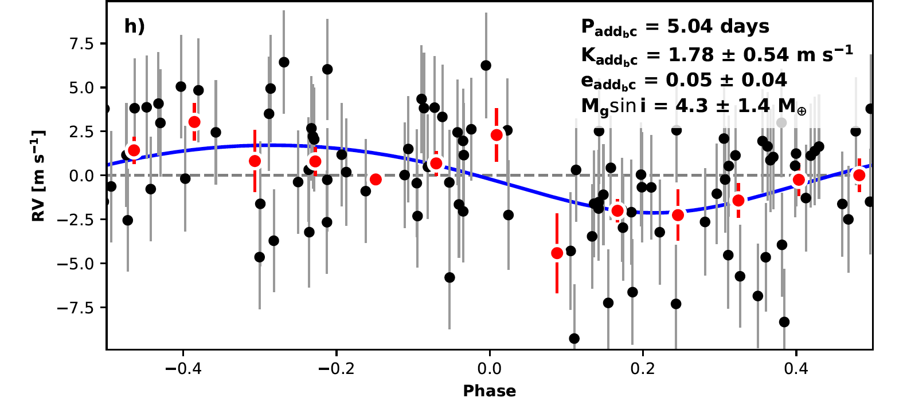
Radial Velocity Method
Used to measure minimum planet mass as well as detect non-transiting planets
Measure movement of host star and use Doppler shift to measure its velocity
Use RadVel python package to fit data for properties of planets

Slide 3
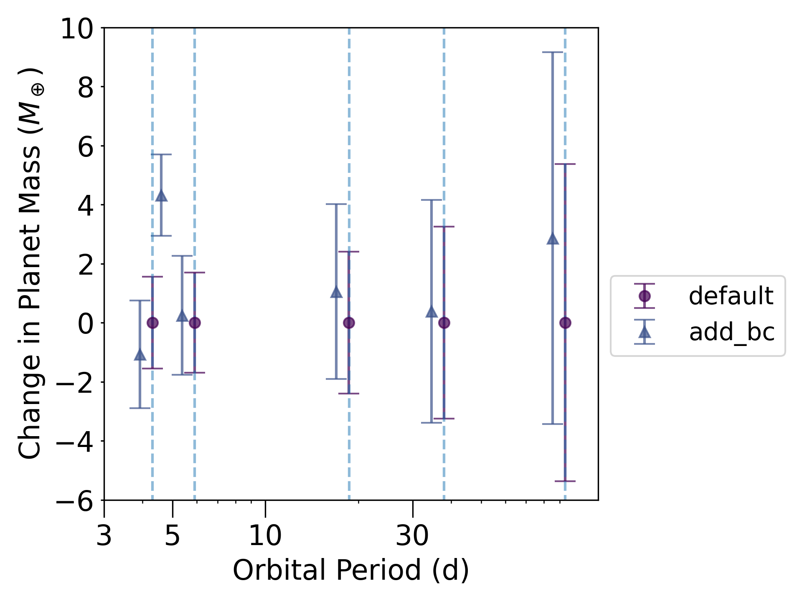
TOI-1246 System and Undetected Planets
4 confirmed transiting planets (Turtelboom et al. 2022)
Perform radial velocity fits, each time adding planets in between each confirmed planet, and determine mass change
How much do undetected planets affect our conclusions about planet mass and subsequent properties?

