Slide 1
Mimas and the Formation of the Cassini Division
Brian Harris

Slide 2
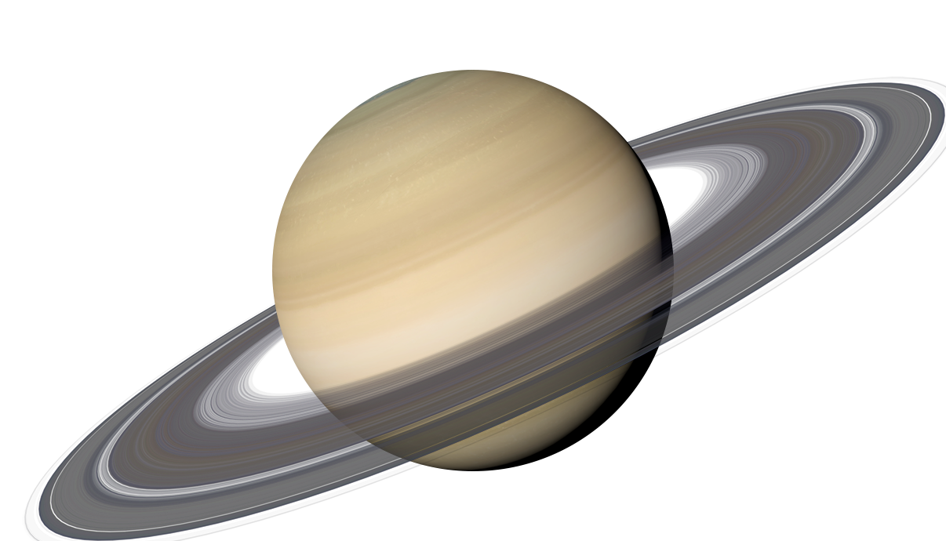
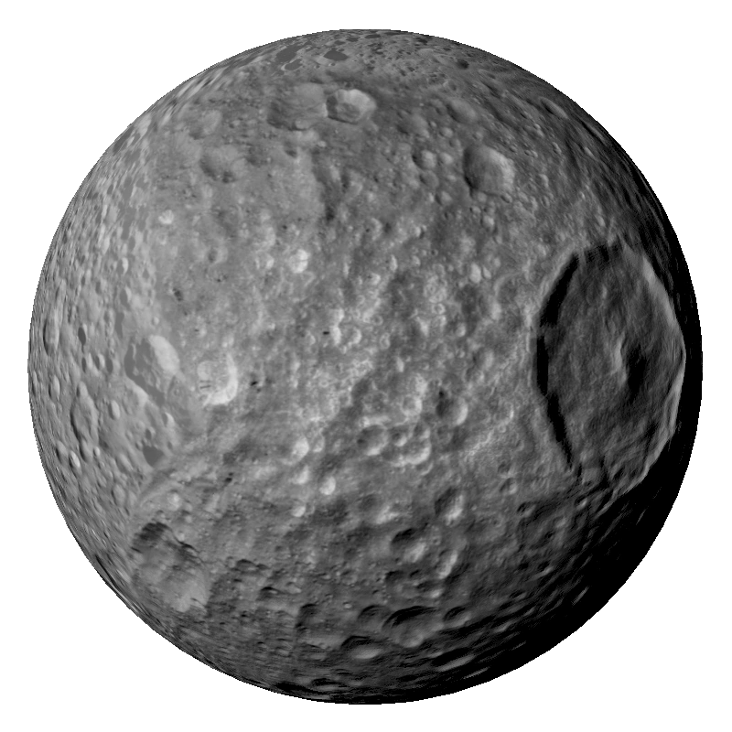
Topic and Methods Applied:
Simulation of Saturn, Saturn’s rings, and Saturn’s moon Mimas
Visualizes the formation of the Cassini Division when ran for a long time
Solves ordinary differential equations based on the KeplerODE from HW11
One ODE for Saturn and Mimas, a second ODE applies to all ring particles
Ring particles do not interact
Thank you to Jizhou Wu for all the debugging help

Slide 3
Animation 1 - Saturnian System Simulation

Slide 4
Animation 2 - Mimas with Exaggerated Mass
Mass of Mimas = 1e+5 Mimas Masses

Slide 5
Animation 3 - Formation of the Cassini Division
Mass of Mimas = 1e+4 Mimas Masses

