Slide 1
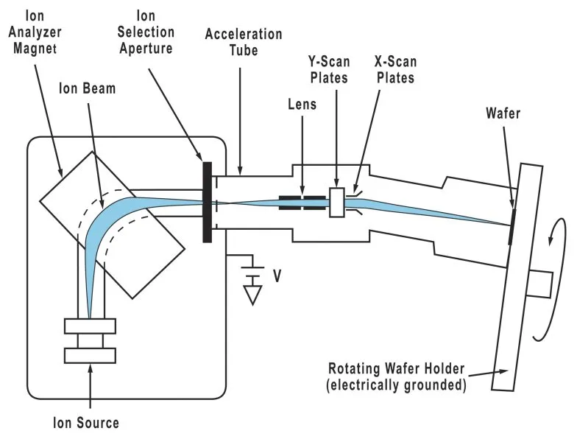
Modeling Ion Implantation for Semiconductor Manufacturing
Vedang Joshi

Slide 2
What is Ion Implantation?
Doping: Introducing impurities to increase or decrease the number of free electrons in the lattice.
Ion Implantation uses particle accelerator technology to achieve precise doping.
Ion Implantation can be modeled as a Diffusion Limited Aggregation problem with elastic collisions.
In order to improve runtime, I used Numba to optimize numpy operations.

