Slide 1
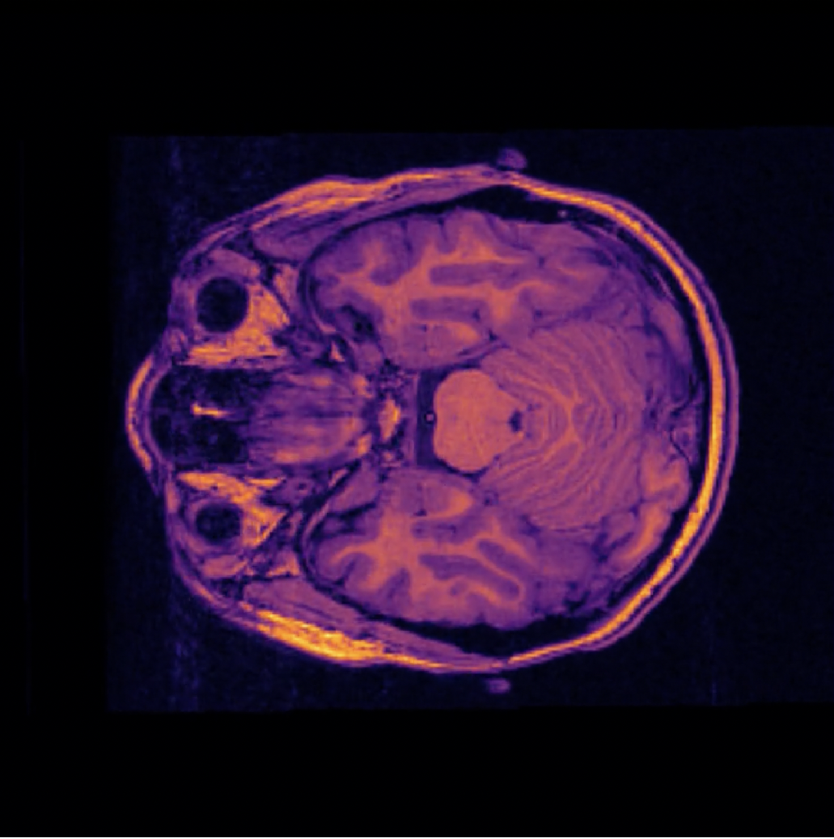
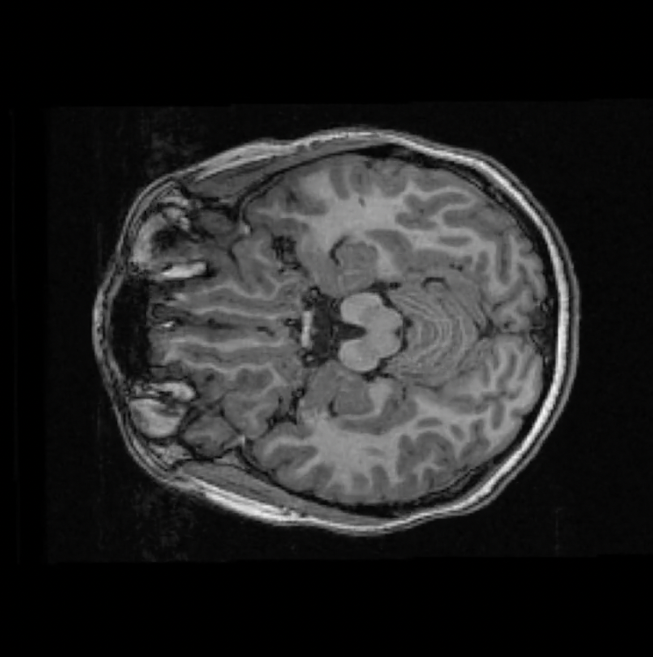
Simulating Brain Scans using 2D Animations
By: Namita Khanchustambham

Slide 2
Project Goals and Methods
Topic: The topic of my final project is investigating brain scans taken by an MRI.
Goal: My goal is to create a simulation of the brain scan that depicts each phase of the brain throughout duration of the MRI scan.
Methods:
Import two data sets from “https://openneuro.org/datasets/ds002424/versions/1.2.0”
Stitch together all the 2D brain scan images in both the data sets using Image Processing
Loop through the first data set to create a mp4 file that contains 2D animation
Modify the first data set to present the images with different variations of color by creating a new color map
Loop through the modified data set to create a mp4 file that contains another 2D animation
Using both the data sets, loop through both of them to create a 2D comparison animation where you can compare two different brain scans, both distinct colors, side by side

Slide 3
Original Animation

Slide 4
Color Modified Animation

Slide 5
Comparison Animation

