Slide 1
Wild Fire Simulation
in High Latitude Area
with Cellular Automation
生态优先 绿色发展
By Siyan Liu

Slide 2
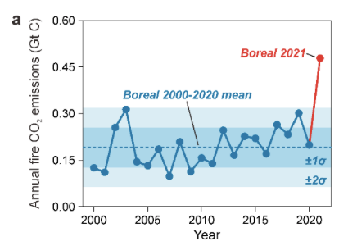
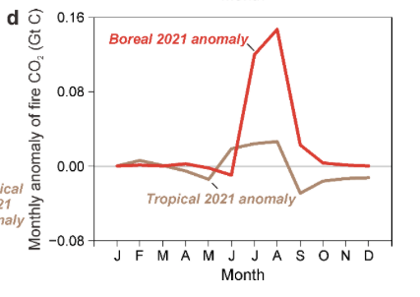
Background & Objectives
Simulation Method:
Cellular automation (random walk)
Objectives:
Simulate wildfire in boreal area
Discuss the influence of wind speed
ecosystem with strong carbon sink function
directly
massive carbon emission
indirectly
weaken the carbon sink capacity of ecosystem
Open Method: each .ipynb file is a kind of scenario, all of them need the file “wildfire function.py”

Slide 3
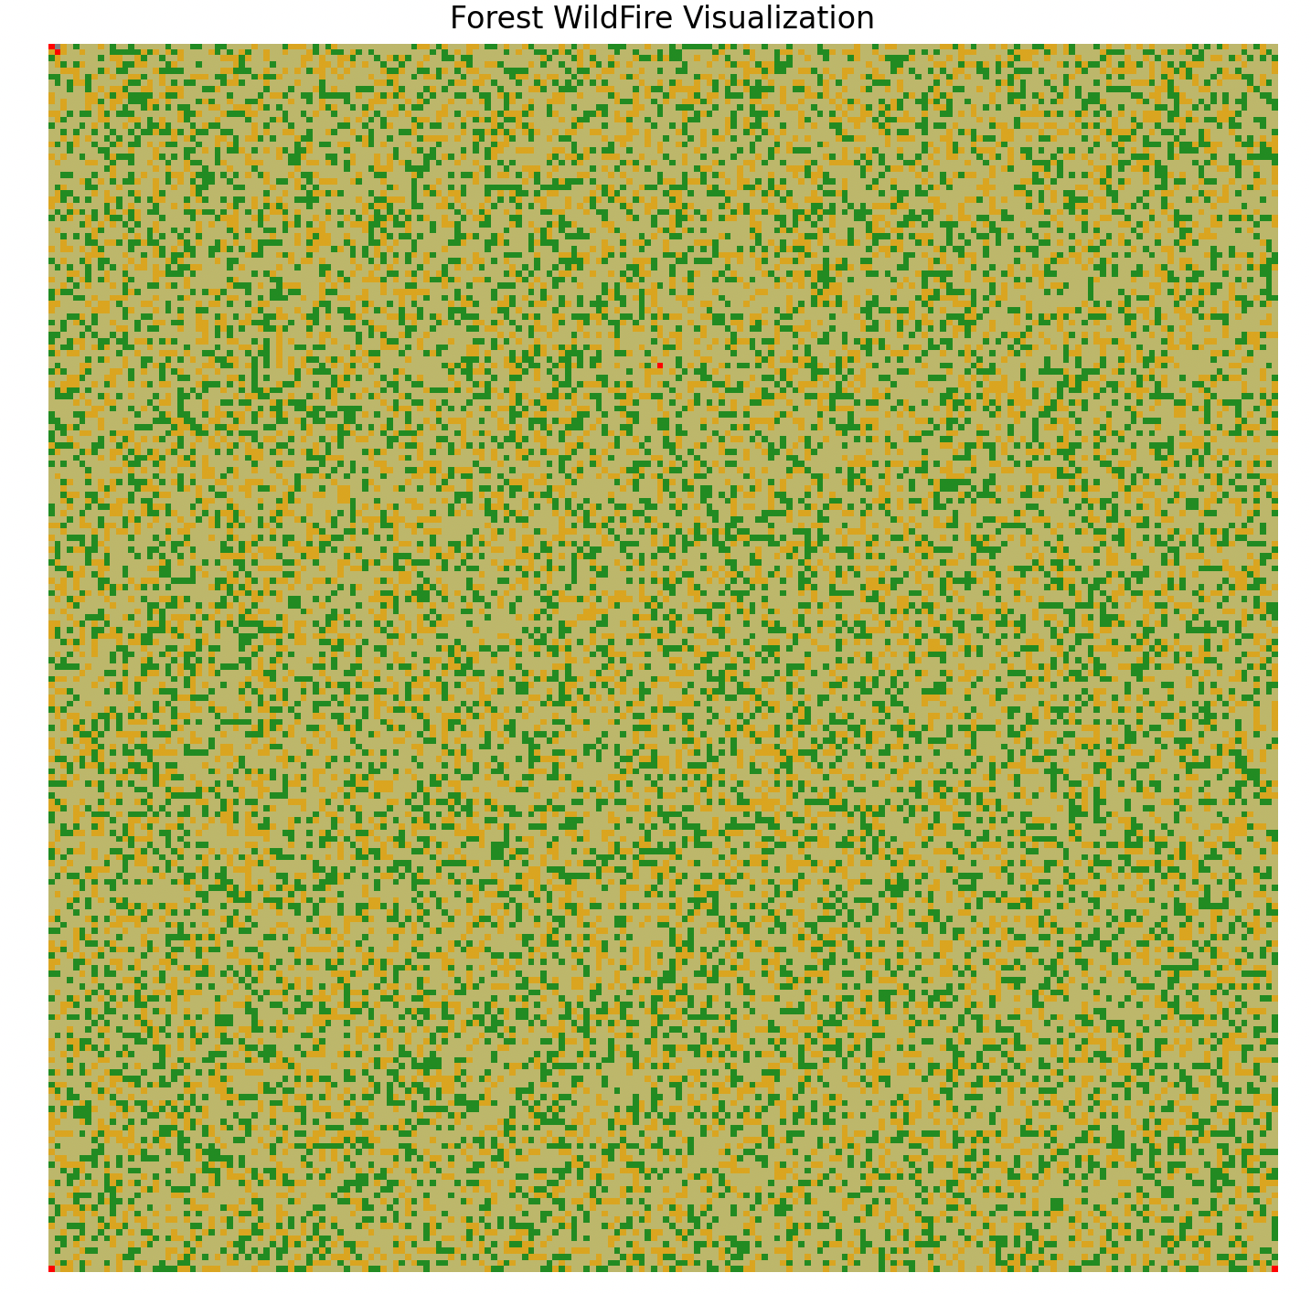
Simulation Process
Initialize the
forest matrix
iteration
Random walk
simulation wildfire
Simulate in different scenarios
Animations
land types | value | *ignition probability (IP) | color
burning area | -1 | - | red
space | 0 | - | grey
low IP area | 1 | 0~$α_{1}$ | khaki
Medium IP area | 2 | $α_{1}$~$α_{2}$ | orange
high IP area | 3 | $α_{2}$~1 | green
IP = 0.7 * moisture content + 0.3 * biomass content

Slide 4
Simulation Process
Initialize the
forest matrix
iteration
Random walk
simulation wildfire
Simulate in different scenarios
Animations
$${ p}_{i, j}+$$
$${ ε}_{northwest}$$
$${ p}_{i, j}+$$
$${ ε}_{north}$$
$${ p}_{i, j}+$$
$${ ε}_{northeast}$$
trees → burning (1 → -1 or 2 → -1 or 3 → -1)
- spread from surrounding trees
- struck by lightning: lightning probability
burning → space (-1 → 0)
space → trees: growing probability (0 → 1)
$${ p}_{i, j}+$$
$${ ε}_{west}$$
$${ p}_{i, j}$$
$${ p}_{i, j}+$$
$${ ε}_{east}$$
$${ p}_{i, j}+$$
$${ ε}_{southwest}$$
$${ p}_{i, j}+$$
$${ ε}_{south}$$
$${ p}_{i, j}+$$
$${ ε}_{southeast}$$

Slide 5
Simulation Process
Initialize the
forest matrix
iteration
Random walk
simulation wildfire
Simulate in different scenarios
Animations
Forest scenario 1: simple forest
The three types of trees account for the same proportion
Forest scenario 2: boreal forest
low IP area (10%), medium IP area (30%), high IP area (60 %)
Forest scenario 3: low latitude forests
low IP area (60%), medium IP area (30%), high IP area (10 %)
Wind direction scenario 1: no wind
Wind direction scenario 2: northwest wind

Slide 6
Simulation Result
Tropical Forest Wildfire Visualization without Wind

Slide 7
Simulation Result
Tropical Forest Wildfire Visualization with Northwest Wind

Slide 8
Simulation Result
Boreal Forest Wildfire Visualization without Wind

Slide 9
Simulation Result
Boreal Forest Wildfire Visualization with Northwest Wind

Slide 10
Thanks！
生态优先 绿色发展
By Siyan Liu

