Slide 1
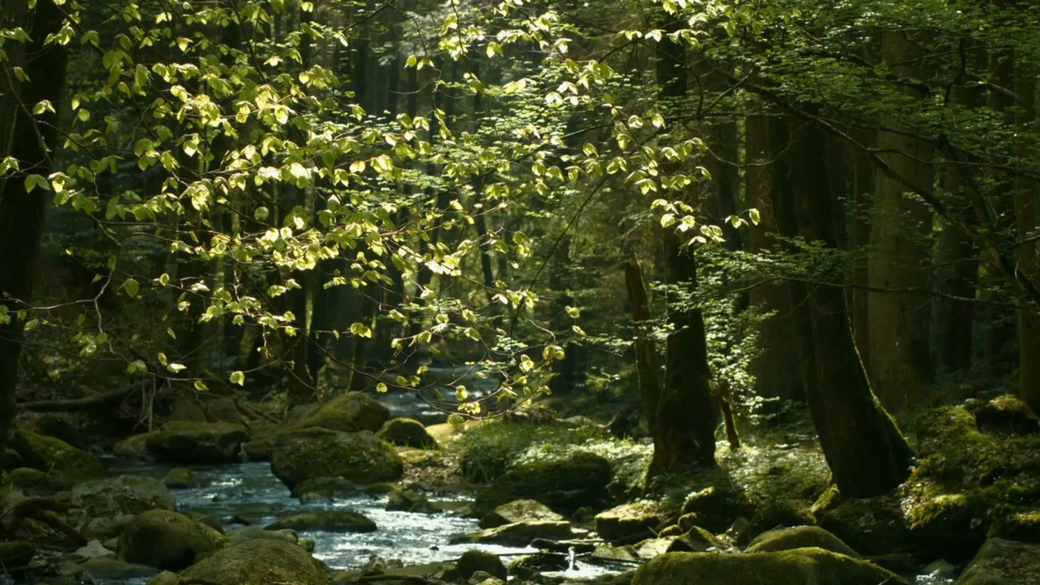
Getting Lost in the Forest
Aya Lubbad

Slide 2
Overview of the Simulation
Methods Used
The simulation uses the concept of random walks to generate a soundscape of a forest to reproduce the experience of walking in a forest.
The animation is a visualization of the resulting waveform after applying random walks on the different audio clips.
Started by loading audio files and trimming them down to be the same length using pydub.
Used random walk to alter the volume and panning of different segments of the audio.
Buffering to smoothen the sound when combining the segments.
Overlayed the multiple audios together.
Created waveform animations using os and moviepy.editor.
Technologies used: Numpy, Matplotlib, simpleaudio, pydub, librosa, os, moviepy.editor

Slide 3
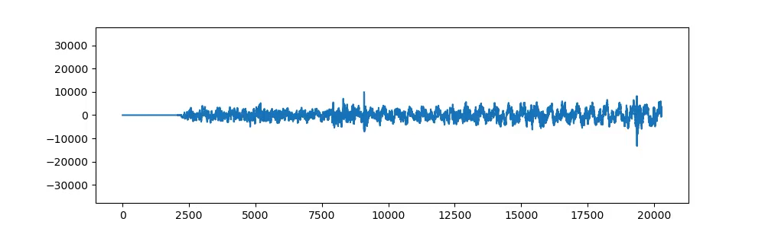

Slide 4
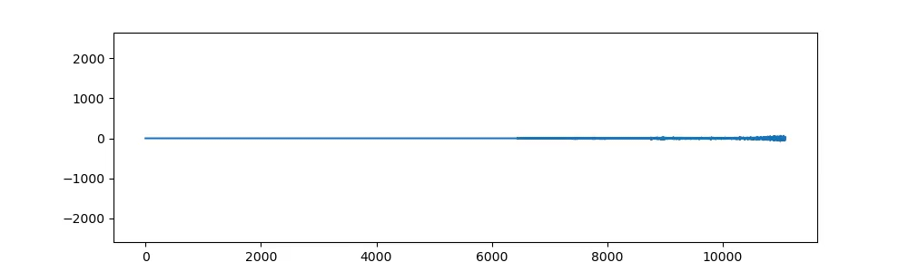
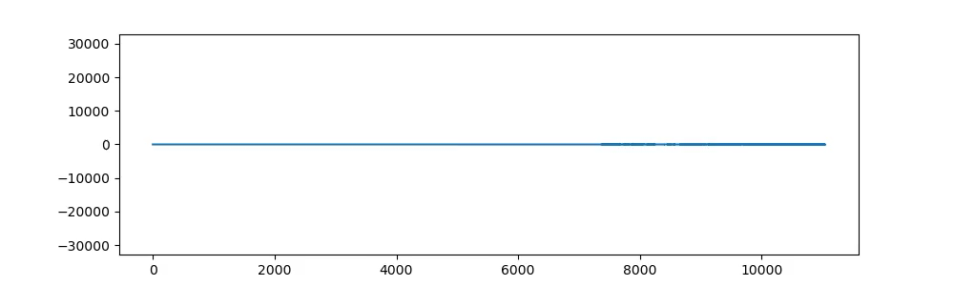
Original Bird Audio Waveform
Altered Bird Audio Waveform After Random Walk

