Slide 1
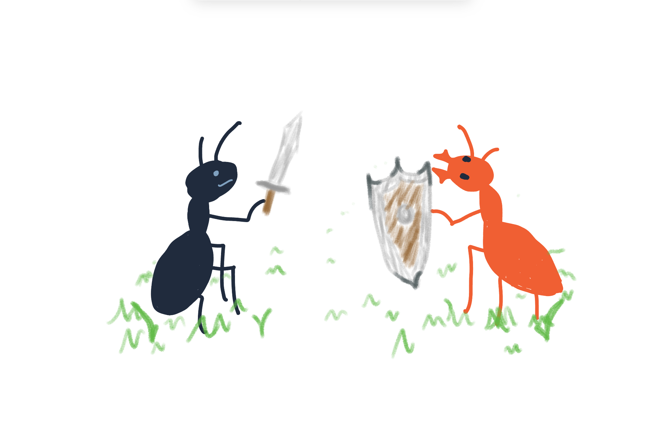
Ant War Simulation
John Nguyen - EPS 109

Slide 2
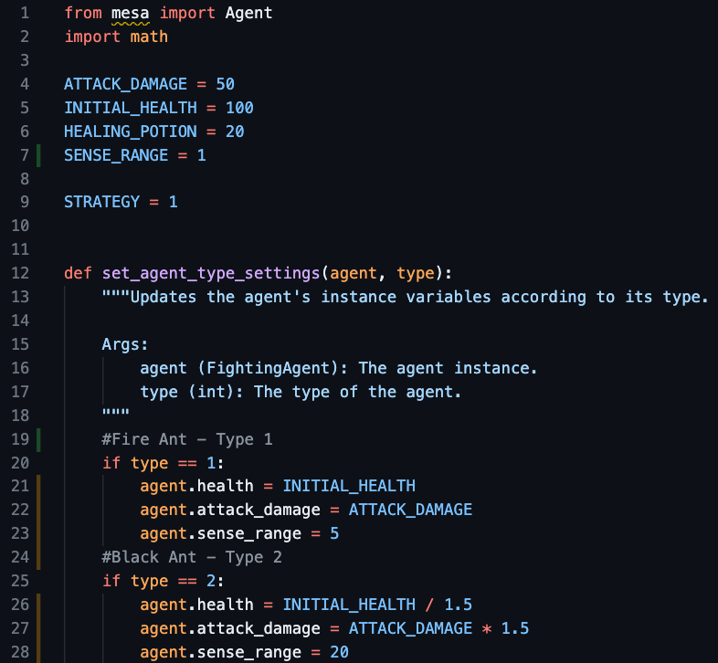
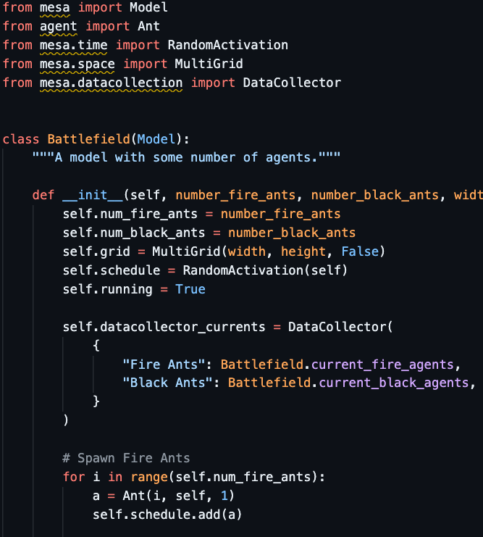
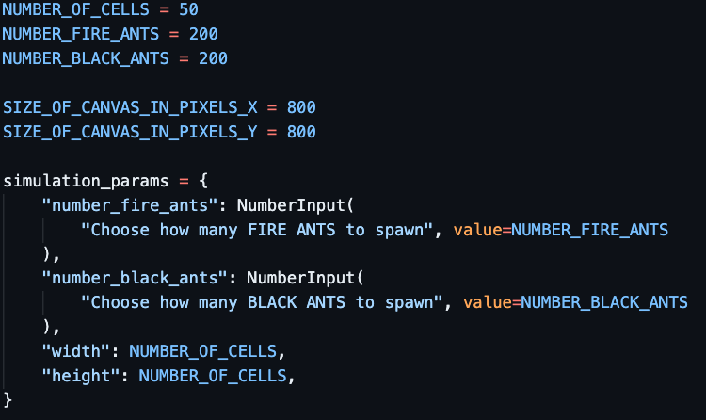
Agent Based Modeling
This is done via Mesa: a Python package used to analyze and visualize agent-based models.
agent.py
model.py
server.py
Ant attributes/behaviors
Environment / data collection
Front End / GUI
Source documentation

Slide 3
