Slide 1
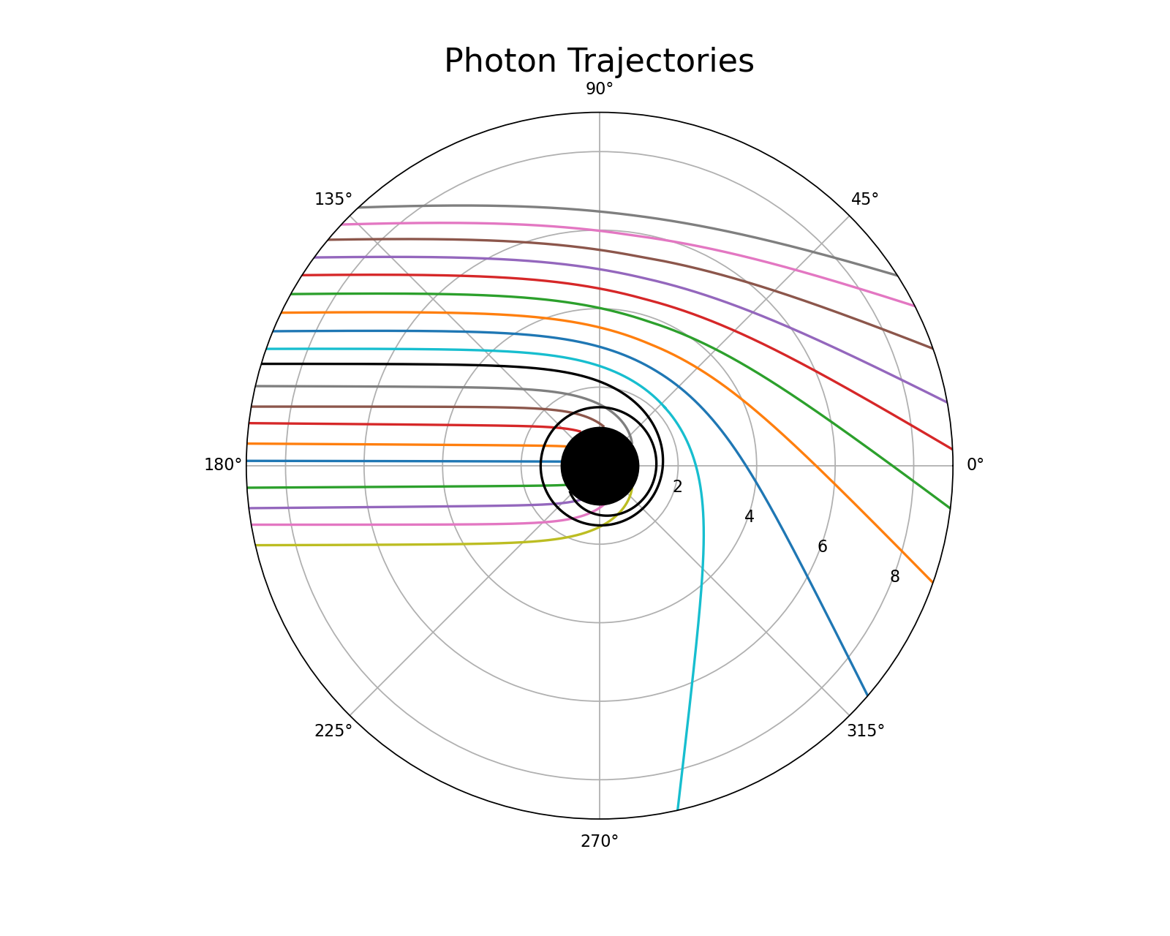
2D particle motion around non-rotating black hole
David Pham

Slide 2
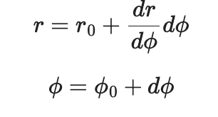
Methods and code review
Starting with the Schwarzschild metric, derive the differential equations for the radial (r) and angular (Φ) components of the photon’s motion.
Define differential equations and generate data using an iterative approach
Guess and check approach for initial conditions r_0 and Φ_0, lots of trial and error!
Combine change in r and phi data to plot different photon trajectories as they approach the black hole gravitational field and escape its pull
Limit to r < 10 to visualize photon behavior close to the black hole field
Showcase cool GR concepts like photon sphere and gravitational lensing

Slide 3
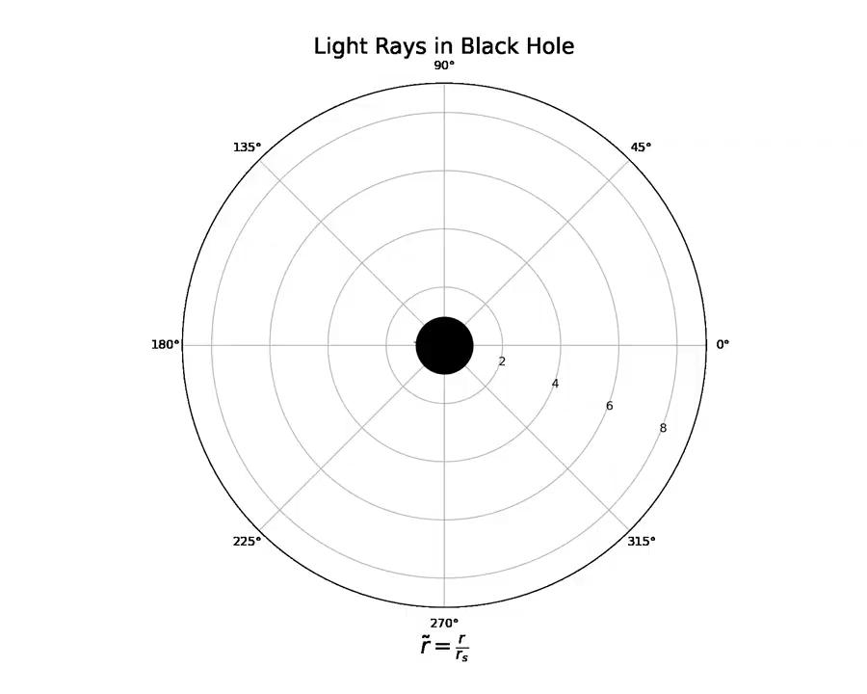
Animation

