Slide 1
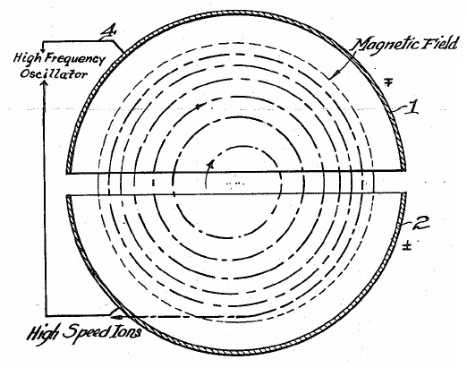
Low-Energy Acceleration of Protons in a Cyclotron
EPS 109
Final Project
Jorge Rios Corral

Slide 2
Concepts and Methods
Cyclotrons use time-dependent E-field to boost charged particles, and B-field to make them rotate.
Important: E-field only exists between electrodes. E-field must always point in the direction of motion of the particle. Solved by tuning to frequency of rotation in B-field.
Eqs. of motion:
Resolution via RK4 method (Δt = 1e-12 s):
$$\frac{d^{2}x}{dt^{2}}=\frac{qE_{x}\left(t\right)}{m}+\frac{qB_{z}}{m}\frac{dy}{dt}$$
$$\frac{d^{2}y}{dt^{2}}=−\frac{qB_{z}}{m}\frac{dx}{dt}$$
$$cyclotronODE\left(t^{\left(i\right)},Y^{\left(i\right)}\right)=\left[\begin{matrix}\begin{matrix}v_{x}^{\left(i\right)} \\ v_{y}^{\left(i\right)}\end{matrix} \\ \begin{matrix}\frac{qE_{x}^{\left(i\right)}}{m}+\frac{qB_{z}}{m}v_{y}^{\left(i\right)} \\ −\frac{qB_{z}}{m}v_{x}^{\left(i\right)}\end{matrix}\end{matrix}\right]$$

Slide 3
Are motion and E-field really synchronized?
(Yes, they are!)

Slide 4
R = 5 cm, d = 5 mm, ΔV = 5 kV, B = 1 T

Slide 5
R = 14 cm, d = 5 mm, ΔV = 4 kV, B = 1.4 T
(Lawrence & Livingston, 1932)

