Slide 1
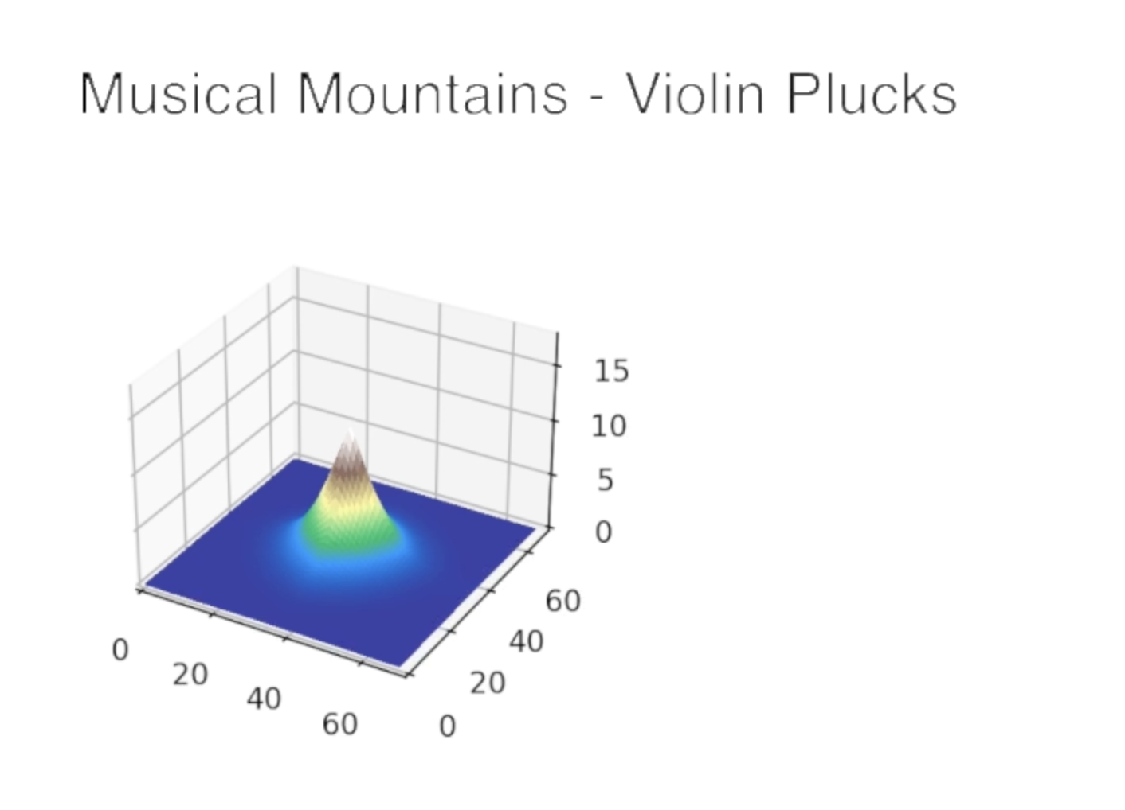
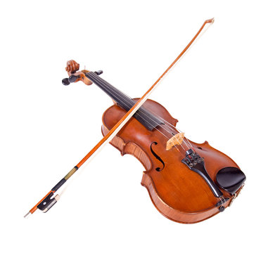
Musical Mountains
Sukhamrit Singh

Slide 2
Topics Used
ODE (Ordinary Differential Equations: Used in Erosion Lab)
Audio Analysis (Used in Audio Lab)
Altitude of the mountains will be changing over time based on the amplitudes of the music at that certain time
If the amplitude is high, it will lead to a growth in altitude, and if it is low, it will lead to a decrease in altitude

