Slide 1
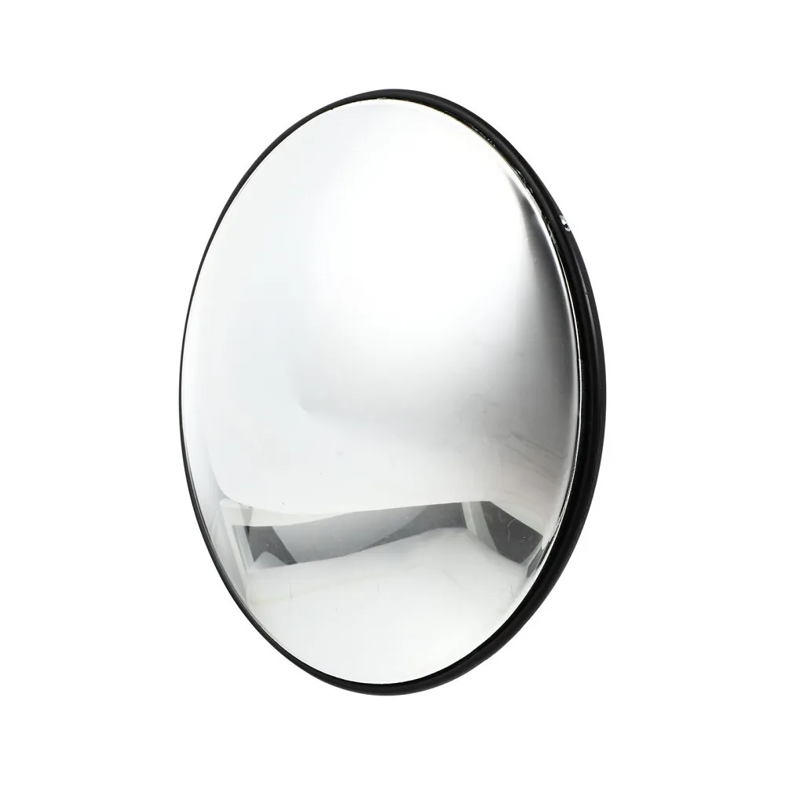
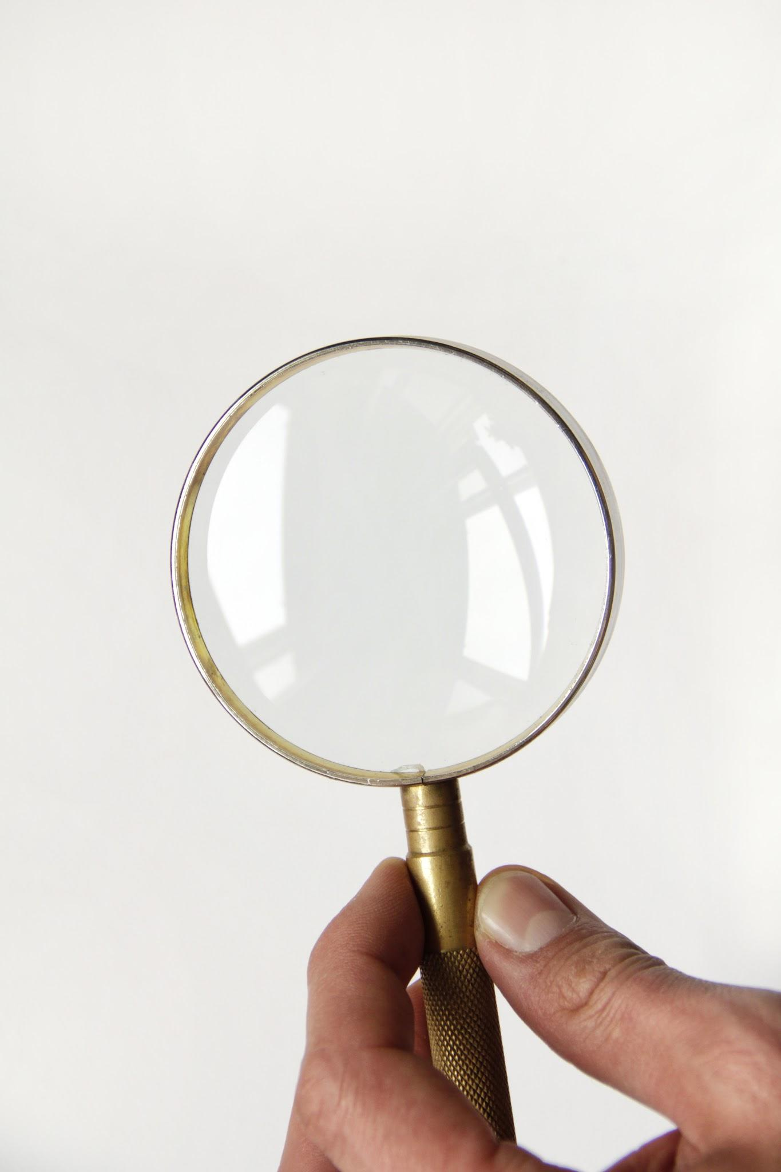
Mirrors and Lenses
Vincent Sommatiphong

Slide 2
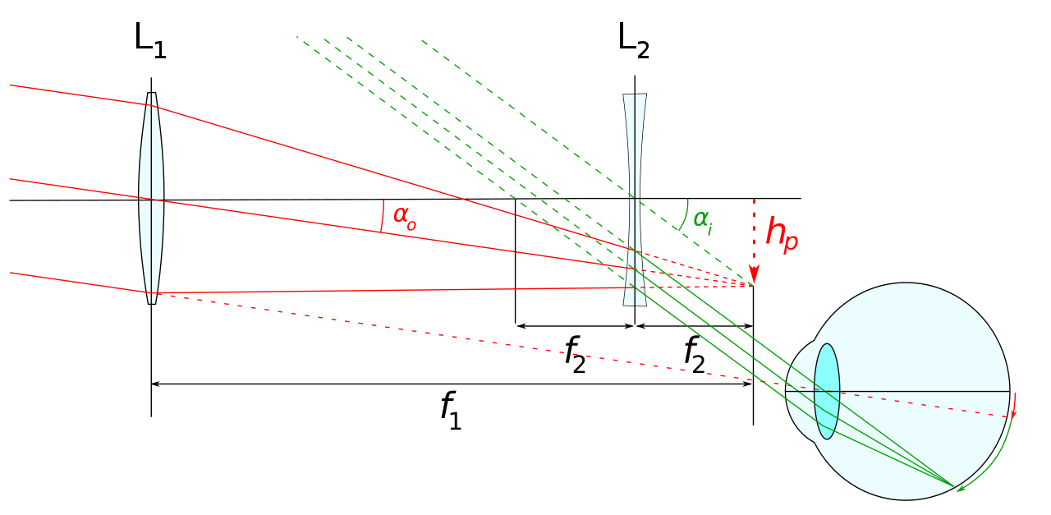
Lenses

Slide 3
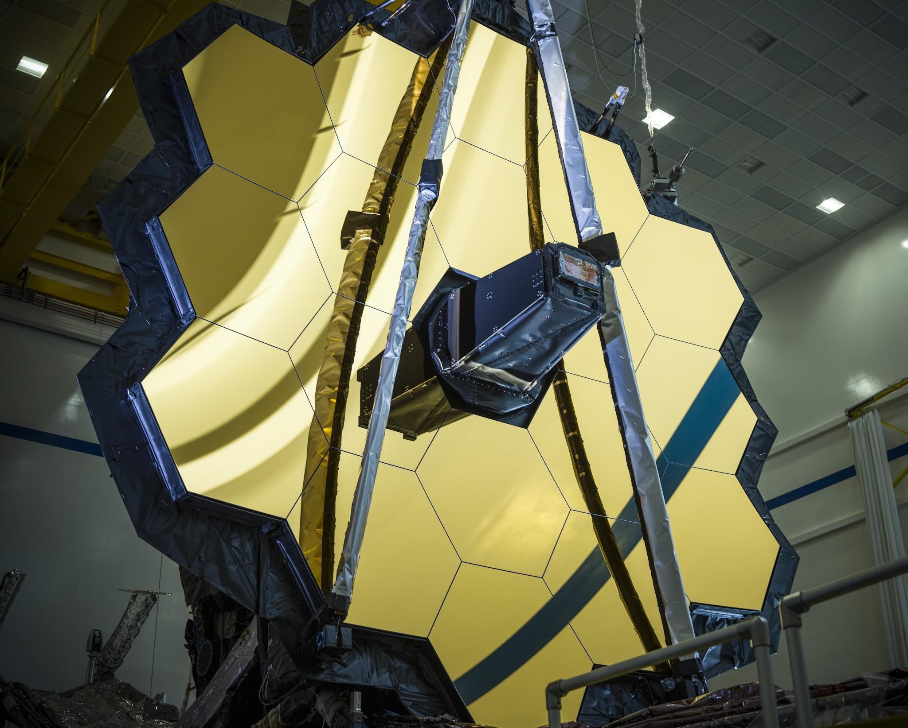
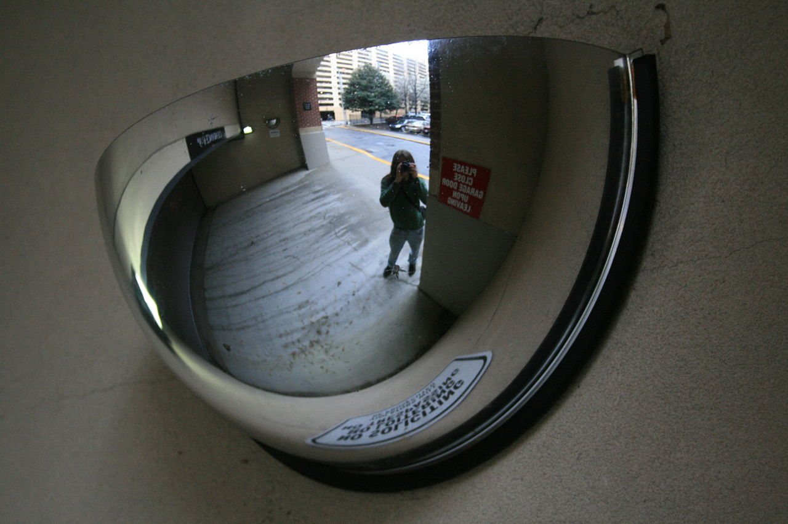
Mirrors

Slide 4
Raytracing
https://stackoverflow.com/questions/13640931/how-to-determine-if-a-vector-is-between-two-other-vectors

Slide 6
Raytracing

Slide 7
