Slide 1
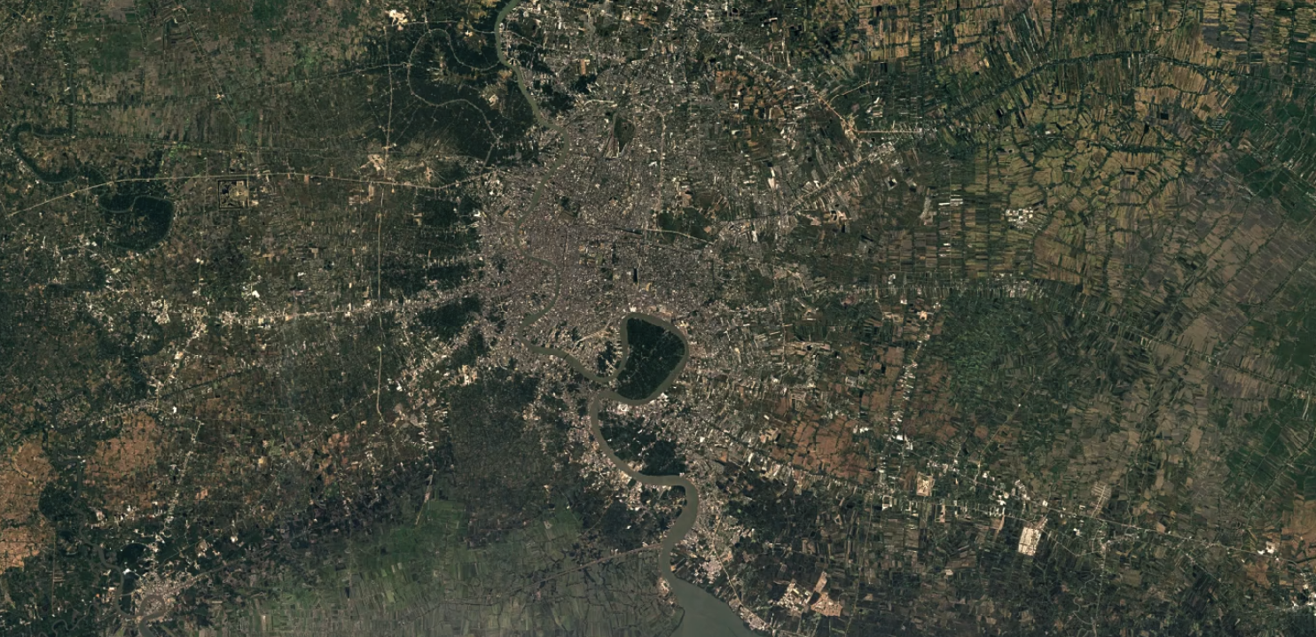
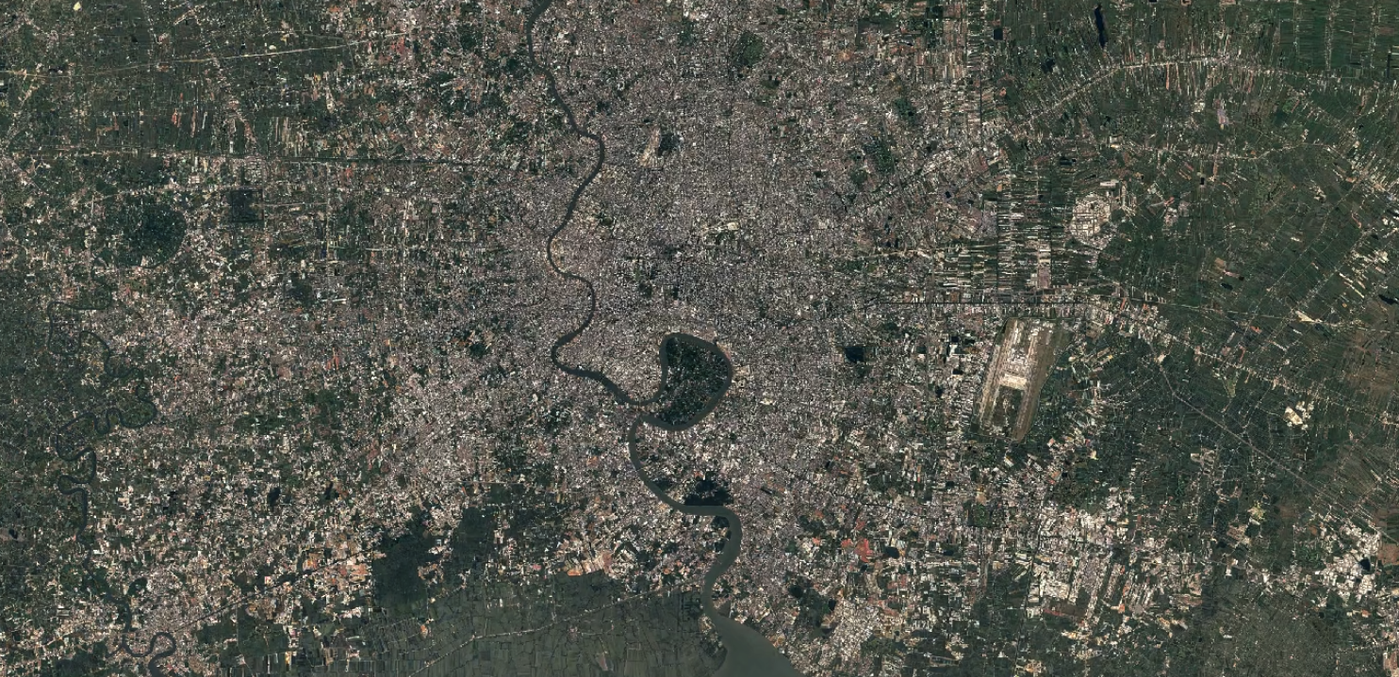
The Correlation Between Urban Sprawl and Environmental Degradation
1984
2022
Ice Unjitwattana

Slide 2
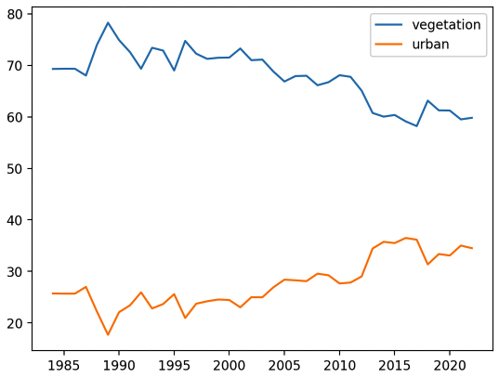

Slide 3
Methodology
Pitfalls
Retrieve RGB data from .png file
Experimentally categorize pixels
Dominant green for vegetation
Gray with dominant red for urban areas
Generate visuals
Analysis is dependent on time of day and time of year when data is collected
Color of trees/rivers
Reflections from
Urban areas come in different colors (data analyzed is a lower bound)

Slide 5
