Slide 1
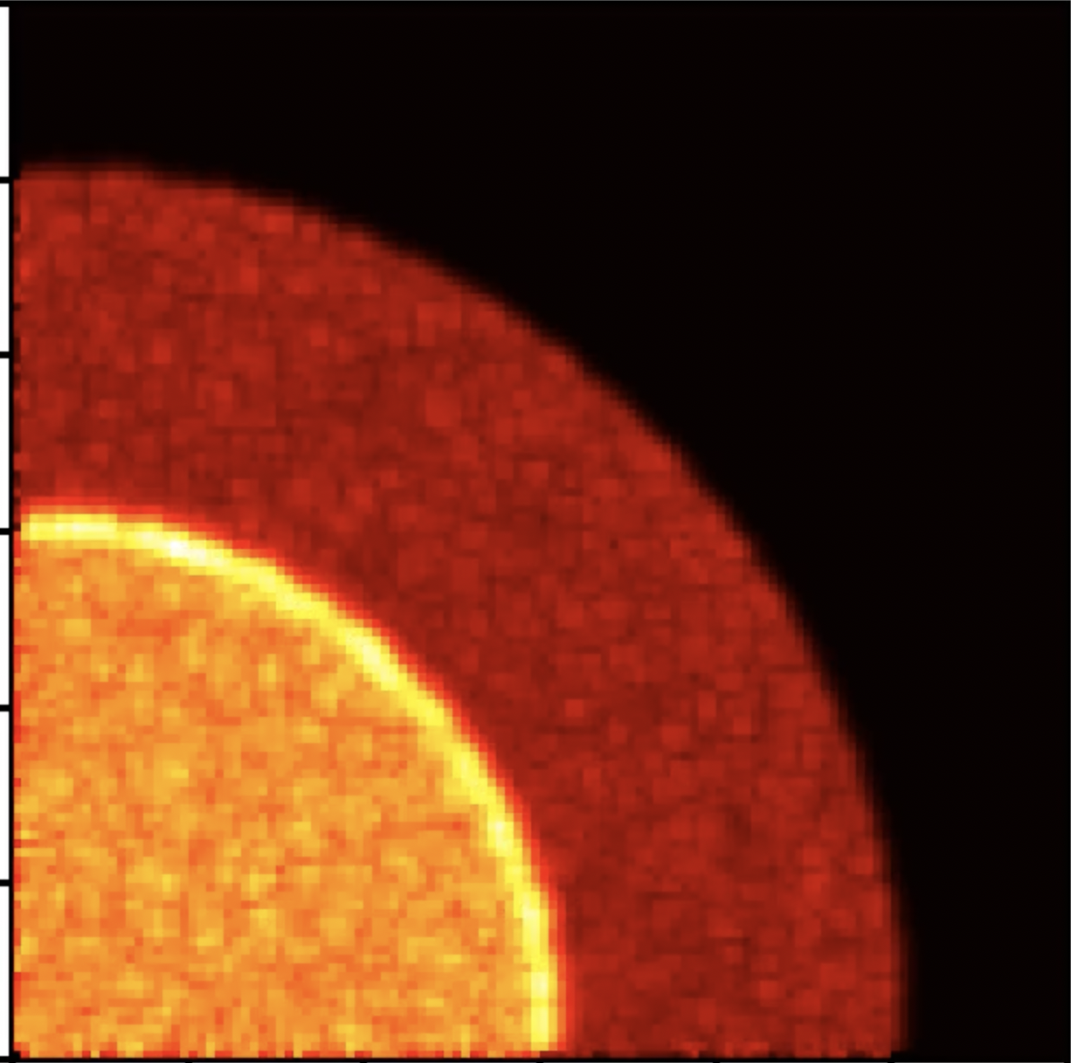
Turbulent Heat Transfer in a Massive Star
By Carlin Will

Slide 2
Topic and Methods
PDE code translation: Finite Differ
Massive star: inner convective zone and outer radiative zone
Radiative
Convective
3 types of turbulence:
Gravitational Buoyancy:
Mixing Length Theory:
Simple Turbulence:

Slide 3
No Turb

Slide 4
Grav Buoyancy

Slide 5
MLT

Slide 6
Simple Turb

Slide 7
All

