Slide 1
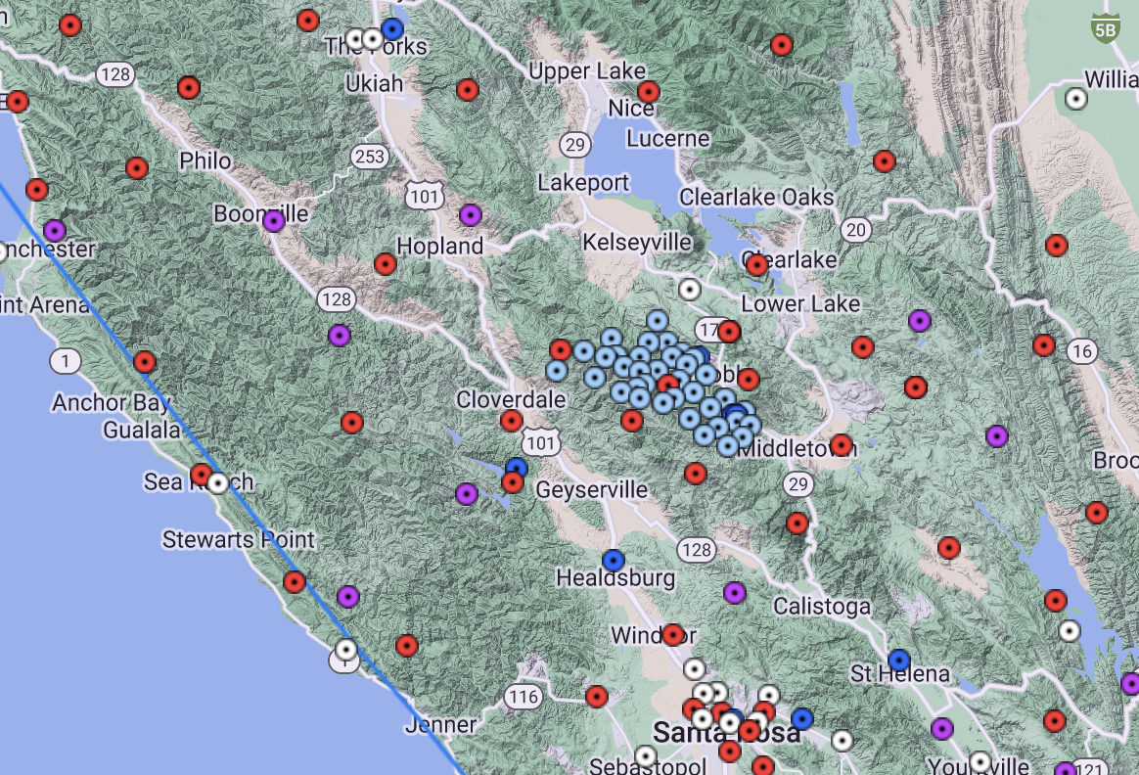
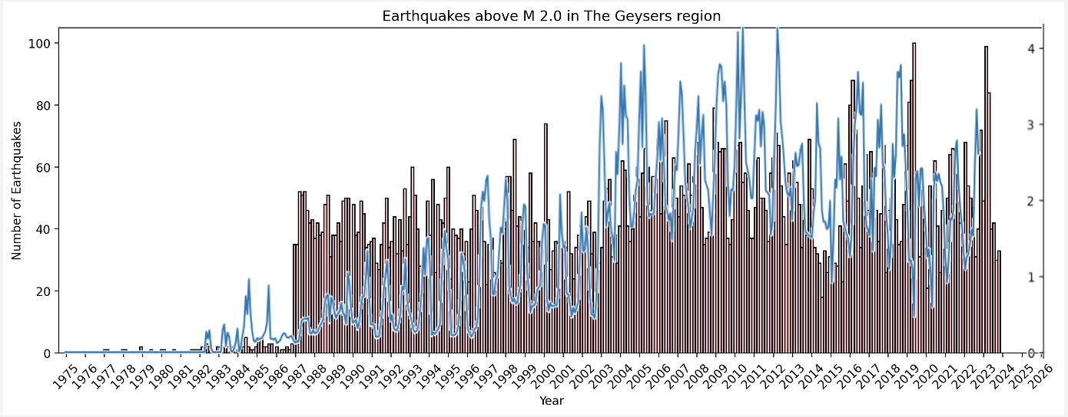
Fluid injection and induced seismicity in The Geysers region
Jia Zhen Yap

Slide 2
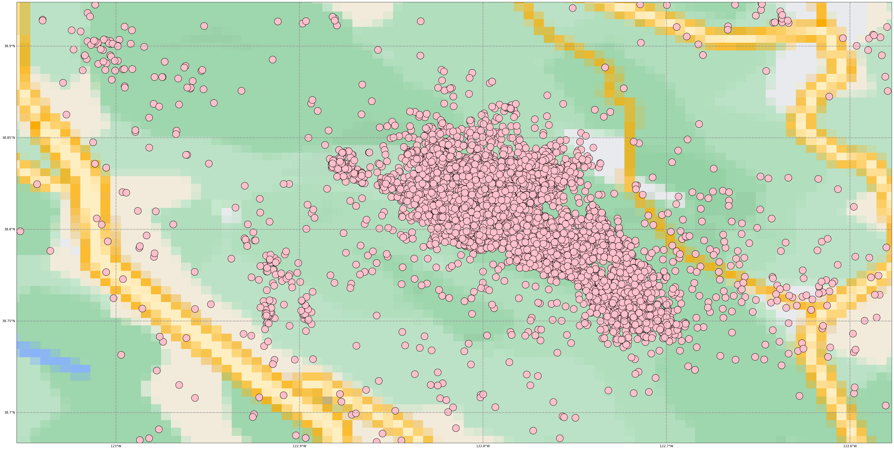
Topic and methods
To show the correlation between fluid injection and seismicity at The Geysers region – a region of geothermal energy production.
Methods:
Earthquake data download and plotting
Animation

Slide 3
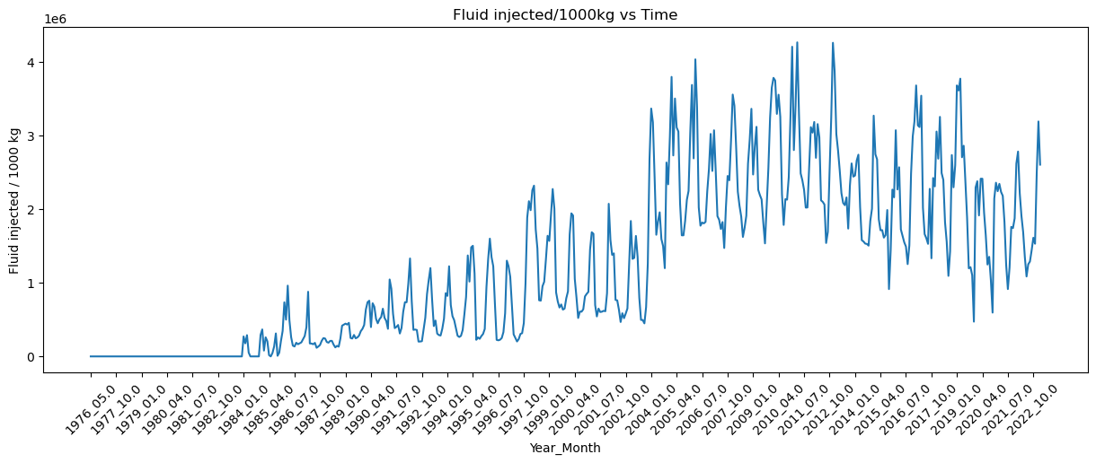
Volume of fluid injected
Data obtained from California Department of Conservation
Only data from active injection wells from 1976 to February 2023

Slide 4
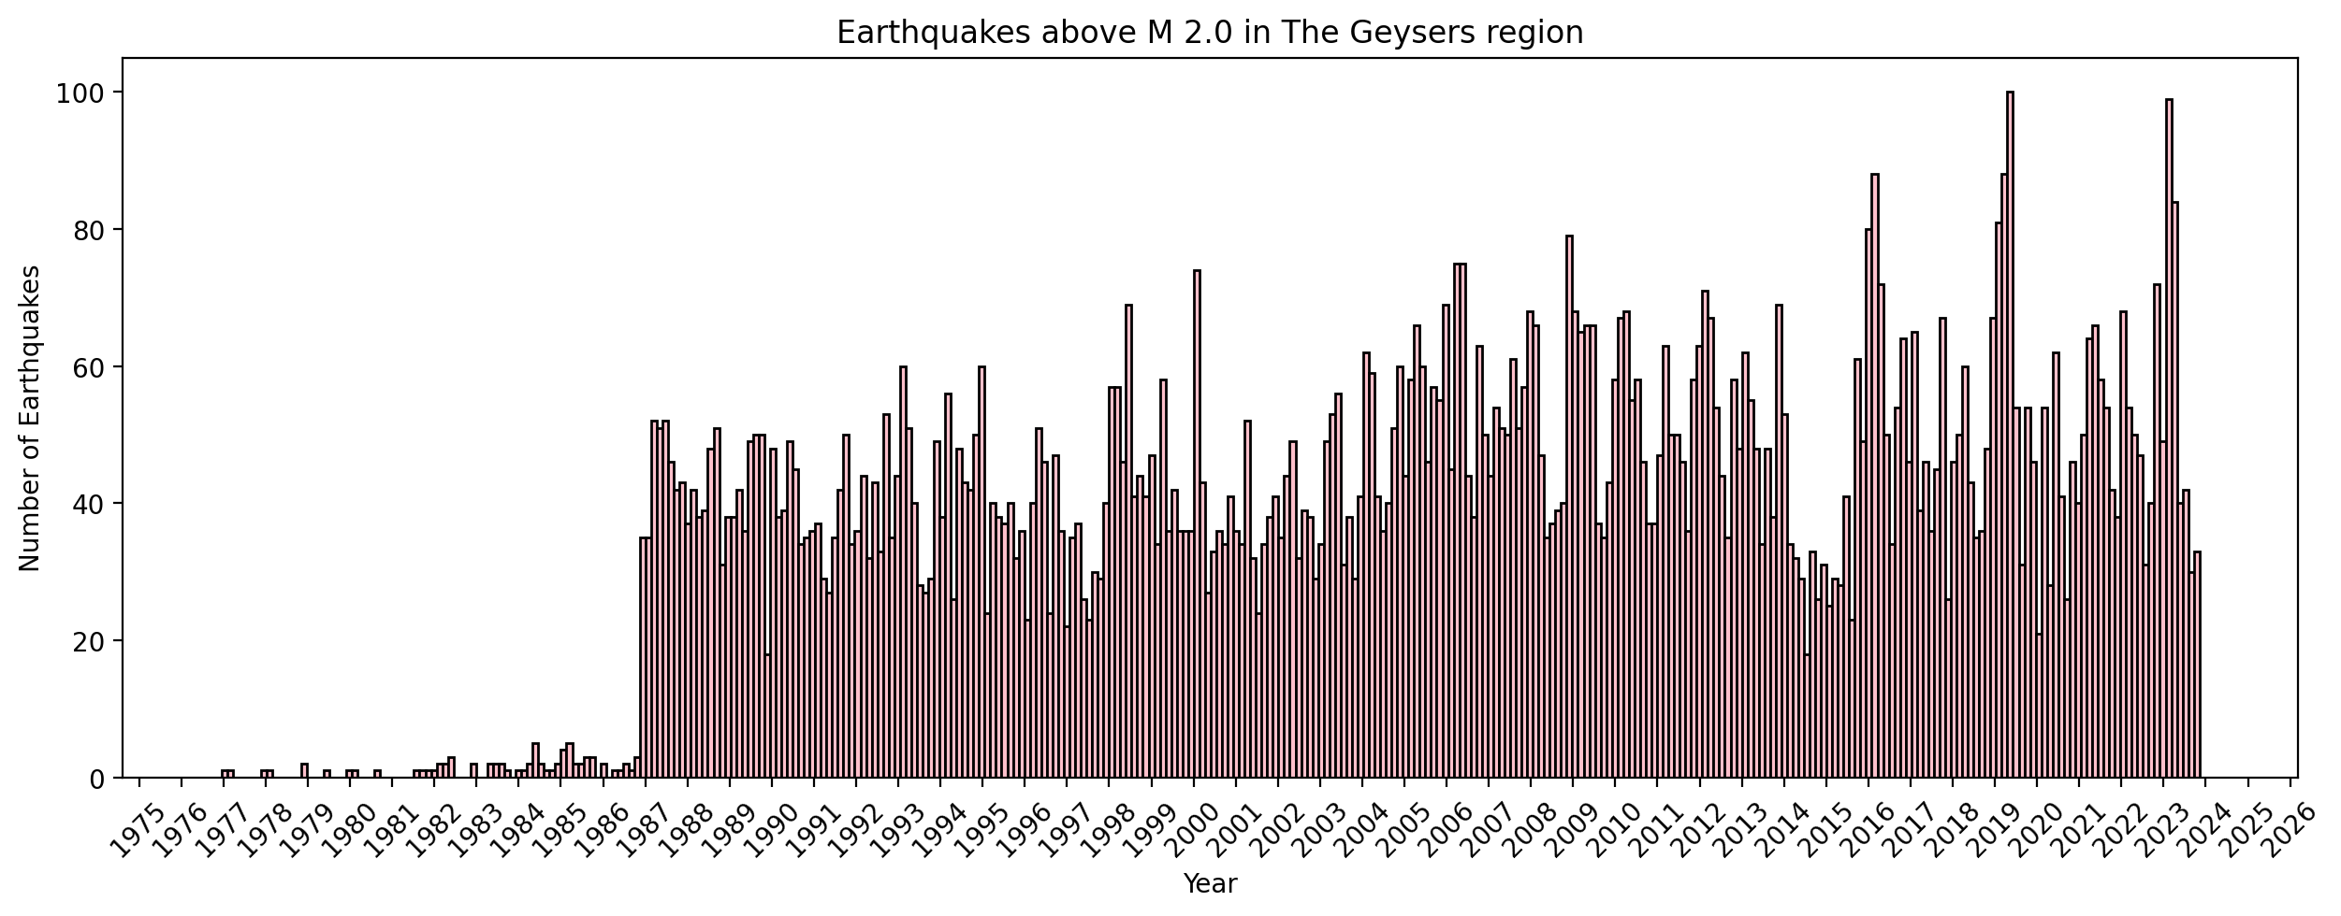
Number of earthquakes > M 2.0
Data obtained from NCEDC and IRIS
From 1976 to 2023

Slide 5
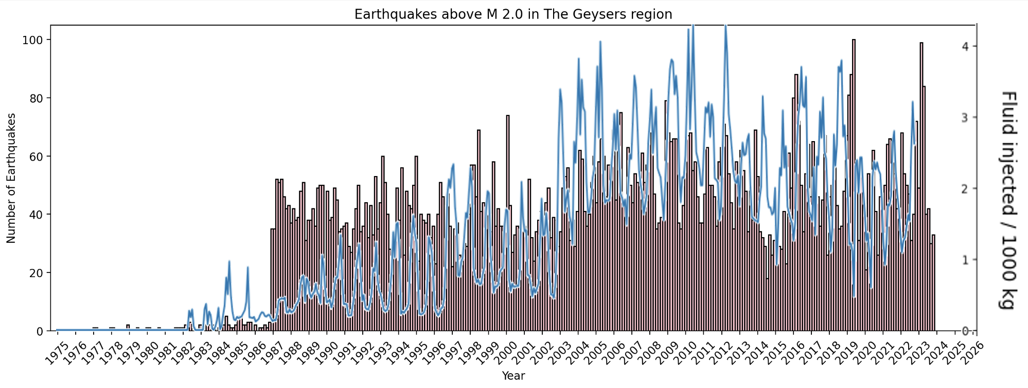
Fluid injection volume vs No. of events
Comparing both plots vs time:

Slide 6
Animation of volume injected and number of events

Slide 7
Thank you

