Slide 1
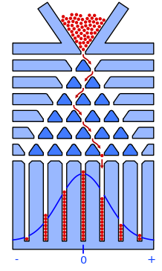
Central Limit Theorem from Galton Board Simulation
EPS 109
Amy Ai

Slide 2
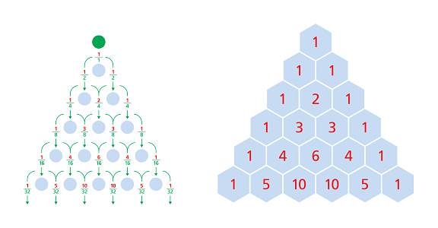
Galton Board
Invented in 1876 Sir Francis Galton demonstrating the Central Limit Theorem from the combination of large number of random events
Pascal‘s Triangle & Binomial Coefficients
Ball’s two choices at each peg:
Left or right
Prob = 0.5
Final positions of the balls follows a binomial distribution
Coefficient $\left({n \atop k}\right)$: the number of ways k successes can occur in n trails
= an element in the Pascal’s Triangle
symmetry
approximates a normal distribution for large n
Central Limit Theorem
Notes:
Through the narrow openning at the top, Each ball in the Galton board has a 50% chance of falling to the left or right each time it hits a peg. This process is a series of Bernoulli trials (trials with two possible outcomes). The number of paths to reach a particular bin at the bottom corresponds to the coefficients in a row of Pascal’s Triangle.

Slide 3
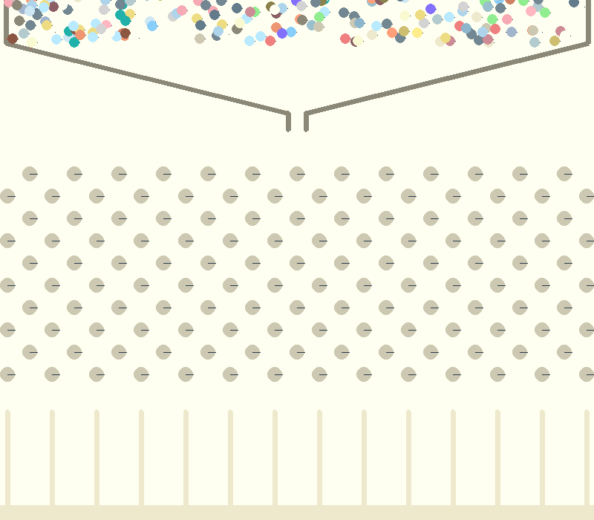
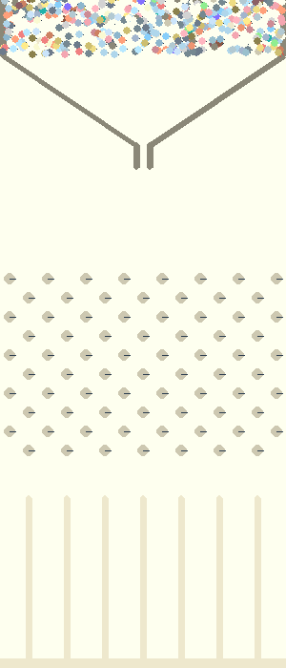
Physics Simulation using Pygame & Pymunk
Ball Elasticity: 0.1
Ball Friction: 0.2
Space Gravity: (0, 8000)
Number of balls: 300
Number of balls: 700
Notes:
Three type of object in pymunk
dynamic, kinetic, and static

Slide 4
Sources
https://www.youtube.com/watch?v=-q_Vje2a6eY
https://www.statisticshowto.com/galton-board/#:~:text=Running%20a%20Galton%20Board%20Demonstration&text=Each%20ball%2C%20as%20it%20falls,l%20%3D%20pr%20%3D%20%C2%BD.
https://medium.com/@ozlazarus/the-math-behind-galton-board-and-pascals-triangle-c6f1eca8218b

