Slide 1
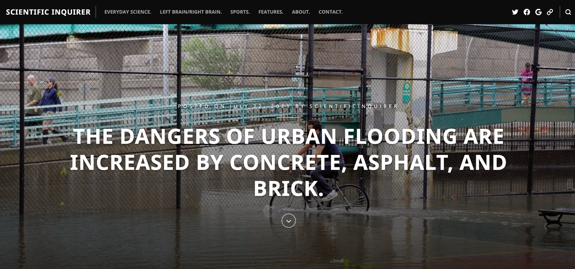
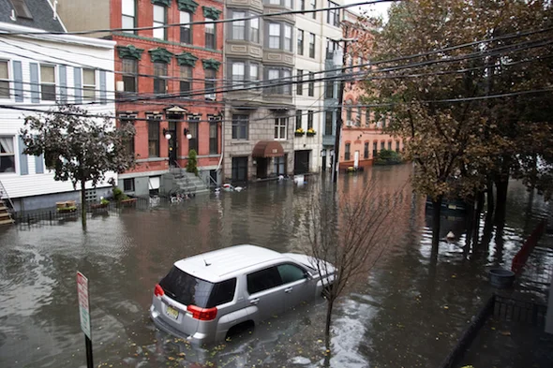
How Concrete Jungles Affect Rainfall Percolation
Emily Chien

Slide 2
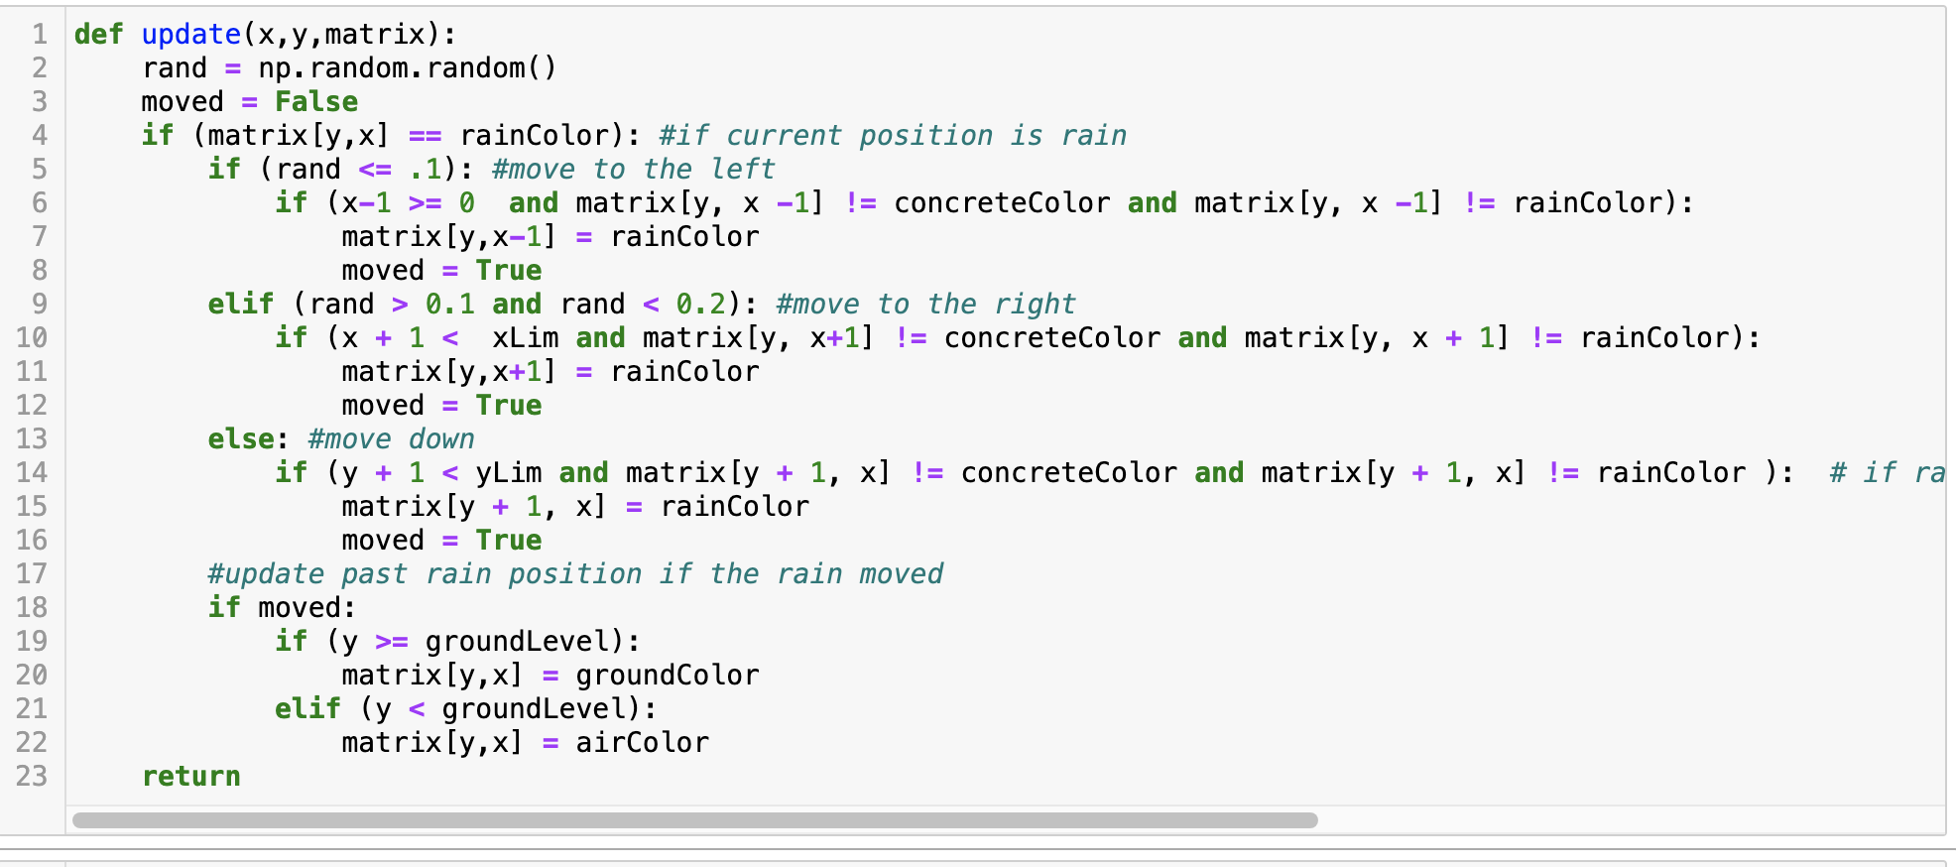
Random walks to determine how the rain falls
Simulation of how concrete in cities affects rainfall percolation
Real world implications:
Flooding
Groundwater is not replenished
Random concrete placement on ground level based on the city’s concrete coverage

Slide 3
0% Concrete Coverage
San Jose:
60% Concrete Coverage
New York City:
90% Concrete Coverage
Notes:
https://cooperatornews.com/article/the-concrete-jungle#:~:text=Not%20for%20nothing%20is%20New,left%20over%20from%20the%201800s. New york - 90% concrete coverage
https://www.mercurynews.com/2013/04/23/nearly-60-percent-of-urbanized-san-jose-has-been-paved-over/ - san jose – 60% concrete coverage

